Slide 1
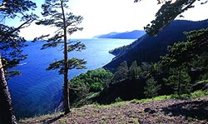
Lake Origins
MARIA SANZ

Slide 2
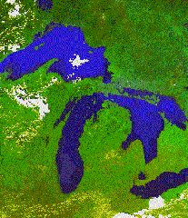
Freshwater
Water in lakes & streams - 0.02% of water on earth
Covers <2% of world’s land area
Most water found in just 20 deep lakes throughout world

Slide 3
Lake Baikal
Contains 20% of all freshwater

Slide 4
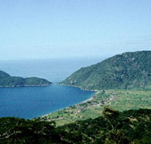
Other Lakes
N.A. Great Lakes
African rift lakes
  Malawi
  Victoria
Canadian great lakes
  Great Bear
  Great Slave
  Athabasca

Slide 5
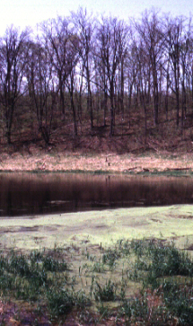
Most Lakes
Most lakes are much smaller, shallower (<20 m)
Lakes can be formed in many ways
Two general categories
  Catastrophic
  Non-catastrophic

Slide 6
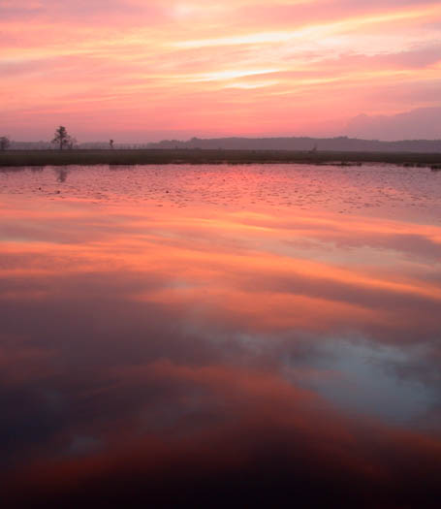
Catastrophic Formation
Most lakes have catastrophic origin
Developed as result of some violent activity
Tendency to be clustered together in lake districts

Slide 7
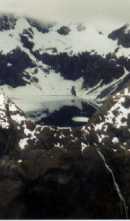
Types of Catastrophic Lakes
Glacial lakes
Erosion and deposition by glacial ice movements
Most important lake-forming process
Most numerous in Northern Hemisphere

Slide 8
Glacial Lakes
Some exist only when in contact with existing glaciers
Pools of water on or beneath glacier
Streams dammed by tongues of ice

Slide 9
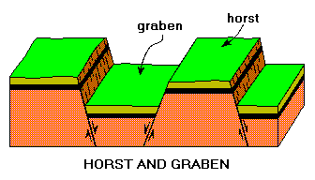
Tectonic Lakes
Lakes formed by faulting, folding, warping of earth’s crust (non-volcanic)
Most common form - graben
Depressed block between adjacent highlands

Slide 10
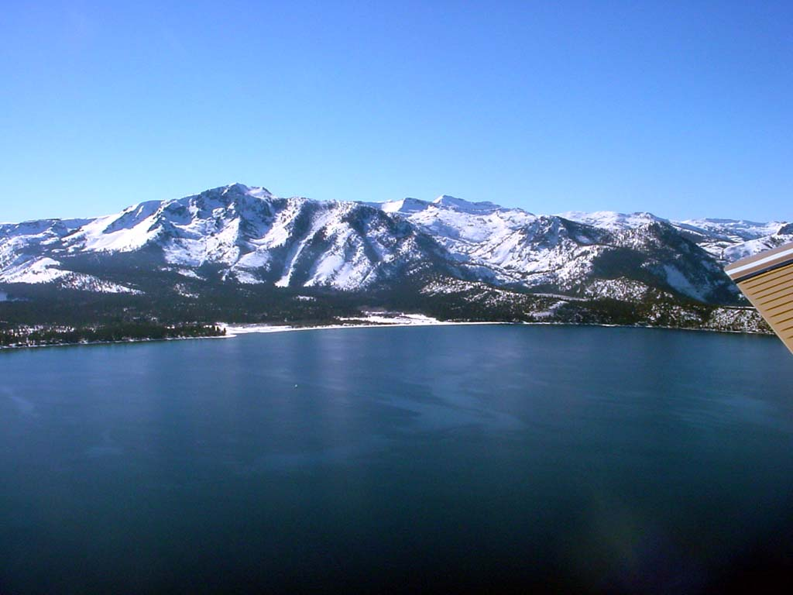
Tectonic Lakes
Lake Tahoe
Lake Tanganyika
Lake Baikal
Great Salt Lake

Slide 11
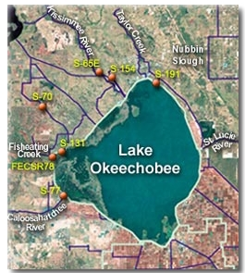
Tectonic Lakes
Uplift basins - elevated above sea by slow, moderate geologic activity
Caspian Sea
Lake Okeechobee
  Very shallow

Slide 12
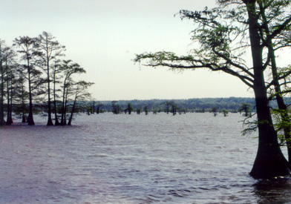
Tectonic Lakes
Earthquake lakes - basins formed by earthquake activity
Reelfoot Lake, KY/TN
Overnight formation (?) after earthquake produced lowlands, filler with water from Mississippi River

Slide 13
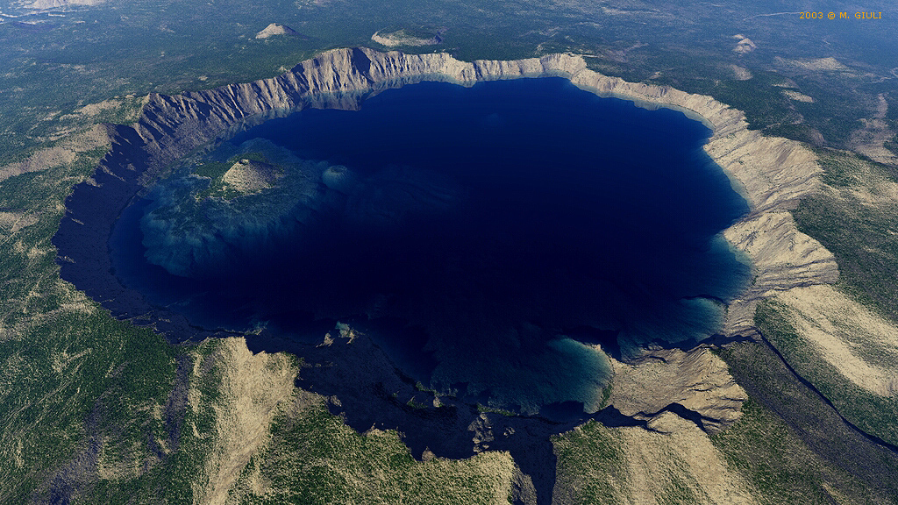
Volcanic Lakes
Crater lakes
Calderas - collapse of magma chambers
Maars - explosion craters
Crater Lake, OR
  A caldera
  Deepest U.S. lake - 608 m

Slide 14
Volcanic Lakes
May also be formed by lava flows damming valleys

Slide 15
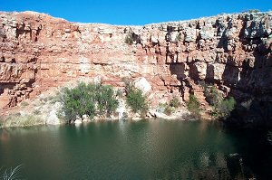
Non-catastrophic Lakes
Solution lakes
Wind-formed lakes
River lakes
Shoreline lakes
Lakes formed by organisms

Slide 16
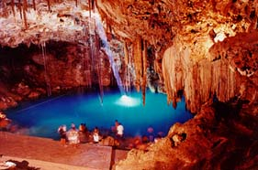
Solution Lakes
Bodies formed when water dissolves soluble rock formations - karst
Limestone sinks
  FL, MI, KY, IN, TN
Cenotes
  Yucatan Peninsula

Slide 17
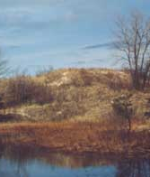
Wind-formed Lakes
Dry climates
Dunes with depressions or damming of streams
May be very short-lived

Slide 18
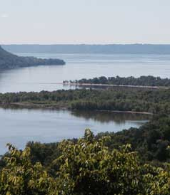
River Lakes
Ponding by deltas
Lateral lakes
  Parallel to river, filled by flooding

Slide 19
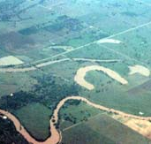
River Lakes
Oxbow lakes
River meanders cut off from main river flow

Slide 20
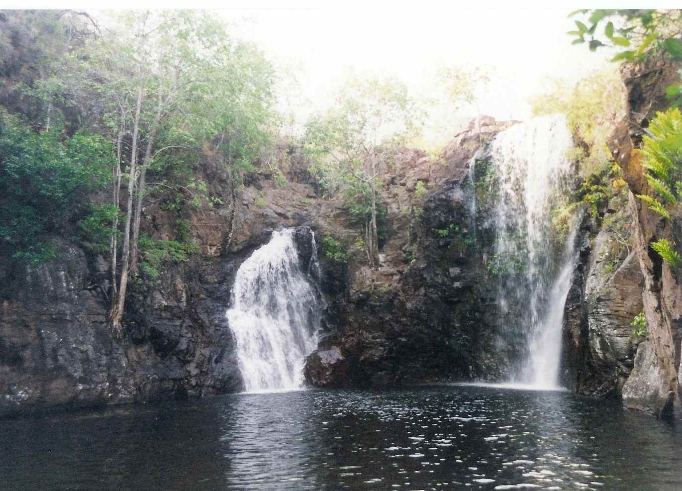
River Lakes
Plunge pools formed beneath waterfalls

Slide 21
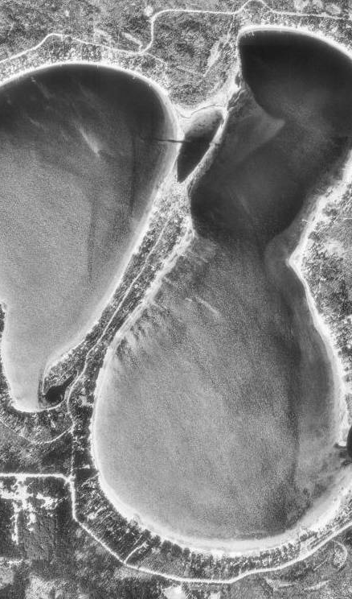
Shoreline Lakes
Bays cut off from main lake by longshore wave action and sand bars

Slide 22
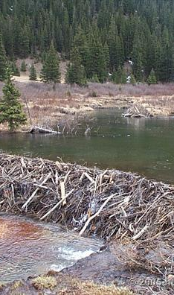
Lakes formed by Organisms
Beaver dams
Human reservoirs
Sphagnum dams

