Slide 1
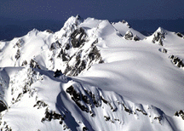
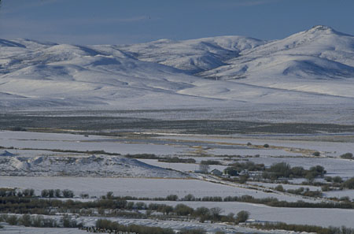
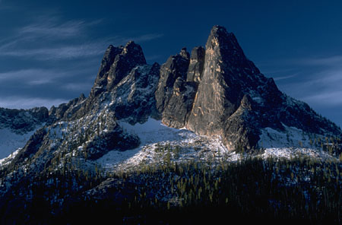

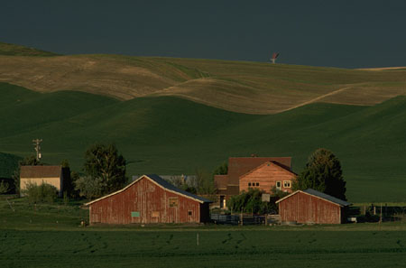
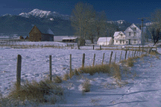
LANDFORMS
What do landforms look like?
How are landforms created?
MARÍA SANZ

Slide 2
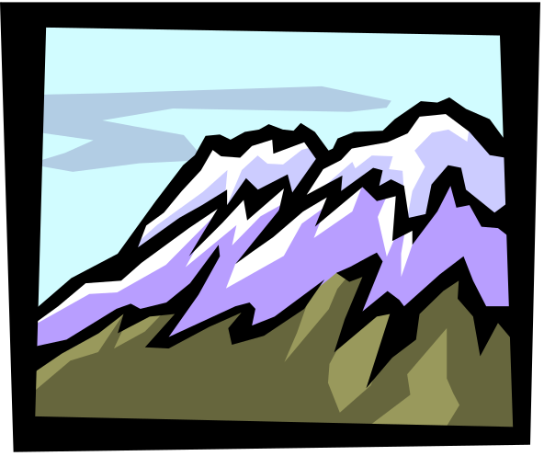
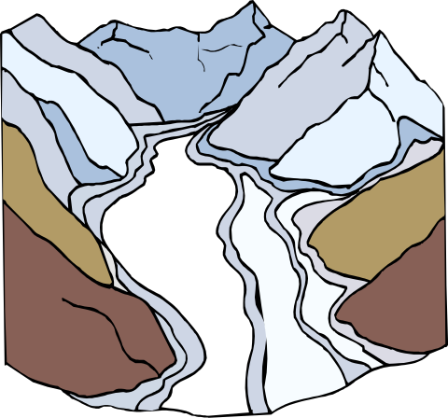
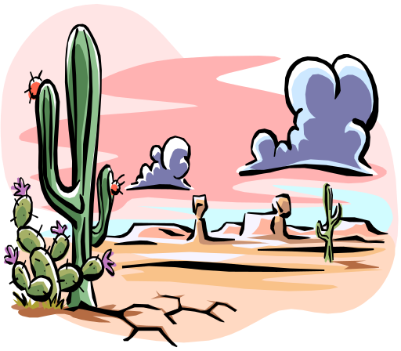



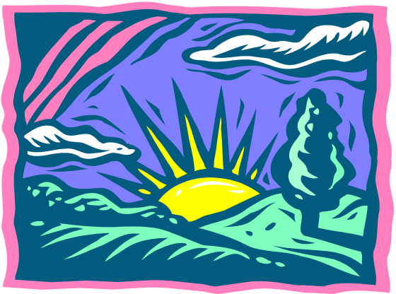
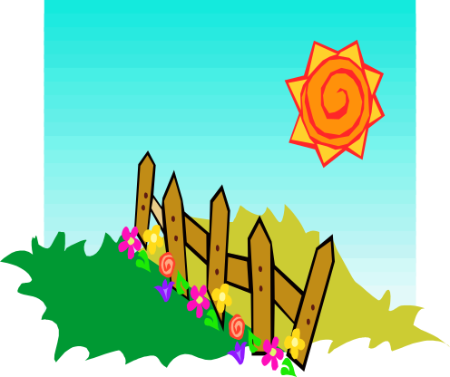
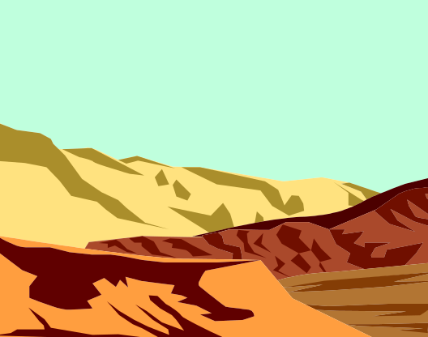

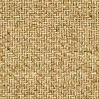

Types of Landforms
Mountains
Glaciers
Deserts
Valleys
Grasslands
Canyons

Slide 3
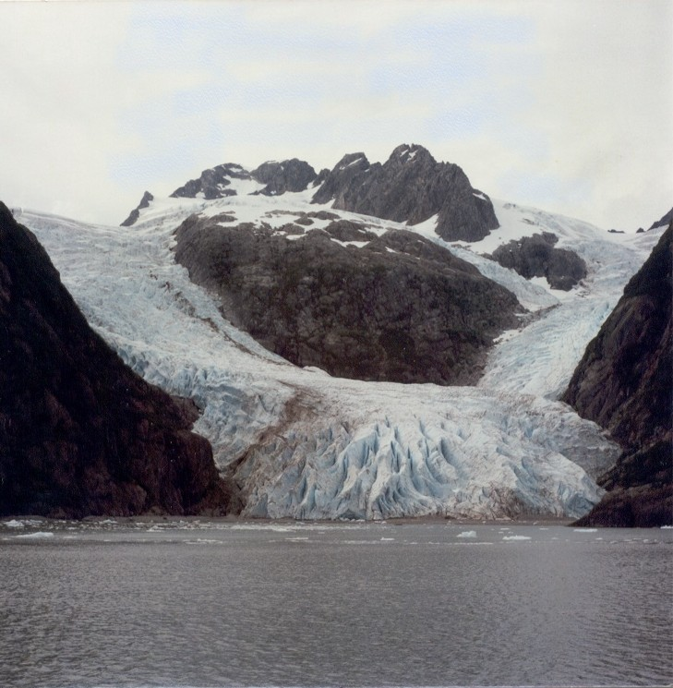
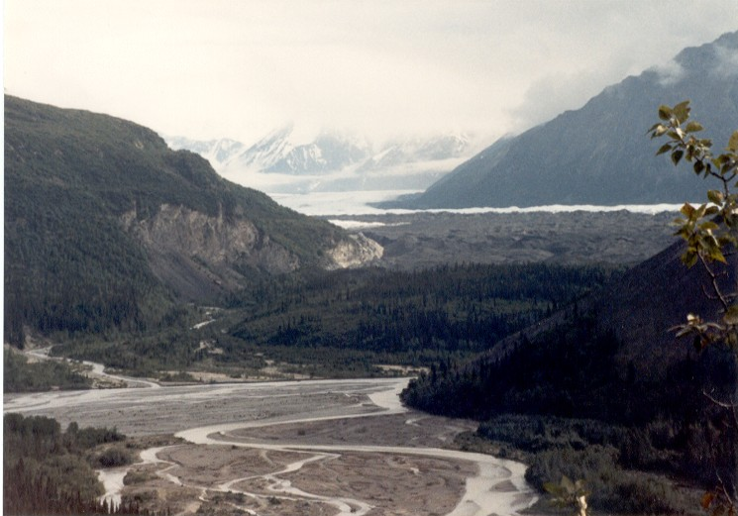

Glaciers
Glaciers grind away rock, sometimes polishing it smooth or leaving
deep scratches. Gravity pulls Glaciers downhill.
Quiz

Slide 4
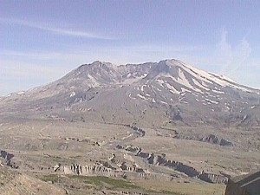
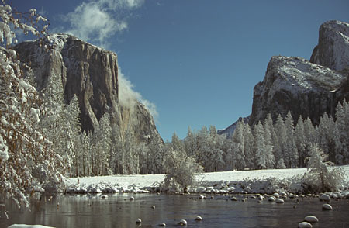
Mountains
Old mountains can have worn, rounded tops caused by erosion or weathering. Young mountains can have steep sides and pointed peaks.
Quiz

Slide 5
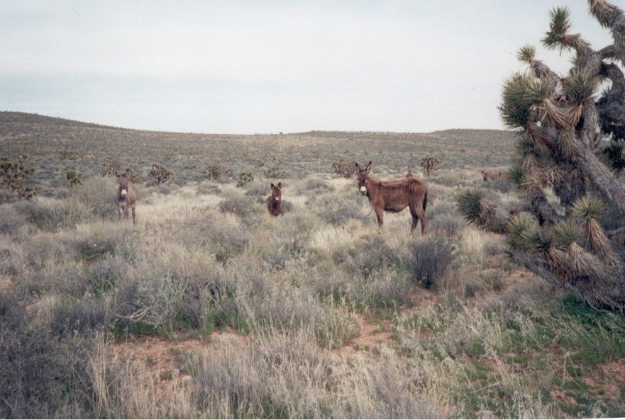
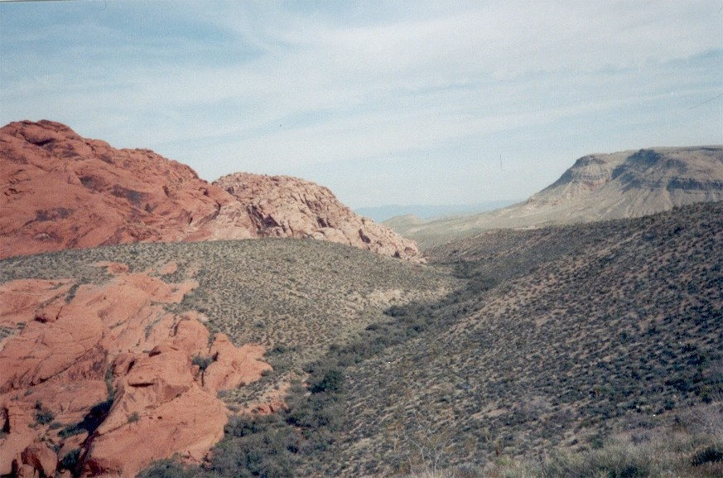
Deserts
Deserts are hot and dry, with little rain fall and low vegetation (plants).
Quiz
Notes:
Nevada, Photo by Ann Wesley

Slide 6
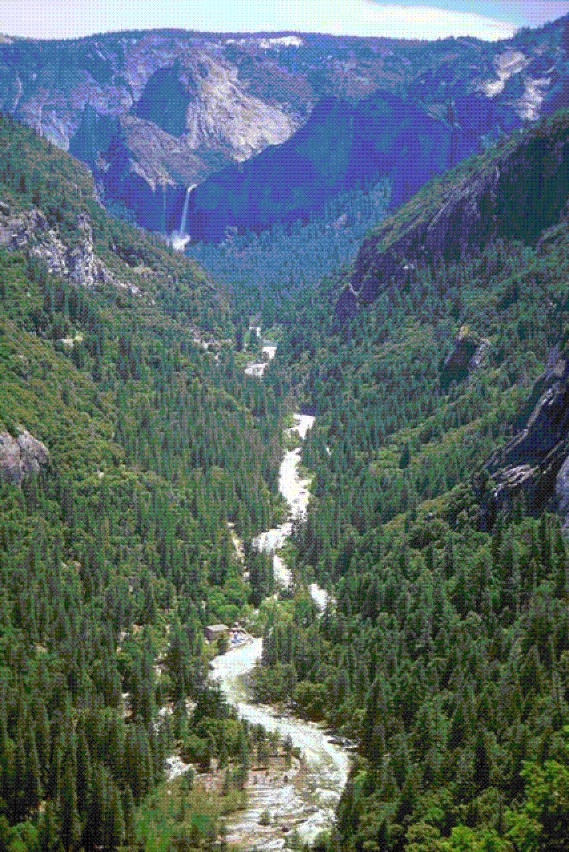
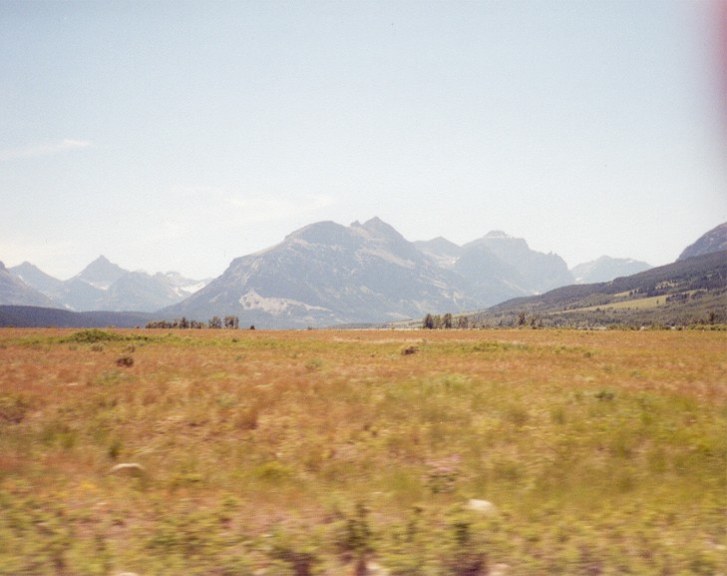
Valley
Valleys are often located between two mountains. A valley is the lowest level of land on which you could find a stream or wetland.
Quiz

Slide 7
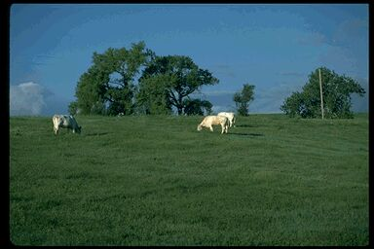
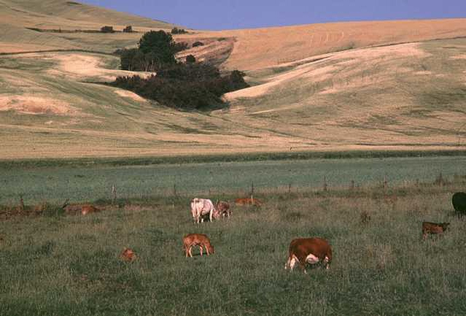

Grassland
Grasslands are open fields with tall grasses and few trees. Animals usually graze in the open land.
Notes:
Photo from Broderbund, ClickArt 400,000 CD

Slide 8
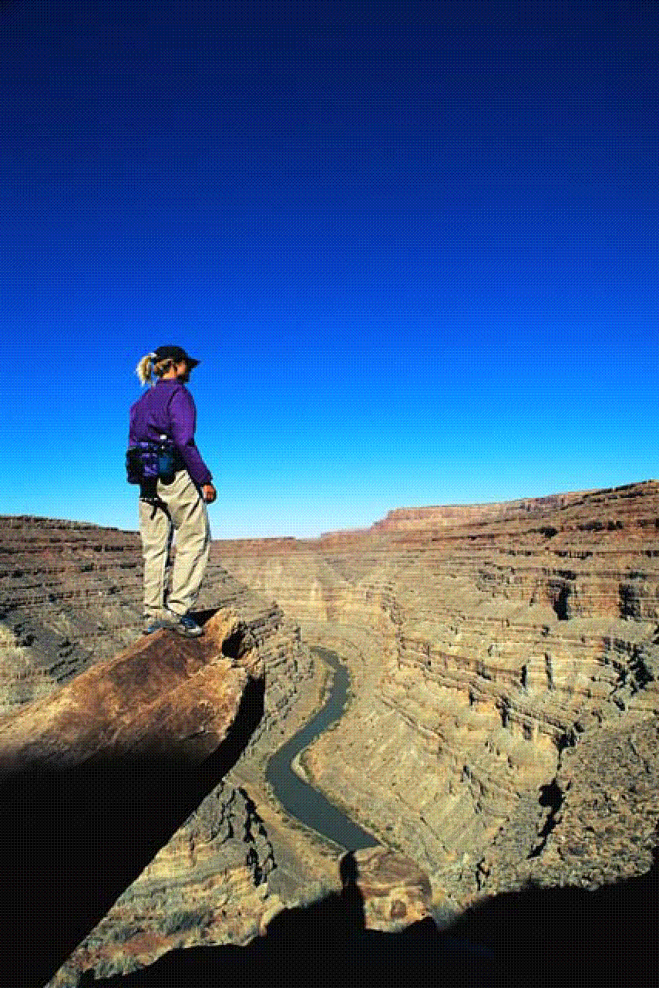
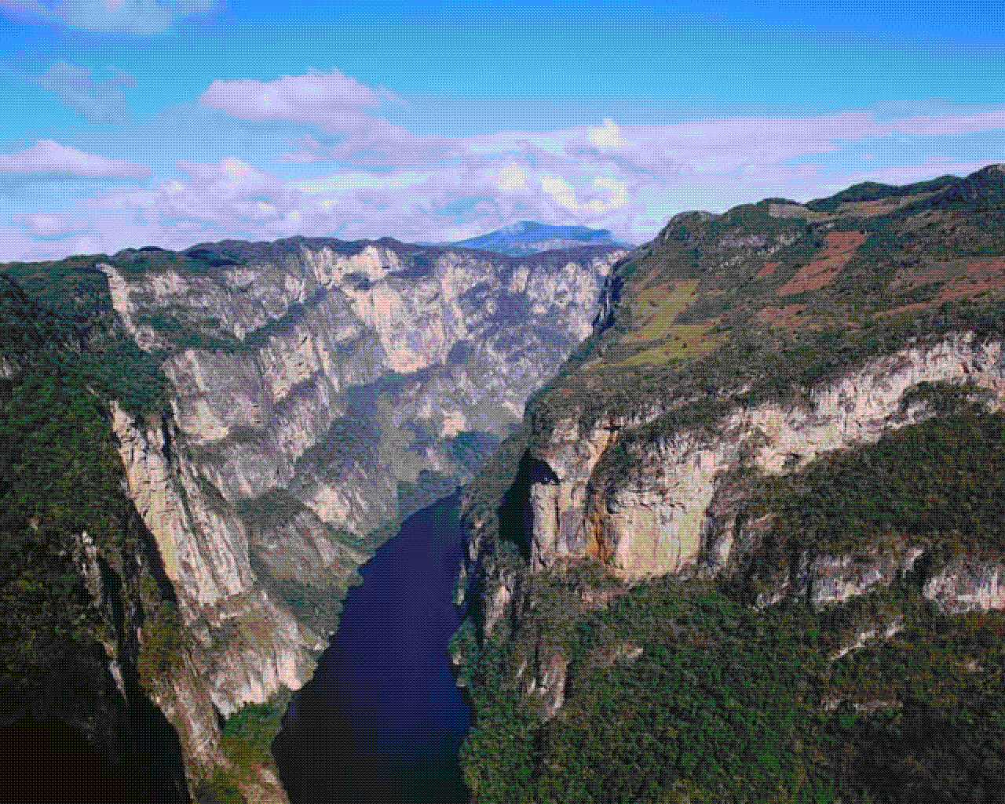
Canyons
A canyon is created by rain, wind and rivers wearing (erodes) away the earth. Fossils can be discovered in canyons as soil erodes away.

Slide 9

What do you Know?
1). Old Mountains look the same as a Young Mountains, having steep sides and pointed peaks.
---True ---False
---------------------------------------------
2). Deserts have little rain fall and low vegetation (plants).
---True ---False
Return to
Types of
Landforms
to
Types of

Slide 10


Super Job!
Congratulations!!!
You are so
Smart!!!
Return

Slide 11
What do you Know?
When glaciers grind away rock, it makes the surface smooth.
True False
When you are in a valley, you would be between
two trees b) two lakes
two mountains d) two canyons
Back to
Types of
Landforms

Slide 12
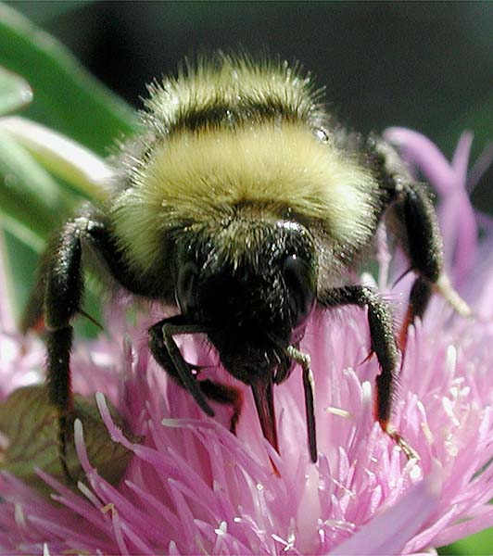
FANTASTIC!!!
BEE-golly,
you got that one!
Return to Quiz

