Slide 1
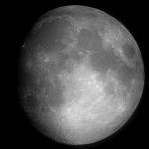
Different
Phases of the Moon
MARÍA SANZ

Slide 2
What will we learn?
We will learn about moon phases
How many moons we have compared to other planets
Why we have moon phases
What the different moon phases look like
How to find our birthday moon phase

Slide 3
Key Vocabulary
1. Orbit - The path of the Moon around the Earth.
2. Rotate - The Earth spins around, like a top, about its axis once each day.
3. Waning – Tends to dissapear
4. Waxing – appears to be growing
5. Gibbous - Swollen on one side
6. Crescent – less than ½ the moon is visible.
7. Revolve- the motion of one object around another ( the moon revolves around Earth)

Slide 4

Our Planet Earth has 1 MOON!
This is our moon
This is Earth

Slide 5
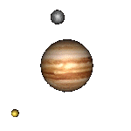
Other Planets have many moons!
THIS IS MARS
FOR EXAMPLE: MARS HAS TWO MOONS !! EACH MOON HAS ITS OWN NAME. THEIR NAMES ARE: PHOBOS & DEIMAS

Slide 6
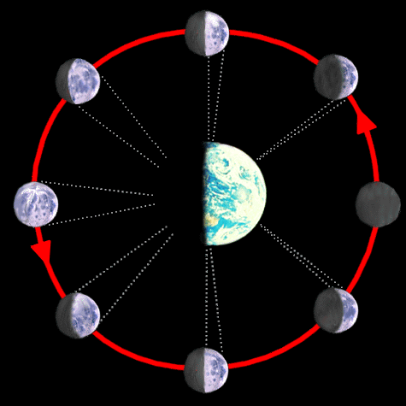
What Causes the different phases of the moon?
The Moon Revolving around the Earth
2. The Moon reflecting sunlight towards the Earth.

Slide 7
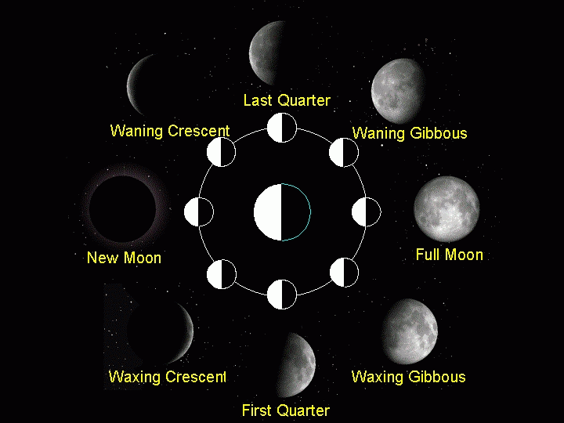
Different Phases of the Moon
Since we only see the lit portion of the moon that is facing Earth, we see a Moon phase.
There are 8 phases of the moon & they always occur in the same order starting with the NEW MOON and ending with WANING CRESCENT

Slide 8
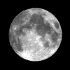
Shadow on the Moon

Slide 9

New Moon
During a NEW MOON we do NOT see any of the Moon’s surface that is lit.
We ONLY see the dark side of the moon.
This is the first phase in the moon’s cycle.

Slide 10
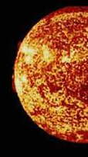
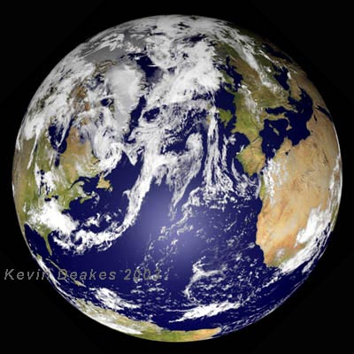

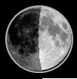
New Moon
New Moon

Slide 11

Waxing Crescent
During the Waxing Crescent moon phase we see : a small sliver of the lit moon on the right side. A waxing moon seems to grow larger.

Slide 12


Waxing CrescentWaxinCrescen

Slide 13

First Quarter
During the first quarter phase, we see: The right half of the lit Moon.
This means that the Moon and Earth are now –at right angles.

Slide 14
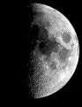

First Quarter

Slide 15

Waxing Gibbous
During this moon phase we see almost the entire right side of the lit moon. The moon is still growing!! It is swollen on one side.

Slide 16

Waxing Gibbous

Slide 17

Full Moon
During a full moon, we can see the entire half of the moon’s lit surface.
This is when the moon is positioned behind the Earth and Sun.

Slide 18
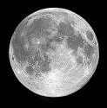

Full Moon

Slide 19

Waning Gibbous
During this moon phase, we see almost the entire Left side of the lit up moon. The moon seems to be shrinking. It is also swollen on one side.

Slide 20
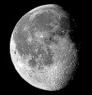
Waning Gibbous

Slide 21

Third (Last) Quarter
During the last quarter moon phase, we see the left half of the Moon lit.
The Moon and Earth are now positioned again, at right angles.

Slide 22
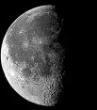
Last Quarter

Slide 23

Waning Crescent
During the waning crescent moon phase, we see a sliver of the lit Moon, now on the left side.

Slide 24

Waning Crescent

Slide 25
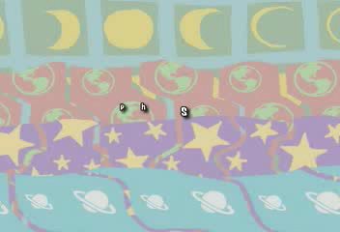

Slide 26
The Phases
of the Moon

Slide 27
The Moon’s Orbit

Slide 28
New Moon
Light Half
Dark Half

Slide 29
How the Moon looks from Earth
Part seen on Earth

Slide 30
New Moon

Slide 31
Waxing Crescent

Slide 32
First Quarter

Slide 33
Waxing Gibbous

Slide 34
Full Moon

Slide 35
Waning Gibbous

Slide 36
Last Quarter

Slide 37
Waning Crescent

Slide 38
New Moon

