Slide 1
PLATE TECTONICS
MARÍA SANZ

Slide 2
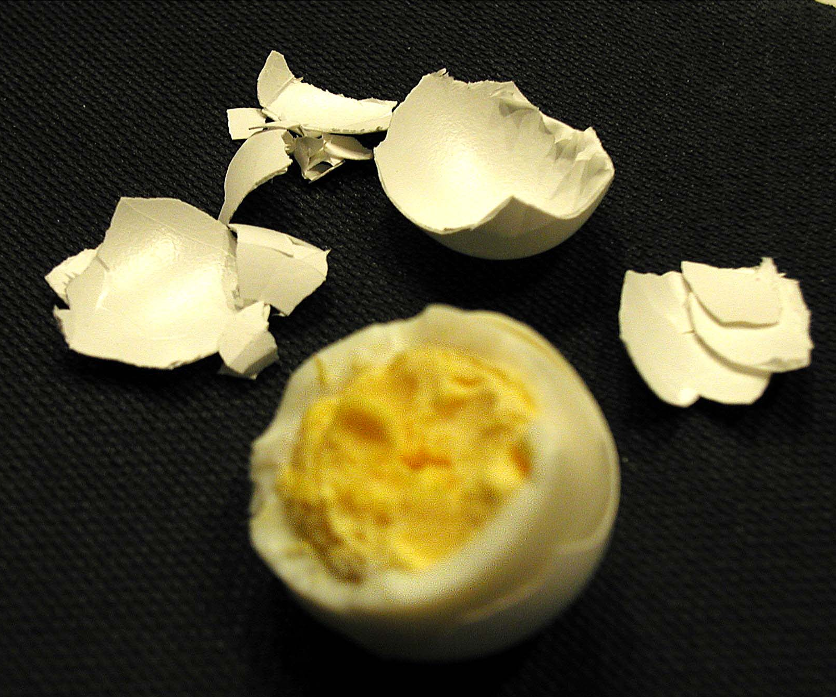
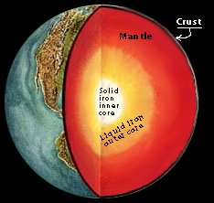
Earth vs.
Egg
Earth radius = 6370 km
Lithosphere (plate) thickness = 100 km
What % of Earth radius is lithosphere?
Egg radius = 0.75 inch
Egg shell thickness = 0.015 inch
What % of egg radius is shell?
How do these compare?
~2%
2%
Watch video lecture
“EggVsEarth”
Notes:
Because we live on the surface of a really big sphere, humans have difficulty visualizing the geometry of Earth. After all, the realization that Earth is NOT FLAT is a relatively recent breakthrough in human understanding of our planet. The exercise of comparing the Earth to an egg is a useful visualization that helps people understand the thickness of plates on a global scale.
NOTE: The lithospheric plates include the crust (arrowed in globe picture) and a bit of the upper mantle; The egg shell represents the plates, not just the crust.
You’ll need a good micrometer to measure the thickness of an egg shell. And of course an egg is not spherical. But this comparison is still useful because everyone occasionally peals an egg. By planting this comparison in students’ minds, they may well think of plates and Earth the next time they peal an egg.
Math: The thickness of the lithosphere is about 1.6% of the Earth’s radius. The shell of an egg is about 2% of its radius. Similar, but this shows just how thin the crust is relative to the Earth.
VIDEO LECTURE: “EggVsEarth” on Teachers on the Leading Edge web site under “Videos” under the topic “Introduction to Plate Tectonics and Earthquakes”. URL http://multimedia2.up.edu/Physics/TOLE/Plates&Earthquakes/VideoLectures/EggVsEarth.mov

Slide 3
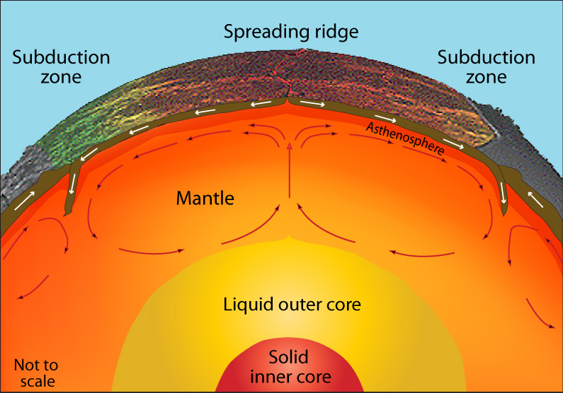
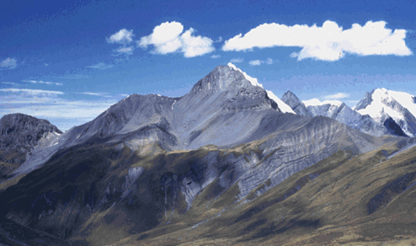
Plate tectonics
Plates are driven by cooling of Earth.
Gravity provides additional force to move plates.
Modified from USGS Graphics
Convection is like a boiling pot.
Notes:
Conceptual drawing of assumed convection cells in the mantle. Below a depth of about 700 km, the descending slab begins to soften and flow, losing its form.
Important principle: The heat energy from Earth’s interior drives the motions of plates on Earth’s surface. Simply stated, convection moves hot material from Earth’s interior up to the surface to cool, then drags cold and dense rocks from the surface back into the hotter interior. This is an efficient way for our planet to cool. In kid vernacular, “heat rises, gravity sucks.” See next slide for convection in boiling pot.
WHERE DOES THE HEAT COME FROM?
The heat in Earth’s interior is about 50% inherited from formation of Earth during the development of our solar system (accretion changes gravitational potential energy to kinetic energy to heat upon impact) and 50% is from decay of naturally occurring radioactive elements (principally U, Th, K). Radioactive decay, a spontaneous process that is the basis of "isotopic clocks" used to date igneous rocks, involves the loss of particles from the nucleus of an isotope (the parent) to form an isotope of a new element (the daughter).
Photograph: The convergence of the Nazca and South American Plates has deformed and pushed up limestone strata to form towering peaks of the Andes, as seen here in the Pachapaqui mining area in Peru. (Photograph by George Ericksen, USGS.)

Slide 4
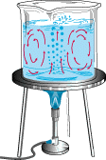
Plate tectonics
Convection in Earth’s interior is like a boiling pot.
Modified from USGS Graphics
The heated soup rises to the surface, spreads and begins to cool, and then sinks back to the bottom of the pot where it is reheated and rises again.
Notes:
The mobile mantle rock beneath the rigid plates circulates in a manner somewhat like a pot of thick soup when heated to boiling. The heated soup rises to the surface, spreads and begins to cool, and then sinks back to the bottom of the pot where it is reheated and rises again. This cycle is repeated over and over to generate what scientists call a convection cell or convective flow. We know that convective motions in Earth’s mantle are a few centimeters per year, much slower than the convection of boiling soup, and many unanswered questions remain. How many convection cells are there? Where and how do convection cells originate? What is their structure? Does the whole mantle convect in really large cells or do the upper and lower portions of the mantle have separate convection systems?
Two activities for study of convection can be found on the Internet:
http://www.exo.net/~emuller/activities/Inverted%20Bottles.pdf
http://www.exploratorium.edu/snacks/pie_pan_convection/index.html

Slide 5
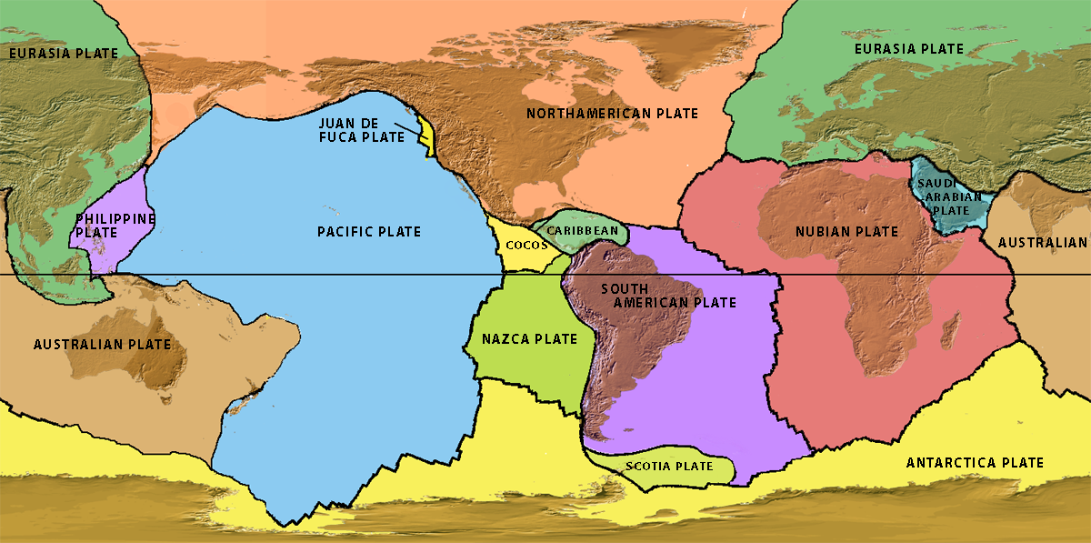
There are a dozen large lithospheric plates (smaller plates not shown).
Some plates have continents; some don’t. All are in motion.
Question: What evidence is there for these plate boundaries?
Tectonic Plates
Flash Rollovers
“Tectonic Plates” & “Plates, Earthquakes, and Volcanoes”
Notes:
Any map of plates shows that there are about a dozen large plates and a number of smaller plates. The smallest plates are not included here. Remember that “Plate Tectonics” is a fairly new scientific discovery stimulated by exploration of the ocean basins after WWII. In 1950, most people didn’t believe that the continents could move across Earth’s surface. This simple map does not show broad areas of deformation between plates. We will see that in a later slide.
ANIMATIONS: This and the next few slides are available on the Teachers on the Leading Edge web site as FLASH rollovers under “Animations” under the topic “Introduction to Plate Tectonics and Earthquakes”.
URL TectonicPlates http://multimedia2.up.edu/Physics/TOLE/Plates&Earthquakes/Animations/FLASHRollovers/TectonicPlates.swf
URL Plates, Earthquakes, and Volcanoes http://multimedia2.up.edu/Physics/TOLE/Plates&Earthquakes/Animations/FLASHRollovers/DynamicPlanet.swf

Slide 6
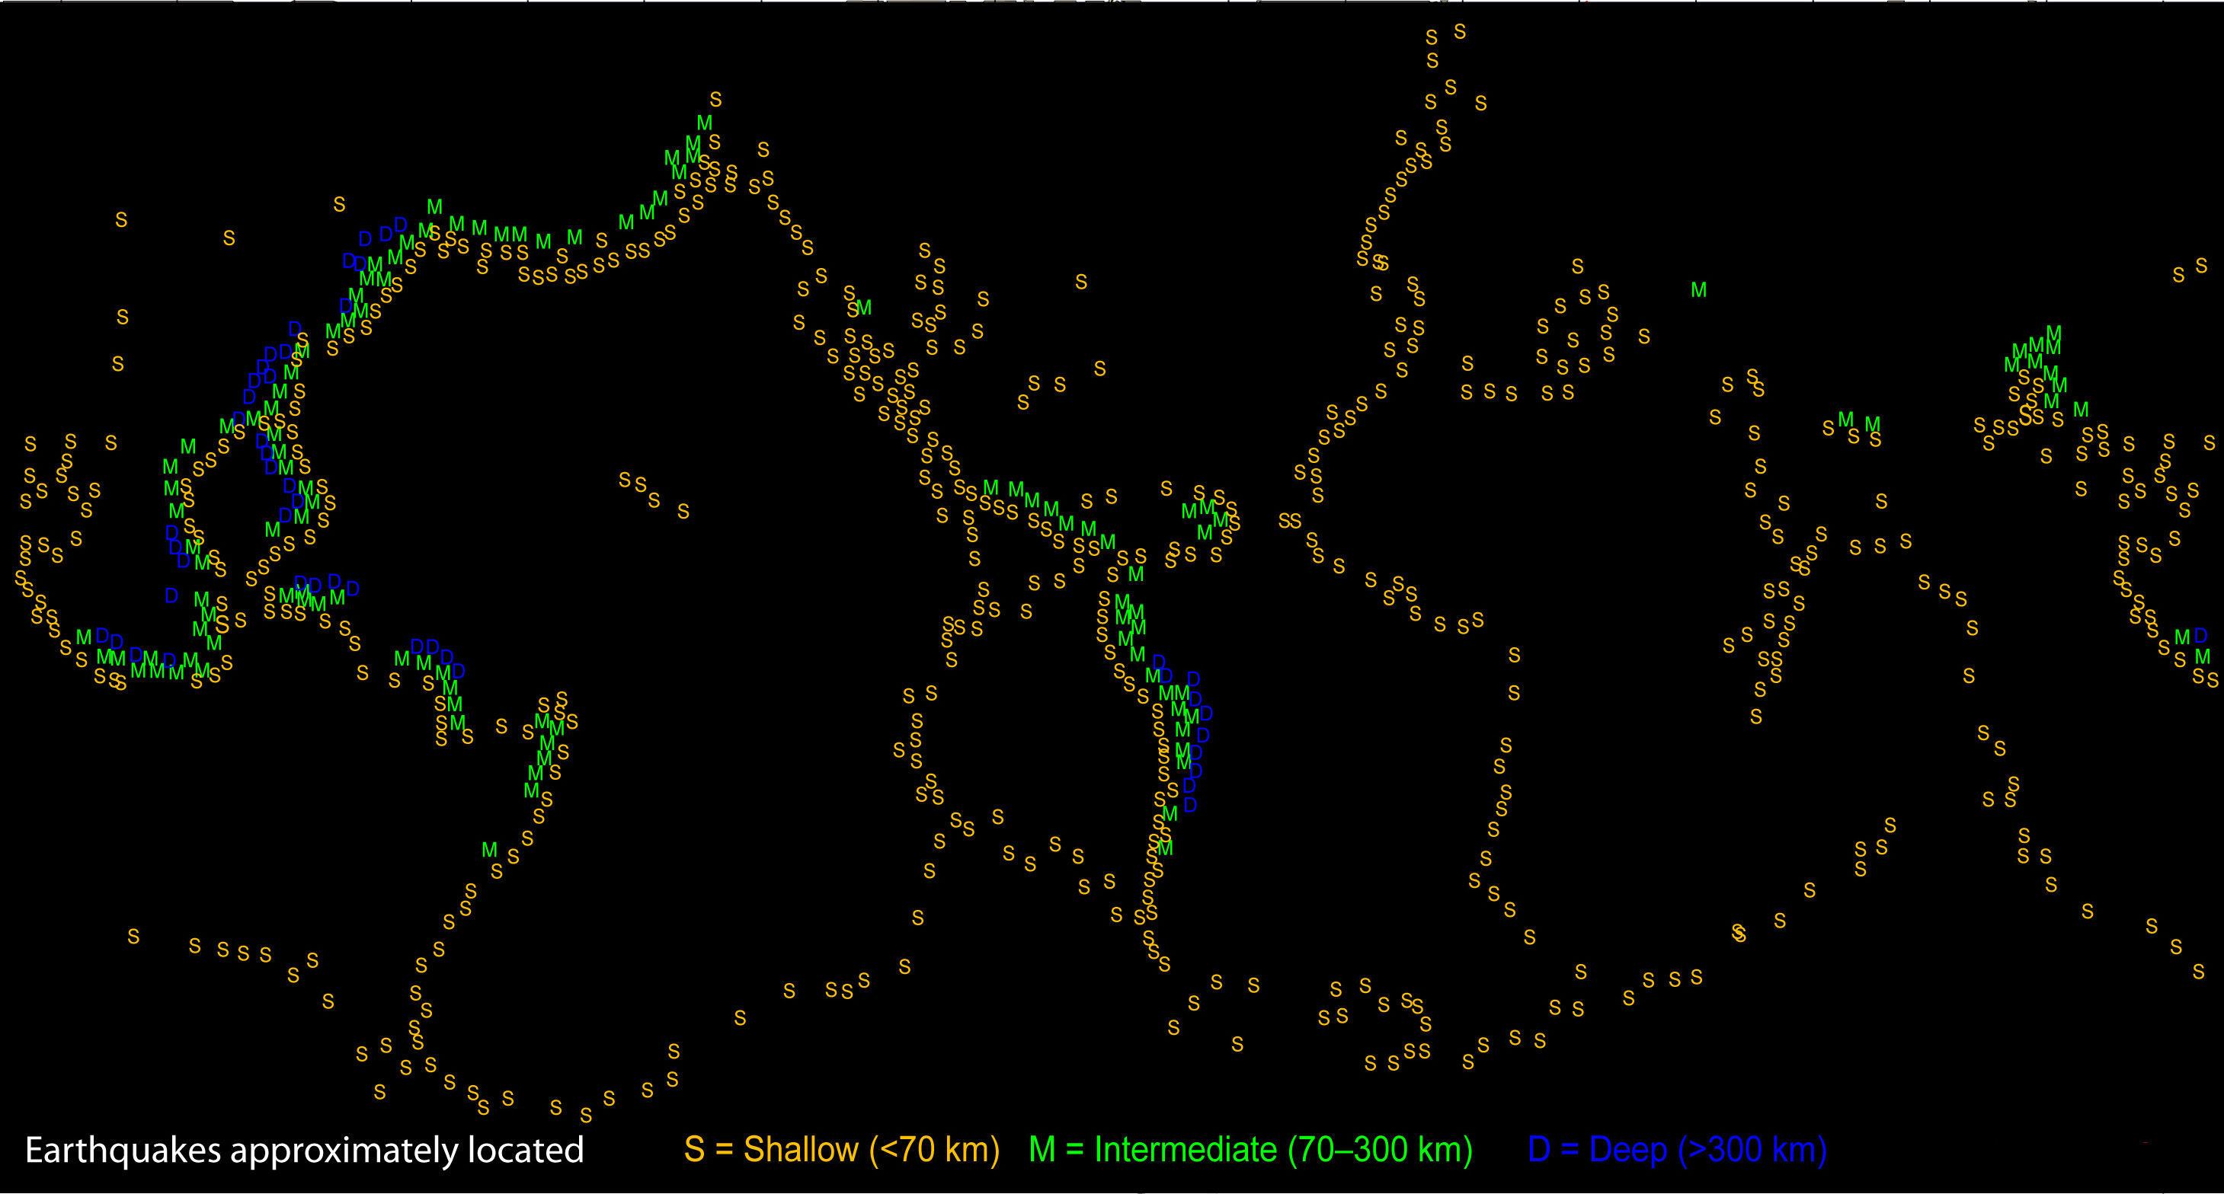
There are thousands of small earthquakes every day
“Strong” earthquakes (~M7) occur once a month. >M8 occur about once/year.
Seismicity & Distribution of Earthquakes
Where are the deepest earthquakes?
Notes:
This figure shows the “baseball-stitching” pattern of earthquakes around the globe. With some imagination you can see some of the gross continental and plate boundaries. This figure illustrates only a small percentage of the earthquakes that would typically occur in a year. Worldwide, strong earthquakes happen more than once per month. Smaller earthquakes, such as magnitude 2 earthquakes, occur several hundred times a day. Over a million earthquakes of magnitude 2 and lower occur every year. And 1,500 Magnitude 5 occur every year. For a one-page flier on “How often do earthquakes occur?” go to the website http://www.iris.edu/edu/onepagers.htm The deepest earthquakes are where one plate is subducting beneath another plate.
For earthquakes of the past 2 weeks, go to http://www.iris.edu/seismon/

Slide 7
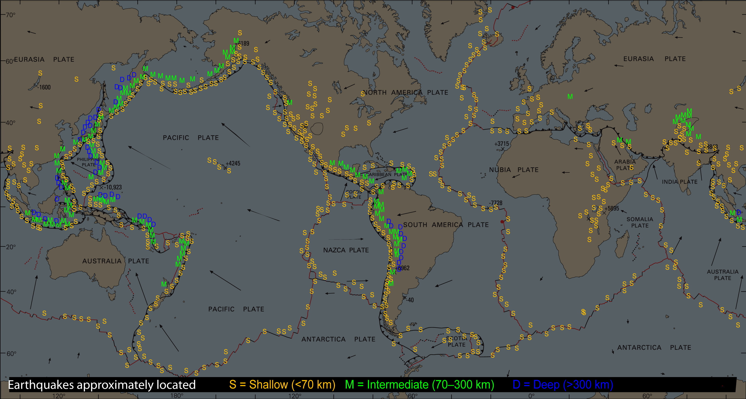
Notice that earthquakes coincide with plate boundaries, and the deepest quakes (blue) are in subduction zones.
Question: Where would you expect to see volcanoes?
World Seismicity & Plate Tectonics
Modified from USGS Graphics
Notes:
This slide shows the relationship between plate tectonics and earthquake locations. There are thousands more earthquakes every year than shown here. While most earthquakes occur at or near plate boundaries, many earthquakes occur are in the middle of plates. Why would there be earthquakes in the middle of plates? Remember that the plate tectonics is a useful but not perfect model of how Earth works. Plates are mostly, but not entirely, internally rigid. Plates are exposed to forces that move them around and occasionally cause earthquakes on faults in the interior of the plate. These forces can reactivate old faults like in the mid-continent of North America.
For earthquakes of last 2 weeks, go to http://www.iris.edu/seismon/
Create your own maps at http://www.iris.edu/quakes/maps.htm

Slide 8
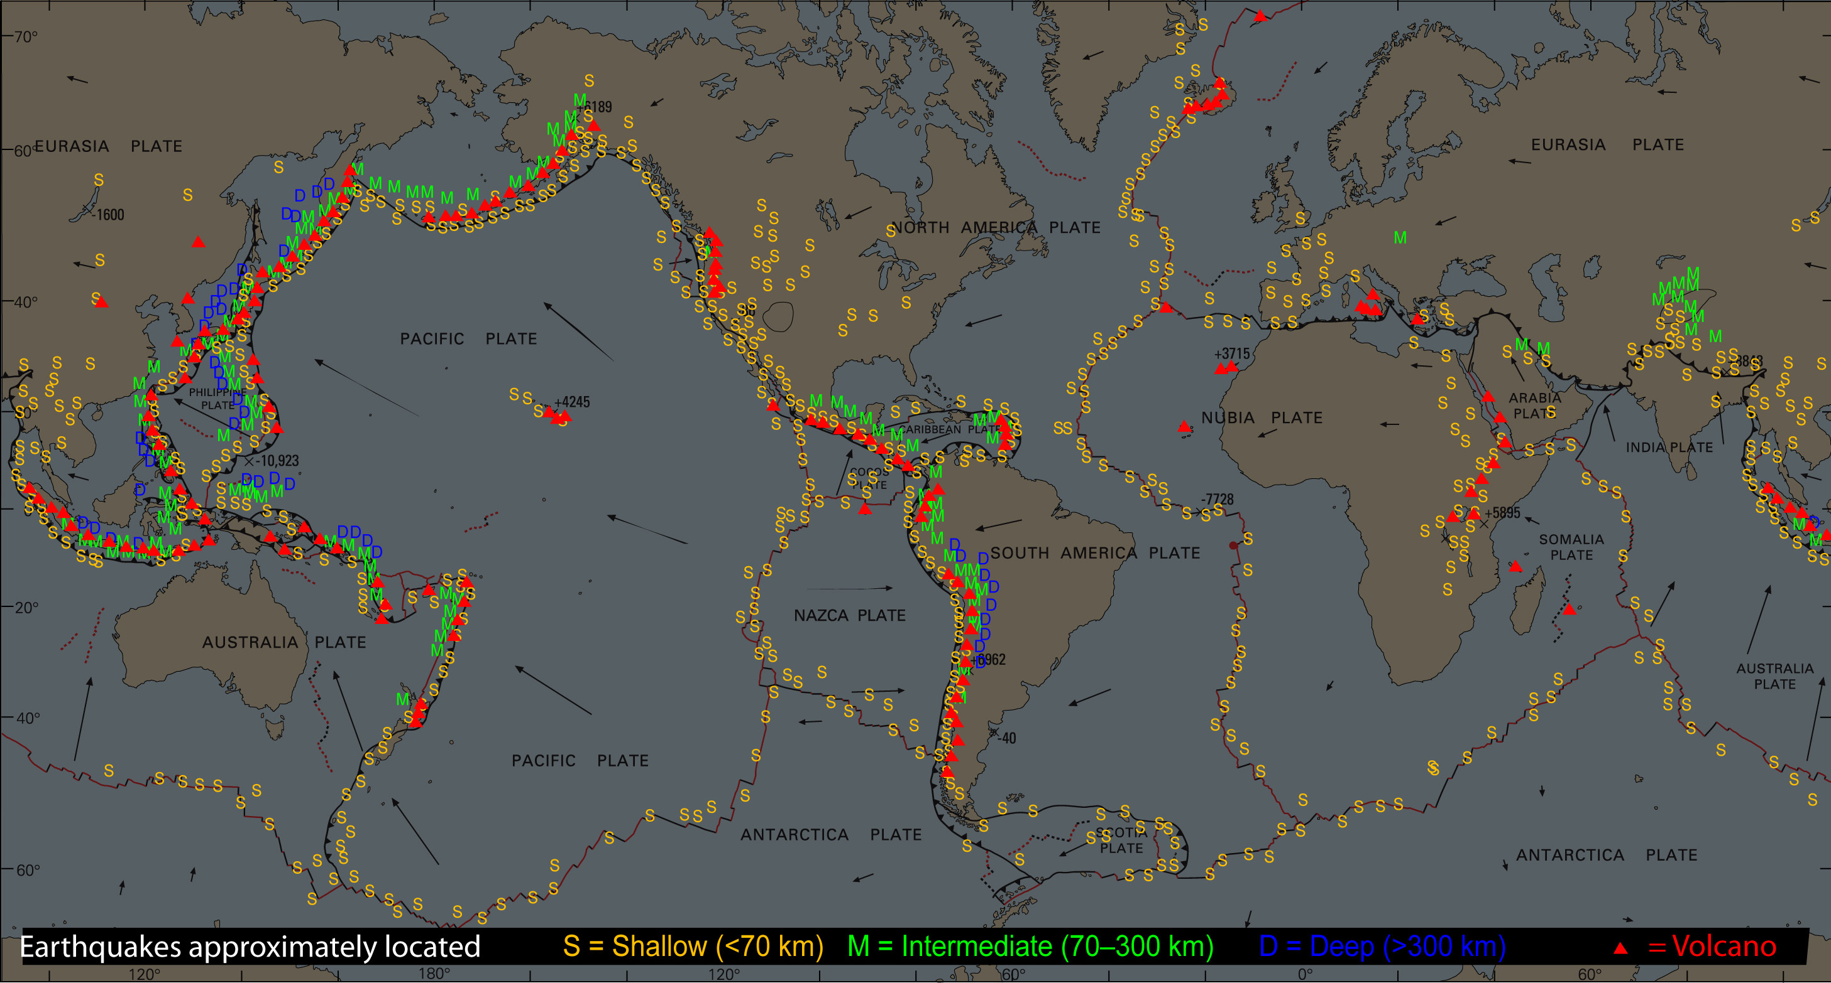
Seismicity, Tectonics, and Volcanoes
This map shows that the locations of subaerial (above sea level) volcanoes correlate with earthquake locations.
Modified from USGS Graphics
Notes:
This image shows a smattering of the most prominent and most active volcanoes that occur above sea level. There are thousands of submarine volcanoes not illustrated here. Where do volcanoes occur? Volcanoes occur on divergent boundaries (especially at spreading ocean ridges where newly generated oceanic curst is capped by a layer of volcanic rocks) and on convergent boundaries where an oceanic plate subducts beneath another oceanic or continental plate.
(A later slide shows the different convergent boundaries). Volcanoes can also occur in the middle of a plate due to “hotspot” processes or in continental rift zones like the East Africa Rift.

Slide 9
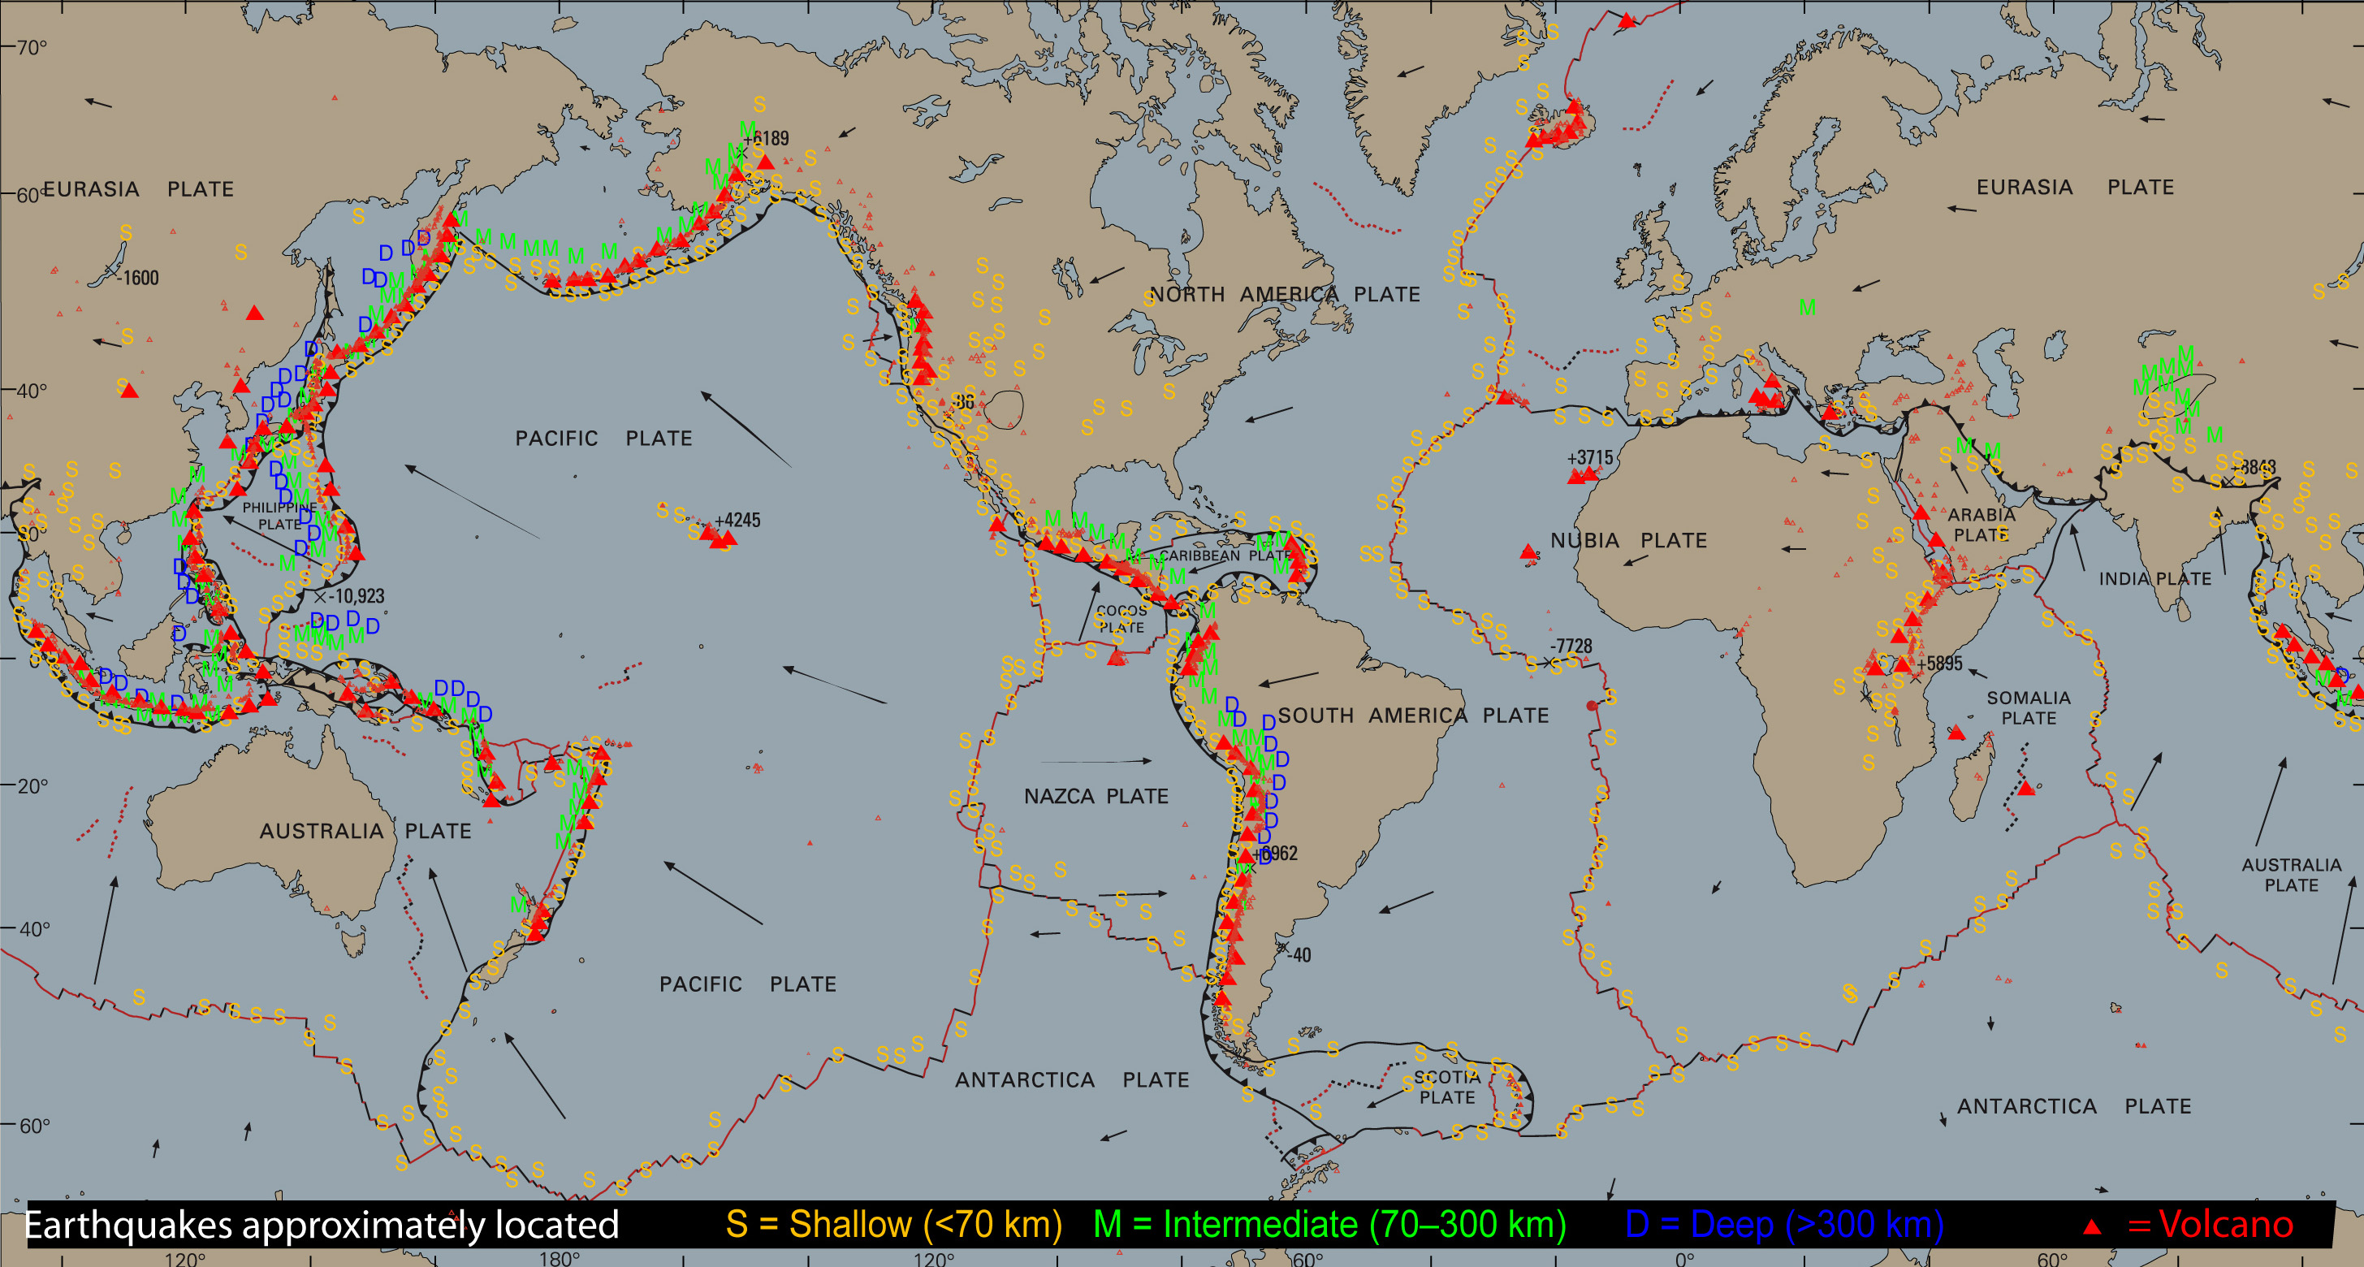
Seismicity, Tectonics, & Volcanoes
The Earth is divided into relatively stable regions bounded by linear zones of earthquakes and volcanoes.
Modified from USGS Graphics
Notes:
This image shows a smattering of the most prominent and active volcanoes. The mid-ocean ridges (red lines on ocean plates) comprise the longest volcanic chain in the world. It is an oversimplification to say that ALL earthquakes and volcanoes occur at or near plate boundaries but there is a very strong concentration of earthquakes and volcanoes near plate boundaries. If you understand how plate motions produce earthquakes and volcanoes, you can explain at least 80% of earthquakes and volcanoes.
The computer program “SeismicEruption” can be used to animate worldwide earthquakes and volcanic eruptions from 1960 until today. This is a great activity to help students understand that earthquakes are concentrated along and near the boundaries between tectonic plates. The animation of volcanic eruptions dramatically shows the “Pacific Ring of Fire”, the belt of volcanoes surrounding the Pacific ocean. The SeismicEruption program runs is freeware developed by Alan Jones.
The program runs on any PC (NOT MAC) and is downloadable from http://bingweb.binghamton.edu/%7Eajones/#Seismic-Eruptions
CLASSROOM ACTIVITY: “SeismicEruption Program Student Worksheet” was developed by Roger Groom, Mt Tabor Middle School, Portland. This activity can be found on TOTLE web site under “LESSON PLANS” under the topic “Introduction to Plate Tectonics and Earthquakes”.
URL http://multimedia2.up.edu/Physics/TOLE/Plates&Earthquakes/LessonPlans/SeismicEruptionPrgm.doc
Background graphic from “This Dynamic Planet, World Map of Volcanoes, Earthquakes, Impact Craters, and Plate Tectonics.” A Smithsonian, USGS, US Naval Research lab publication. Available at http://mineralsciences.si.edu/tdpmap/ (Note that this material is copyright protected; the content may only be used for personal, educational or noncommercial purposes.)

Slide 10
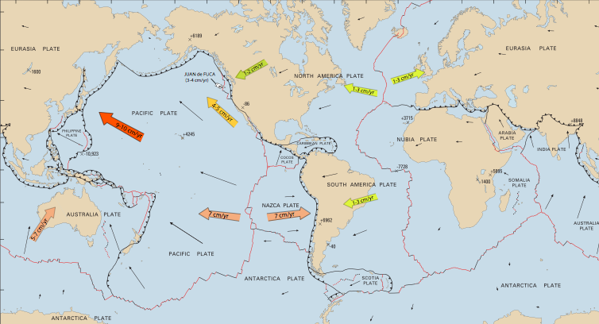
How fast are the plates moving?
Plates move 1-10 centimeters per year (≈ rate of fingernail growth).
Tectonic Plates
Modified from USGS Graphics
Notes:
The Nazca Plate (west of South American plate) and the Pacific Plate are the fastest moving plates. Rates of plate motions are typically an inch or two per year (about the rate of growth of your fingernails). Although these rates seem slow, over 100s of millions of years, these motions open and close large ocean basins and completely change the arrangement of continents.
CLASSROOM ACTIVITY: For a classroom lesson plan and a detailed world map of plates, see the Mapping World Plates Activity and associated files on Teachers on the Leading Edge web site under “Lesson Plans” under the topic “Introduction to Plate Tectonics and Earthquakes”.
Mapping World Plates Activity URL:
http://multimedia2.up.edu/Physics/TOLE/Plates&Earthquakes/LessonPlans/MappingPlates/WorldTectonicMapActivity.pdf
Mapping World Plates Poster URL:
http://multimedia2.up.edu/Physics/TOLE/Plates&Earthquakes/LessonPlans/MappingPlates/WorldTectonicMap-Poster.pdf
Mapping World Plates Questions URL:
http://multimedia2.up.edu/Physics/TOLE/Plates&Earthquakes/LessonPlans/MappingPlates/PTMapQuestions.doc
Mapping World Plates Small Map URL:
http://multimedia2.up.edu/Physics/TOLE/Plates&Earthquakes/LessonPlans/MappingPlates/WorldTectonicMapSmall.pdf
See John Lahr’s web site for documentation of his finger nail growth: http://jclahr.com/science/earth_science/thumbnail/index.html
Background graphic from “This Dynamic Planet, World Map of Volcanoes, Earthquakes, Impact Craters, and Plate Tectonics.” A Smithsonian, USGS, US Naval Research lab publication. (Note that this material is copyright protected; the content may only be used for personal, educational or noncommercial purposes.)

Slide 11
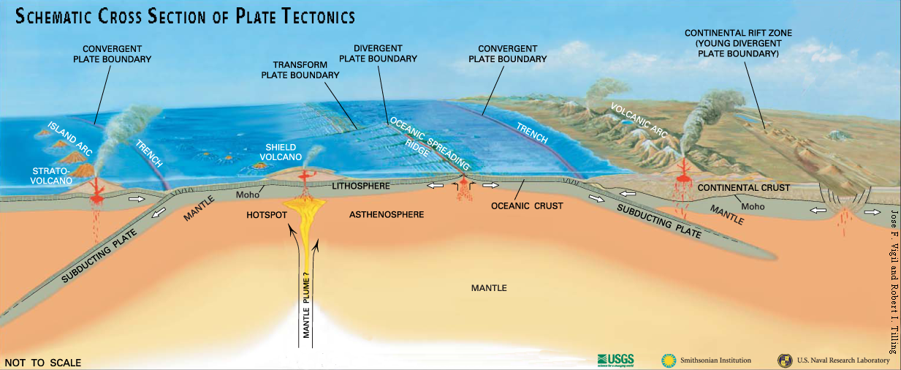
What are the tectonic plates?
Lithosphere
Is the ~100-km-thick surface of Earth;
Contains crust and upper mantle;
Is rigid and brittle;
Fractures to produce earthquakes.
Watch video lecture
“Lithospheric plates”
Notes:
There is widespread confusion between “crust” and “plates”. Unfortunately this confusion is reinforced by many popular science programs [e.g. Discovery Channel programs, etc.]). It’s not complicated if you lay this out correctly from day #1. The “plates” of plate tectonics are more correctly referred to as “lithospheric plates”. The upper portion of the lithospheric plates is Earth’s crust that is the outer rock layer of Earth chemically distinct from the underlying mantle layer. The deeper portion of the lithospheric plates is mantle material. To distinguish mantle rocks that are part of lithospheric plates from deeper, hotter, and therefore weaker mantle rocks, the term “lithospheric mantle” is sometimes used for the mantle that makes up the deeper part of plates. Total thickness of lithospheric plates is about 100 km. Compared to deeper layers of Earth, lithospheric plates are colder, more rigid, and much more brittle (capable of breaking when large forces are applied). The mantle below the plates is called “asthenosphere” or “asthenospheric mantle”. This part of the mantle is not liquid but it is close to its melting temperature. It is therefore capable of flowing (at very slow rates) if forces are applied for long times. Silly putty is a useful analog to the mechanical behavior of the asthenosphere.
VIDEO LECTURE: “Lithospheric Plates” on Teachers on the Leading Edge web site under “Videos” under the topic “Introduction to Plate Tectonics and Earthquakes”. URL for Lithospheric Plates http://multimedia2.up.edu/Physics/TOLE/Plates&Earthquakes/VideoLectures/TectonicPlates.mov
Background graphic from “This Dynamic Planet, World Map of Volcanoes, Earthquakes, Impact Craters, and Plate Tectonics.” A Smithsonian, USGS, US Naval Research lab publication. (Note that this material is copyright protected; the content may only be used for personal, educational or noncommercial purposes.)

Slide 12
What is the asthenosphere?
USGS Graphics
Asthenosphere:
Is the hotter upper mantle below the lithospheric plate;
Can flow like silly putty; and
Is a viscoelastic solid, NOT liquid!!
Watch video lecture
“Properties of the asthenosphere”
Notes:
There is also confusion about the asthenosphere. This region of the mantle is not liquid and the plates do not glide over it like a sheet of water. The asthenosphere is hot but, rocks because it is under intense pressure from the overlying rocks, it is not hot enough to melt more than a small fraction of the rocks in the asthenosphere. Instead the asthenosphere is what we call a viscoelastic solid. It can deform and flow if forces are applied over a long interval of time. Therefore a good analog is silly putty which will stretch and deform when pulled slowly.
VIDEO LECTURE: “Properties of the asthenosphere” on Teachers on the Leading Edge web site under “Videos” under the topic “Introduction to Plate Tectonics and Earthquakes”.
URL http://multimedia2.up.edu/Physics/TOLE/Plates&Earthquakes/VideoLectures/Asthenosphere.mov
Background graphic from “This Dynamic Planet, World Map of Volcanoes, Earthquakes, Impact Craters, and Plate Tectonics.” A Smithsonian, USGS, US Naval Research lab publication. (Note that this material is copyright protected; the content may only be used for personal, educational or noncommercial purposes.)

Slide 13
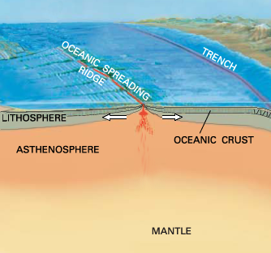
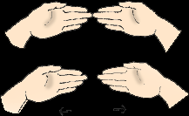
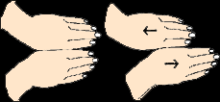
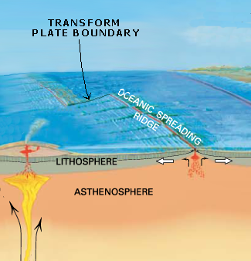
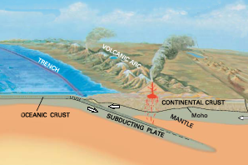
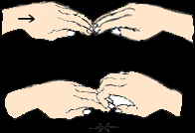
Three Basic Types of Plate Boundaries
Using hands to show relative motion
Divergent
Transform
Convergent
USGS Graphics
Notes:
Plates can have three kinds of motion across boundaries: [note video lecture on next slide]
1. Plates can move away from each other at a divergent boundary (= spreading ocean ridge or a rift zone). Use parallel hands moving apart.
2. They can slide past each other horizontally at a transform boundary. Slide left and right hands past each other.
3. Plates can move toward each other at a convergent boundary. Use parallel hands moving together. Can slide one hand beneath the other to show subduction.
When two plates carrying continents converge, a continental collision occurs where continental crust piles up. Continental crust is lower density than mantle rocks, so continental rocks cannot be “subducted” into the mantle. If continental rocks are pushed into the mantle, they will soon pop up again. This is like trying to push a piece of Styrofoam into a swimming pool. You can push the Styrofoam into the water (with some force) but, when you let it go, it pops back to the surface because it is much less dense than the water on which it floats.
CLASSROOM ACTIVITY: For classroom lesson plans that can help students understand different kinds of faults and different kinds of plate boundaries, see: (1) Types of Faults #1: Teaching About Faults Using Foam Model (Six-page guide to using foam faults to teach about geometry of faults, including instructions for making foam fault models); (2) Types of Faults #2 (classroom activity on types of faults including instructions for students to build a three-dimensional geologic block model used in the activity), and Types of Faults #3. All of these documents are on Teachers on the Leading Edge web site under “Lesson Plans” under the topic “Introduction to Plate Tectonics and Earthquakes”.
Teaching About Faults Using Foam Model URL:
http://multimedia2.up.edu/Physics/TOLE/Plates&Earthquakes/LessonPlans/FoamFaults/TypesOfFaults1.doc
Types of Faults #2 URL:
http://multimedia2.up.edu/Physics/TOLE/Plates&Earthquakes/LessonPlans/FoamFaults/TypesOfFaults2.doc
Types of Faults #3 URL:
http://multimedia2.up.edu/Physics/TOLE/Plates&Earthquakes/LessonPlans/FoamFaults/TypesOfFaults3.doc
Background graphics from “This Dynamic Planet, World Map of Volcanoes, Earthquakes, Impact Craters, and Plate Tectonics.” A Smithsonian, USGS, US Naval Research lab publication. (Note that this material is copyright protected; the content may only be used for personal, educational or noncommercial purposes.)

Slide 14
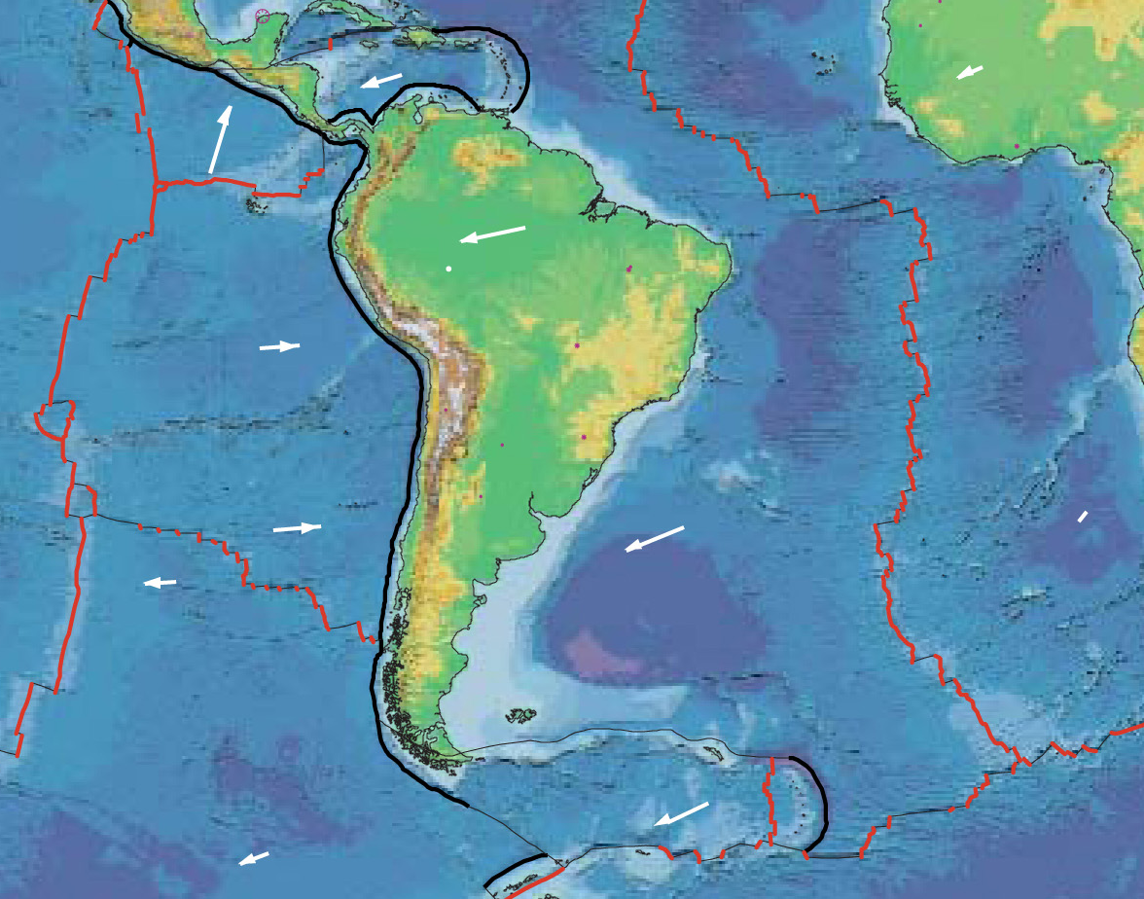
Three Basic Types of Plate Boundaries
Divergent
Transform
Convergent
Watch video lecture
“Plate boundaries”
USGS Graphics
Notes:
VIDEO LECTURE: “Plate boundaries” on Teachers on the Leading Edge web site under “Videos” under the topic “Introduction to Plate Tectonics and Earthquakes”.
URL http://multimedia2.up.edu/Physics/TOLE/Plates&Earthquakes/VideoLectures/TypesOfBoundaries.mov
Graphics from “This Dynamic Planet, World Map of Volcanoes, Earthquakes, Impact Craters, and Plate Tectonics.” A Smithsonian, USGS, US Naval Research lab publication. (Note that this material is copyright protected; the content may only be used for personal, educational or noncommercial purposes.)

Slide 15
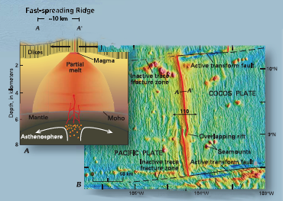
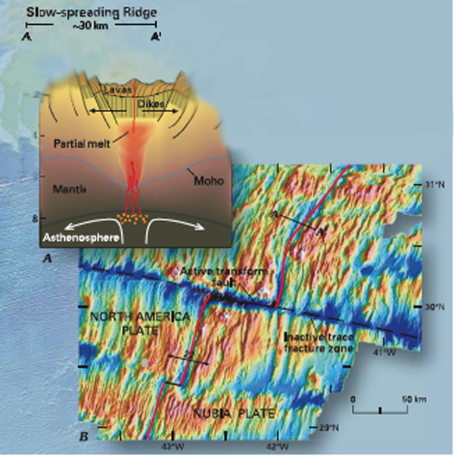
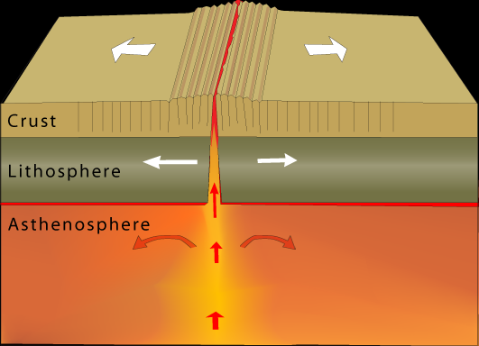
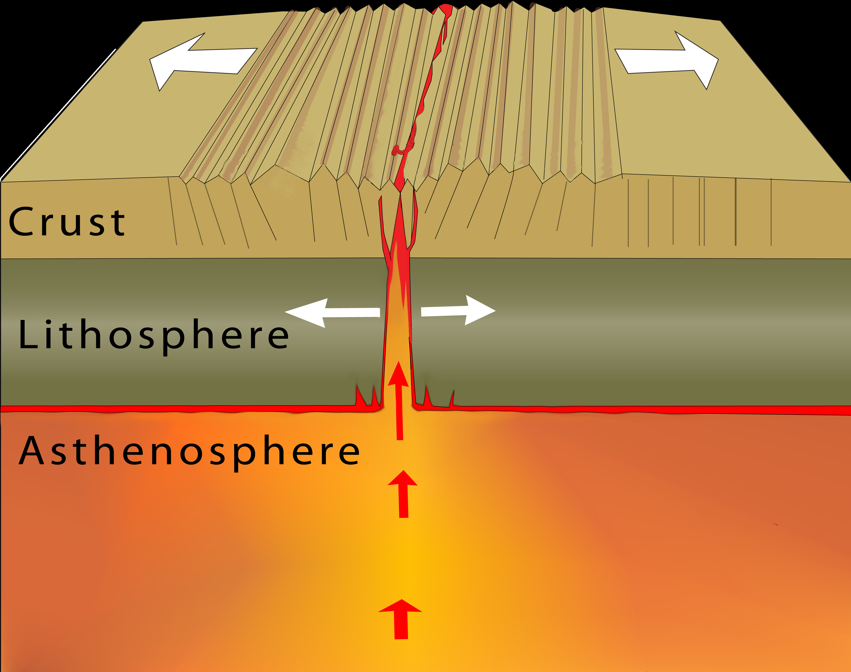
New crust is generated as the plates pull apart.
Occur at spreading ocean ridges and in continental rifts.
Earthquakes are shallow and small.
Divergent boundaries
USGS sea-floor maps
Example:
● East Pacific Rise (moving
apart at about 15 cm/year)
Examples:
● Atlantic mid-ocean ridge
● Basin and Range, USA
● African Rift Valley
● Northern Red Sea
Notes:
A closer view of a spreading ocean ridges where asthenospheric mantle rises toward the surface to form new oceanic lithospheric plates. A small portion (about 5%) of the rising asthenospheric mantle melts and the melted portion then freezes at or near the seafloor to form the igneous rocks of the oceanic crust. 95% of the rising asthenospheric mantle never melts but simply flows upwards to form the lithospheric mantle portion of the newly formed oceanic lithospheric plate. In the process of rising, the mantle rocks cool and become more rigid and brittle. The high elevation of a spreading oceanic ridge is due to the fact that the rocks of the newly formed plate are hotter under the ridge than they are after they have cooled for millions of years. Being hotter, the oceanic plate at the ridge is thermally expanded compared to older and colder parts of the plate. This cooling continues for about 100 million years.
Reminders: The crust is the upper part part of the lithosphere. The lithosphere is the “plate” comprised of the crust above an underlying layer of “lithospheric” mantle.
Some fine points:
Fast-spreading ridges lack the faulted valleys of slow-spreading ridges.
Continental rifts are zone of extension that are slowly pulling apart a continental plate. The East African Rift is a famous example. The Red Sea is a newly developing ocean resulting from the rifting of the Arabian Peninsula away from Africa. The Basin Range Province in Nevada, Utah, and southeastern Oregon is a broad region that has extended over 50% in the past 50 million years.
Earthquakes occur as rocks “snap, crackle, and pop” at divergent boundaries boundaries. In detail, plate motions occur in “jerks” and the jerks are earthquakes.

Slide 16
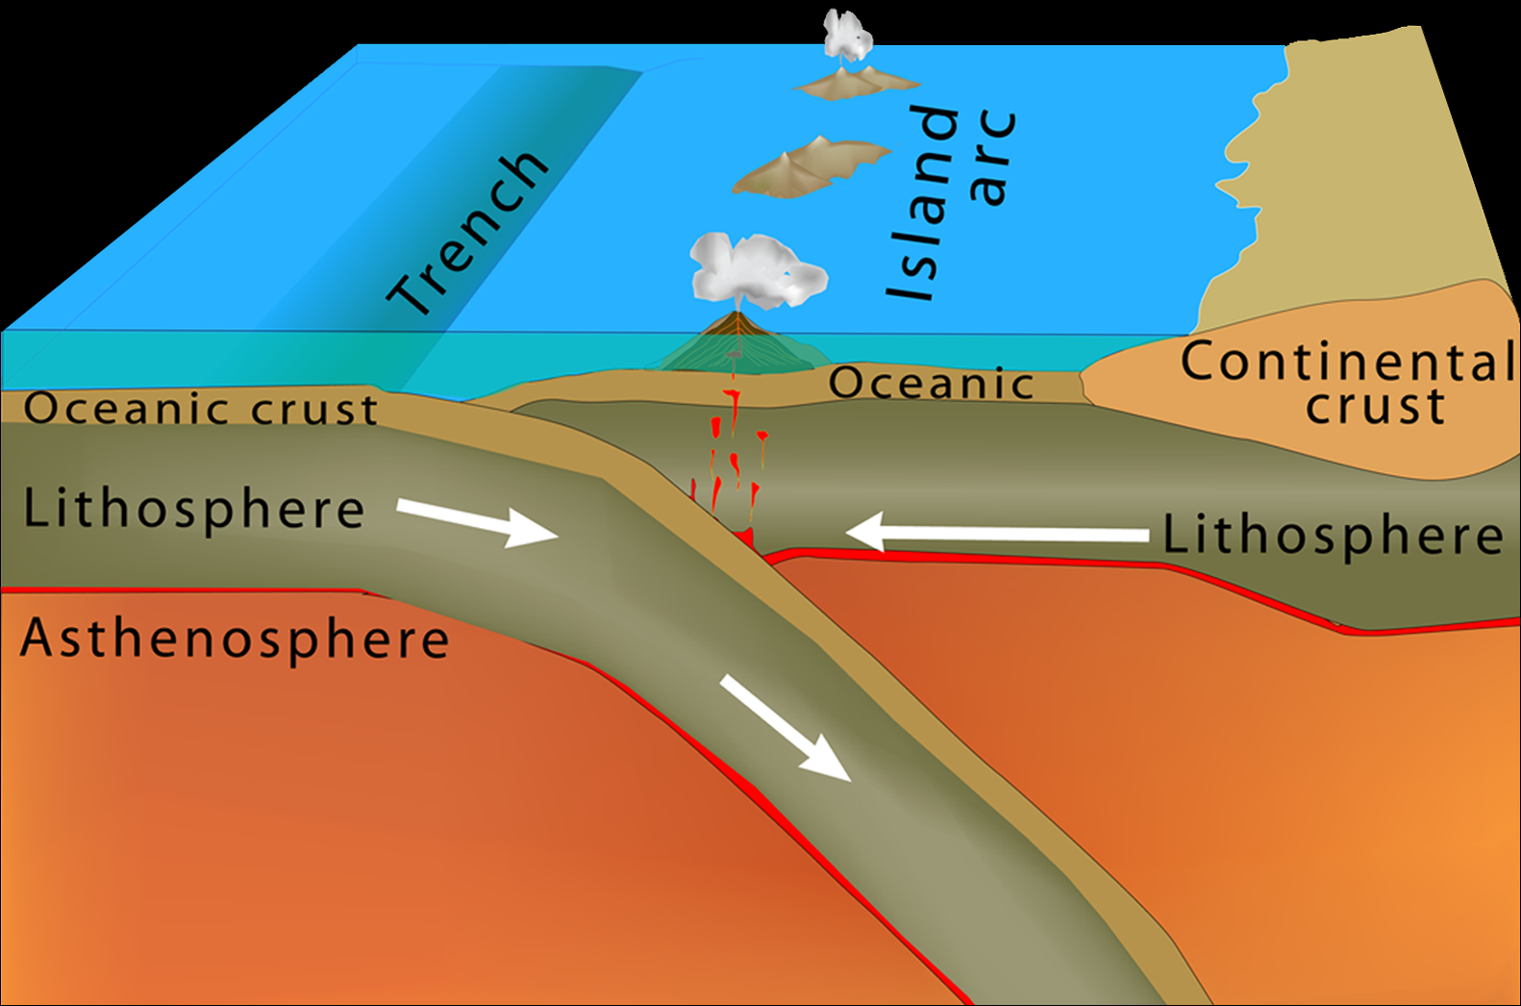
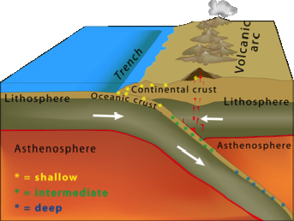
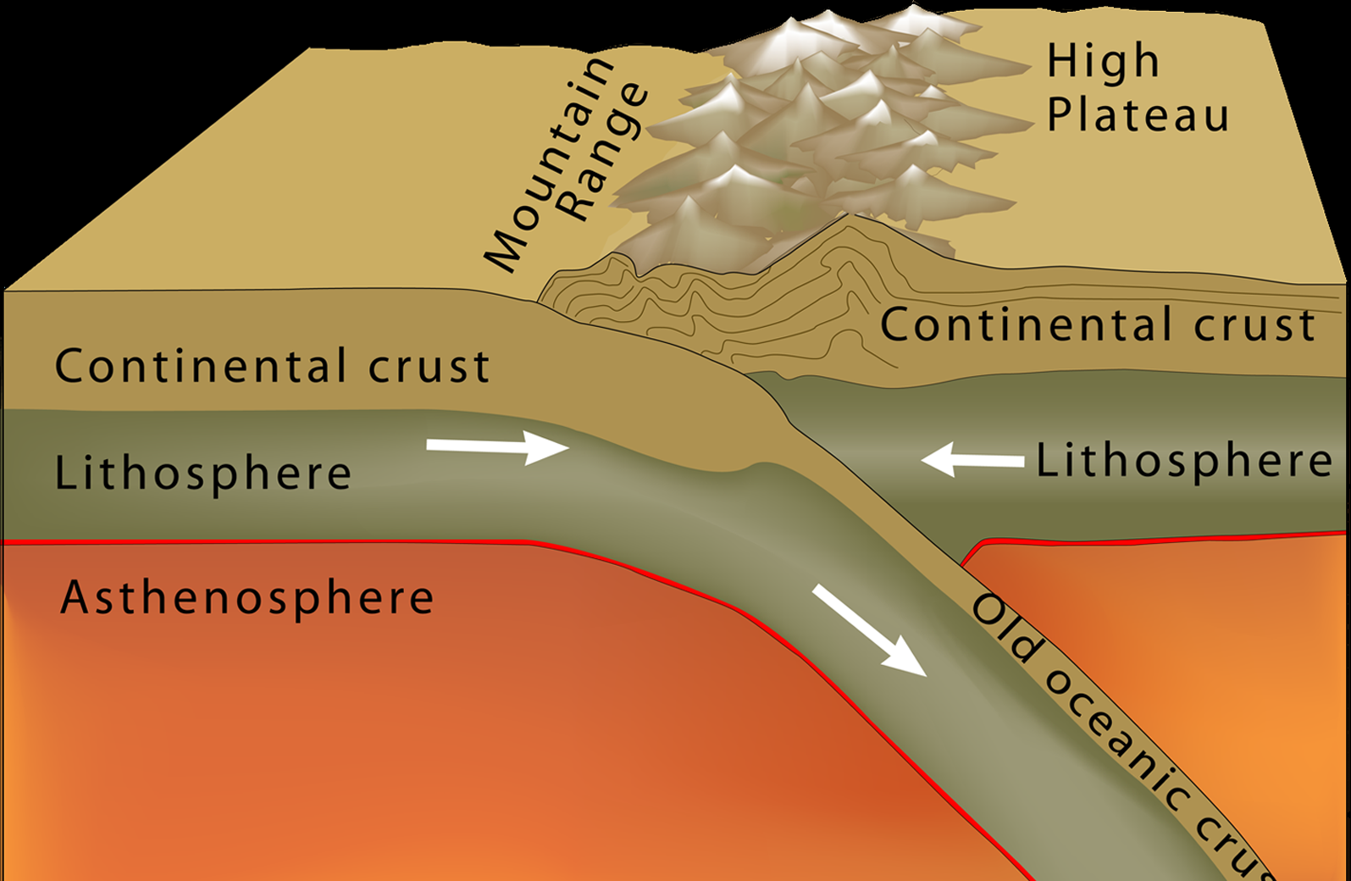
Convergent Plate Boundaries
Plates push together.
A) The denser plate
subducts, or
B) two continental plates
crunch together to
form high mountains.
Ocean /Ocean convergence (Marianas)
Ocean /Continent convergence (Cascades)
Continent/Continent Collision (Himalayas)
Next slide: Why and where would earthquakes occur in convergent boundaries?
Notes:
The most complex kind of boundary is convergent plate boundaries. We distinguish three kinds of convergent boundaries:
1. Two oceanic plates converge and one plate subducts (as in the Marianas Trench of the western Pacific Ocean).
2. An oceanic plate converges with a continent plate and subducts beneath the “leading edge” of the continent (as in the Cascadia subduction zone of the Pacific Northwest or at the Peru – Chile Trench along the western side of South America).
3. Two continental plates converge resulting in a “geologic train wreck” where continental crust piles up to form a mountain range (as in the Himalayas where the Indian and Asian plates collide). Remember that rocks of the continental crust are lower density than mantle rocks, so continental crust cannot “subduct” into the mantle. If continental rocks are pushed into the mantle, they will pop up again like a piece of Styrofoam pushed into a swimming pool.

Slide 17
Earthquakes along Convergent Zones with
Subducting Oceanic Lithosphere
Shallow earthquakes:
The most destructive of these
occur between the plates
on the plate boundary.
Shallow earthquakes also occur
within the subducting plate
and within the overriding
plate near the plate boundary.
Intermediate and Deep earthquakes:
The depth range defined as “intermediate” is 100 – 300 km deep
while “deep” earthquakes are in the 300 – 700 km depth range. Intermediate and deep earthquakes occur only within the subducting oceanic lithosphere.
Notes:
An oceanic plate dives into the deeper mantle at a convergent plate boundary in a process called “subduction”. When introducing subduction, it is important to reinforce that earthquakes occur only in brittle rocks that are cold enough to fracture when exposed to large forces. If rocks are too warm, they will not be brittle and cannot break to produce earthquakes. Most rocks at depths greater than 100 km are too warm to be brittle. So intermediate (100 - 300 km depth) and deep (300 - 700 km depth) earthquakes only occur within the subducting oceanic plate. This plate is still cold enough to fracture at these depths because it takes millions of years for it to warm up as it subducts into the deeper mantle. The asthenospheric mantle cannot generate earthquakes because it is too warm to be brittle. Instead it is “viscoelastic”, like silly putty.
Colors match the color scheme of Slides 5 and 6; yellow is shallow, green is intermediate, blue is deep
VIDEO LECTURE: “Brittle fracture” and “Brittle and ductile deformation” on Teachers on the Leading Edge web site. URLs:
http://multimedia2.up.edu/Physics/TOLE/Plates&Earthquakes/VideoLectures/BrittleFracture-Butler.mov
http://multimedia2.up.edu/Physics/TOLE/Plates&Earthquakes/VideoLectures/BrittleVsDuctile.mov

Slide 18
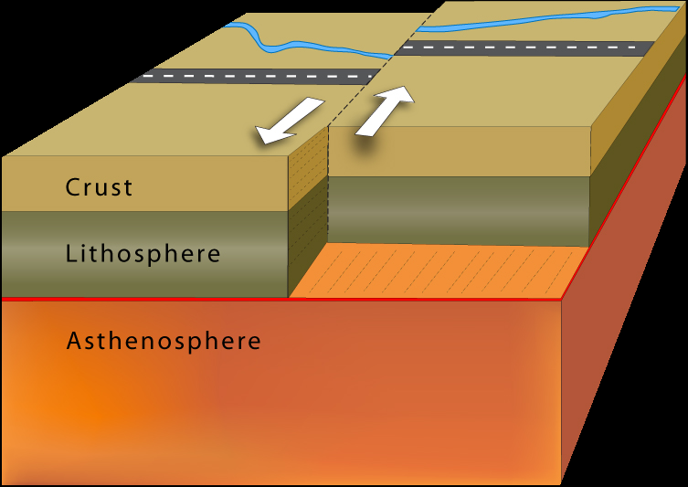
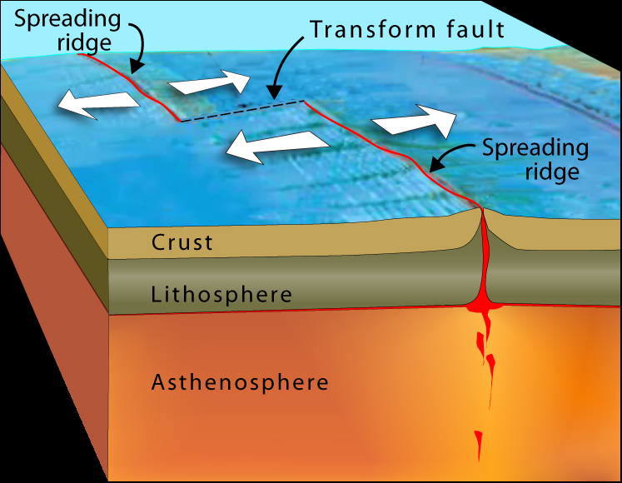
Transform Boundaries
Lithosphere is neither produced nor destroyed as the plates slide horizontally past each other.
Strike-slip fault
Strike-slip fault between two spreading ridges
allows the two plates to move apart.
Example:
San Andreas Fault, California
Notes:
Motion of plates across transform boundaries is purely horizontal. Along a transform boundary, plates are moving PARALLEL to the boundary between them. Earthquakes occur as the plates grind in “jerky” motions past each other. The strain buildup is greater on transform faults separating plates with continental crust (like the San Andreas Fault) than on transform faults faults separating plates with oceanic crust (like on the hundreds of transform boundaries that offset segments of spreading oceanic ridges).
A note about “Fracture Zones” in the oceans: When considering oceanic plates, remember that “older” means “colder” and “colder” means lower elevation because the plate shrinks as it cools. So the top of an older piece of an oceanic plate is deeper than the top of a younger piece of an oceanic plate. This means that there can be a small difference in elevation (a “scarp”) where older and younger parts of an oceanic plate are adjacent to each other (e.g. across the transform fault on the right diagram of this slide). Along most parts of active transform faults in the oceans, there are offsets in the depth of the ocean floor. Oceanic fracture zones (like the Mendocino Fracture Zone off the coast of northern California) are the locations of presently active (or formerly active) transform faults that separate pieces of oceanic plates of different ages and therefore different elevations.

Slide 19
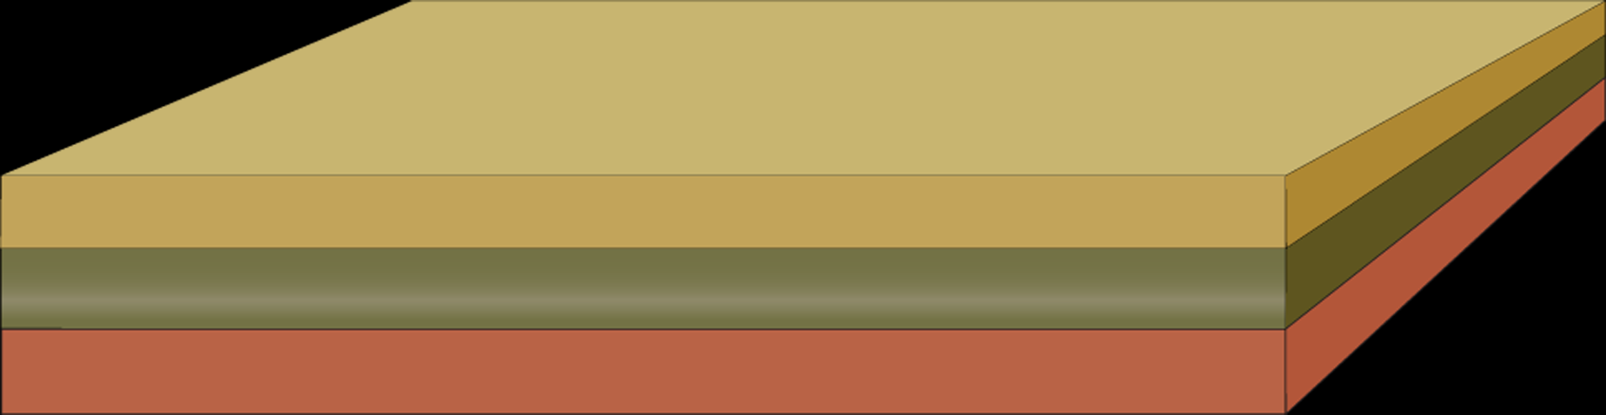
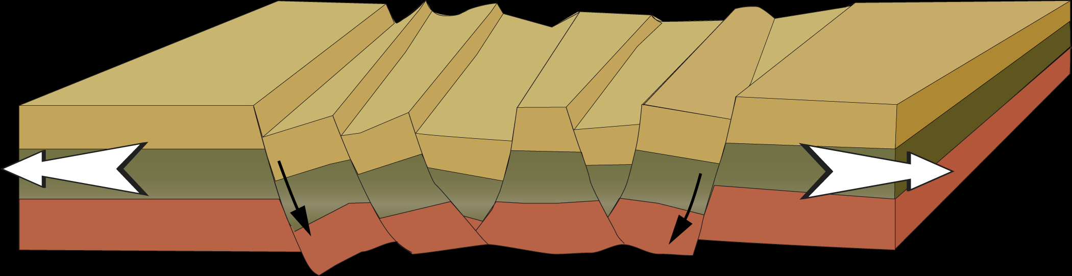
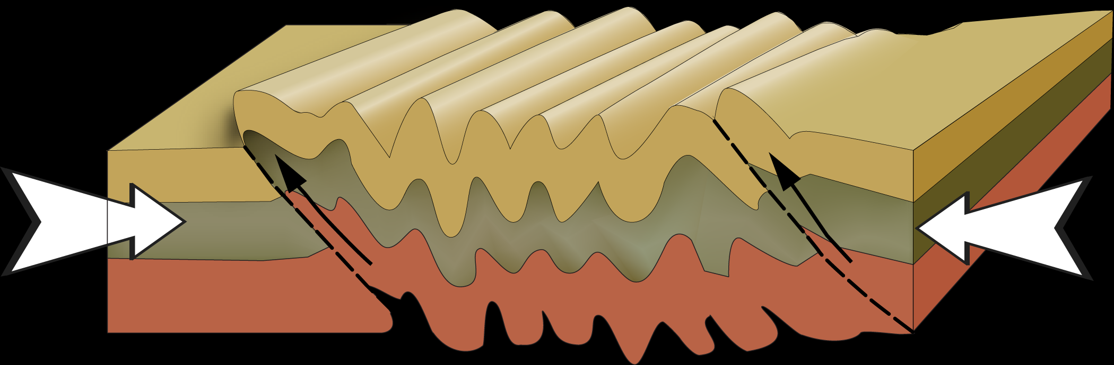
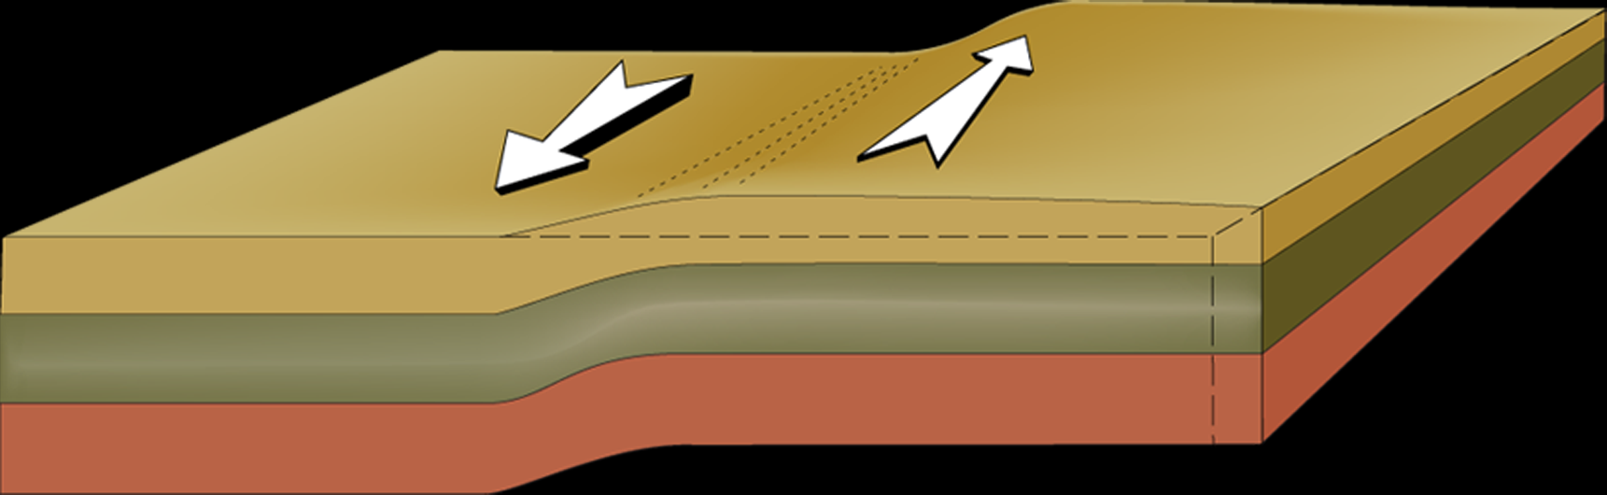
Deforming Earth’s Crust
Types of stress: Extension, Compression, Shear
Undeformed beds: no stress applied.
Extension makes faults and regional
thinning. (Ex., Basin & Range.)
Compression makes faults and folds.
(Ex., Rocky Mountains.)
Shearing displaces layers horizontally
and can result in strike-slip faulting.
(Ex., San Andreas Fault, California.)
Notes:
WHAT IS STRESS? Stress = force per unit area, like pounds per square inch or newtons per square meter. We can classify stresses as : 1. Extension = stresses that pull materials apart. 2. Compression = stresses that squish materials together. 3. Shearing = stress that bend materials. For rocks in Earth’s crust, extension tends to break rocks forming faults. Compressional stresses can result in either folding or faulting. Shearing stresses can result in folding or faulting. Animations on next slide may clarify these kinds of stress.

Slide 20
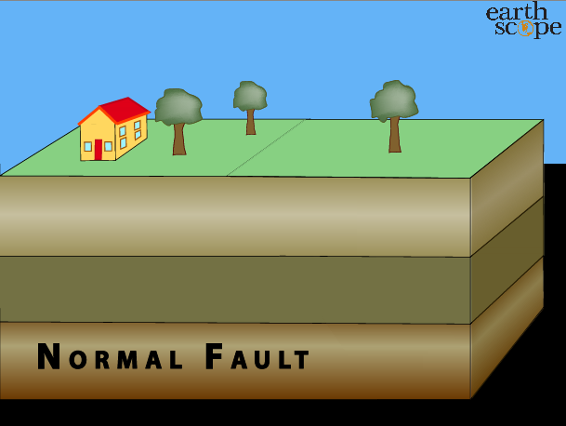
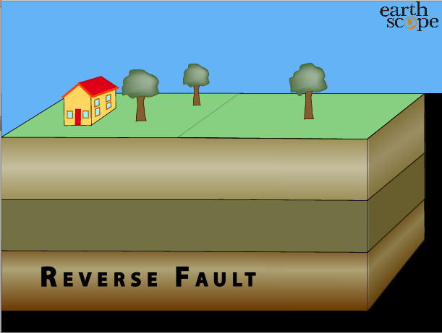
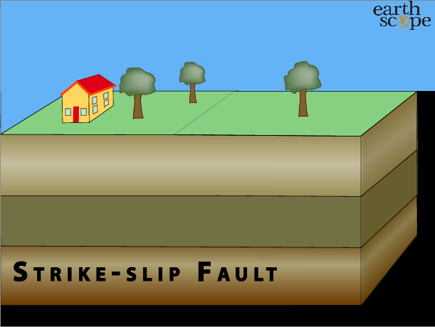
Types of Faults
Normal Reverse Strike-slip
Links to animations are provided in the Notes panel in normal view.
Can you think of examples of each?
Watch video lecture
“Foam fault demonstrations”
Activity: Foam models of faults.
Notes:
ANIMATIONS: These animations can be found on the TOTLE web site under “Animations” under the topic “Introduction to Plate Tectonics and Earthquakes”.
Normal Fault URL: http://multimedia2.up.edu/Physics/TOLE/Plates&Earthquakes/Animations/Faults&PlateBoundaries/NormalFault.mov
Reverse Fault URL: http://multimedia2.up.edu/Physics/TOLE/Plates&Earthquakes/Animations/Faults&PlateBoundaries/ReverseFault.mov
Normal Fault URL: http://multimedia2.up.edu/Physics/TOLE/Plates&Earthquakes/Animations/Faults&PlateBoundaries/StrikeSlipFault.mov
VIDEO LECTURE: “Foam fault demonstrations” on Teachers on the Leading Edge web site under “Videos” under the topic “Introduction to Plate Tectonics and Earthquakes”. URL http://multimedia2.up.edu/Physics/TOLE/Plates&Earthquakes/VideoLectures/FoamFaultModels.mov
CLASSROOM ACTIVITY: For classroom lesson plans that can help students understand different kinds of faults and different kinds of plate boundaries, see “Teaching About Faults Using Foam Models”, “Types of Faults #1”, and “Types of Faults #2” on Teachers on the Leading Edge web site under “Lesson Plans” under the topic “Introduction to Plate Tectonics and Earthquakes”.
Definitions of types of faults:
Normal Fault In a normal fault, the block above the fault moves down relative to the block below the fault. This fault motion is caused by tensional forces and results in extension. [Other names: normal-slip fault, tensional fault or gravity fault]
Reverse Fault In a reverse fault, the block above the fault moves up relative to the block below the fault. This fault motion is caused by compressional forces and results in shortening. A reverse fault is often called a thrust fault, if the dip of the fault plane is shallow. [Other names: thrust fault, reverse-slip fault or compressional fault]
Strike-slip Fault In a strike-slip fault, the movement of blocks across the fault is horizontal. If the block on the opposite side of the fault moves to the left (as shown in this animation), the fault is called a left-lateral strike-slip fault. If the block on the far side moves to the right (like along the San Andreas Fault), the fault is called a right- lateral strike-slip fault. Strike-slip faults are caused by shearing forces. [Other names applied to various types of strike-slip faults: transcurrent fault, lateral fault, tear fault or wrench fault]

Slide 21
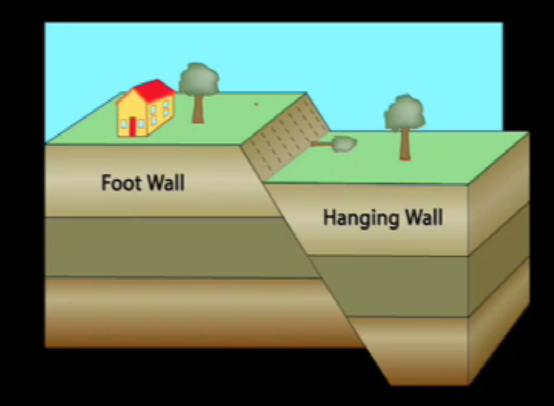
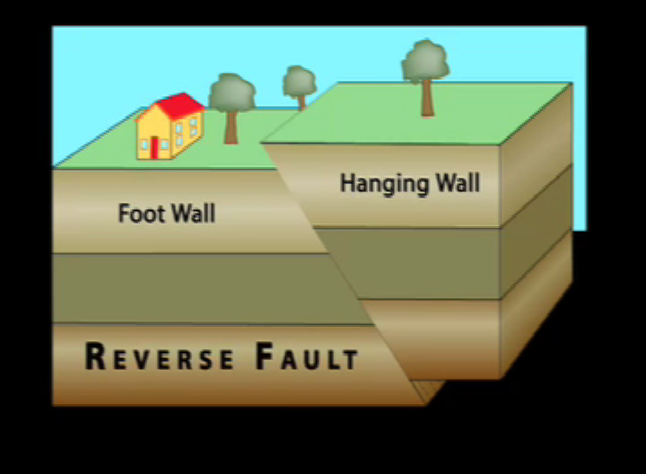
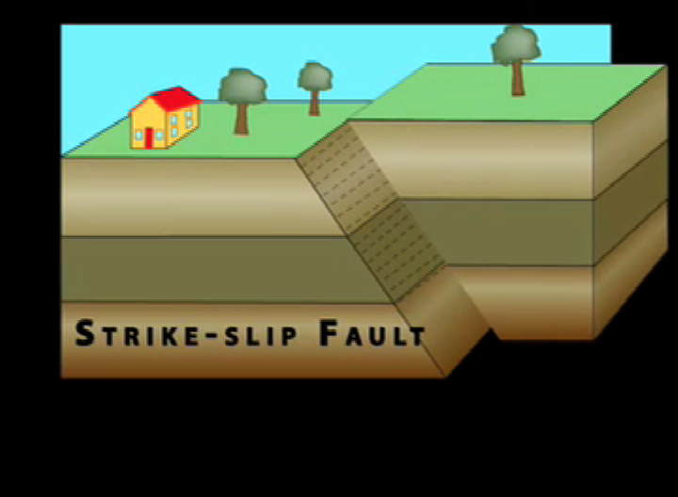
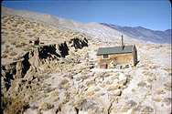
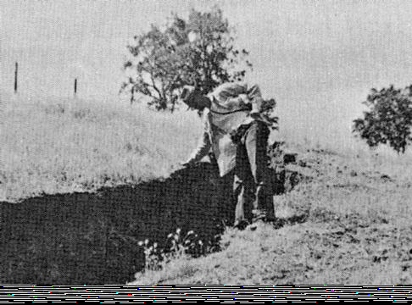
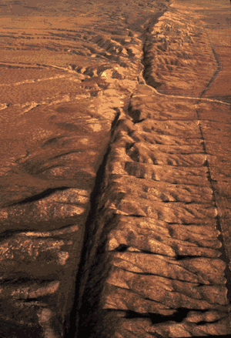
Normal Reverse Strike slip
Basin & Range Himalayas San Andreas, Calif.
African Rift Rocky Mountains N. Anatolian, Turkey
USGS photographs
Notes:
See notes section of previous slide for supporting information on types of faults.

Slide 22
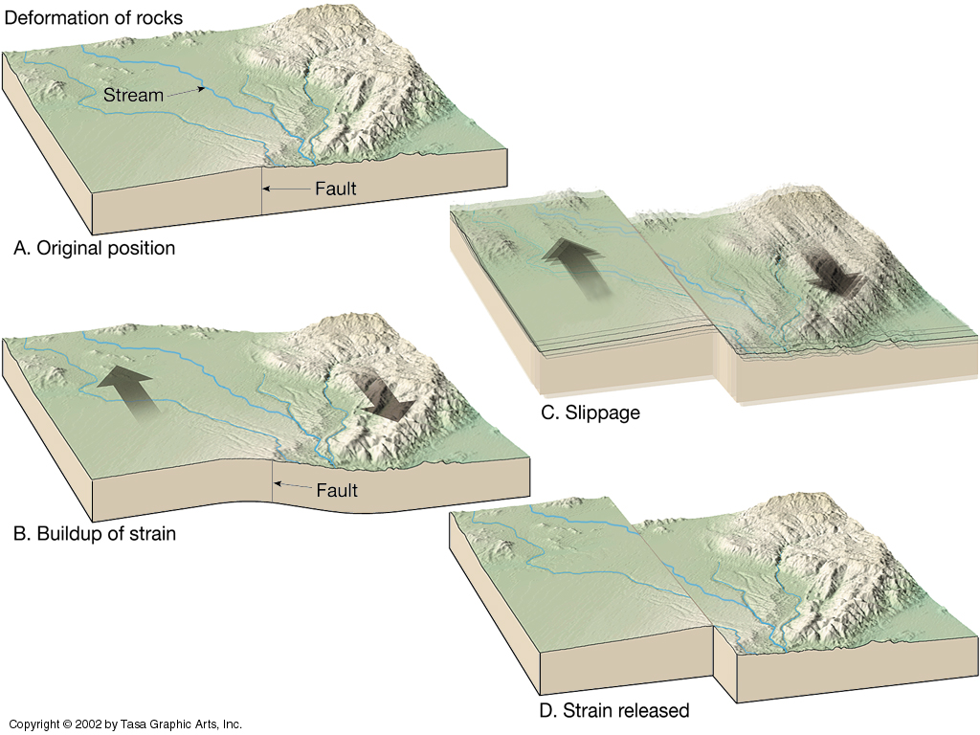
Elastic Rebound Theory—Stick-slip
Jerky motions on faults produce earthquakes
Three Fs of earthquakes: Forces, Faults, and Friction.
Notes:
The mechanics of earthquakes. Basically earthquakes result from the “jerky” motion of rocks along faults. Slip on faults generally does not occur in a smooth, steady fashion but rather as a series of jerks. “Elastic rebound theory” was developed by J.R. Reid during his studies of the San Andreas Fault after the disastrous 1906 San Francisco earthquake. This four-part diagram presents the essence of elastic rebound theory on a strike-slip fault. Between A and B, forces slowly bend rocks adjacent to the fault. Strain energy is stored in the rocks as they are bent. C. When stress along the fault exceeds the strength of rocks on the fault, the rocks on opposite sides of the fault suddenly snap producing an earthquake. D. The rocks on opposite sides of the fault end up in a new position with much of the stored strain energy released by the earthquake. Then the “earthquake cycle” starts again. The interaction of forces, faults, and friction (the 3 Fs) controls earthquakes.
CLASSROOM ACTIVITY: For classroom lesson plans that can help students understand the “Three Fs of Earthquakes”, see “Earthquake machine” on TOTLE web site under “LESSON PLANS” under the topic “Introduction to Plate Tectonics and Earthquakes”.
However, you may wish to view the PowerPoint presentation “Earthquake Seismology” that provides more background on earthquakes before you
TASA Figure 219t. Graphics from Tasa Graphic Arts Inc (http://www.tasagraphicarts.com/) : Copyright protected: The content may only be used for personal, educational or noncommercial purposes.

Slide 23
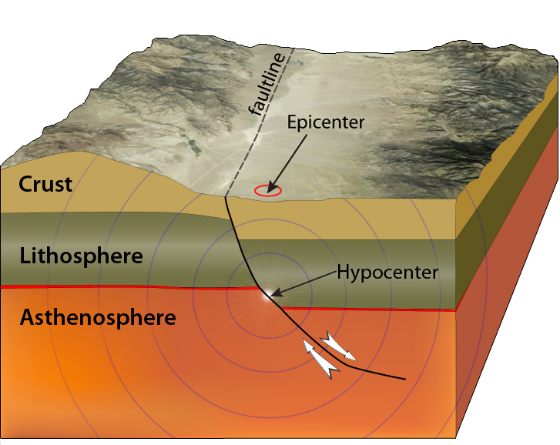
Focus (or hypocenter):
Location within the Earth where the earthquake occurred.
Epicenter & Focus of Earthquakes
Epicenter:
Location on Earth’s surface directly above the earthquake.
Watch video lecture “Earthquake focus (hypocenter) and epicenter”
Notes:
VIDEO LECTURE: “Earthquake focus (hypocenter) and epicenter” on TOTLE web site under “VIDEOS” under the topic “Introduction to Plate Tectonics and Earthquakes”.
URL http://multimedia2.up.edu/Physics/TOLE/Plates&Earthquakes/VideoLectures/Hypocenter.mov
Some A, B, Cs of earthquakes: Earthquakes occur along faults IN the Earth, NOT on the surface of the Earth. The actual place in the Earth where an earthquake occurs is called the “Focus”, also called the “hypocenter.” This diagram shows the earthquake waves (seismic waves) moving out from the earthquake focus. The “Epicenter” is the place on the surface of the Earth directly above the earthquake. In news media reports about earthquakes, the epicenter is often reported. This location is generally where the earthquake damage will be greatest because it is the surface point closest to the earthquake. To describe where in the Earth an earthquake occurred, you must indicate the “epicenter” AND the depth of the earthquake.
More information and teaching resources on earthquakes can be found on TOTLE web site under the topic “Earthquake Hazards, Damage, and Mitigation”.

