Slide 1
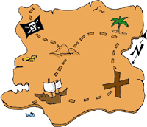

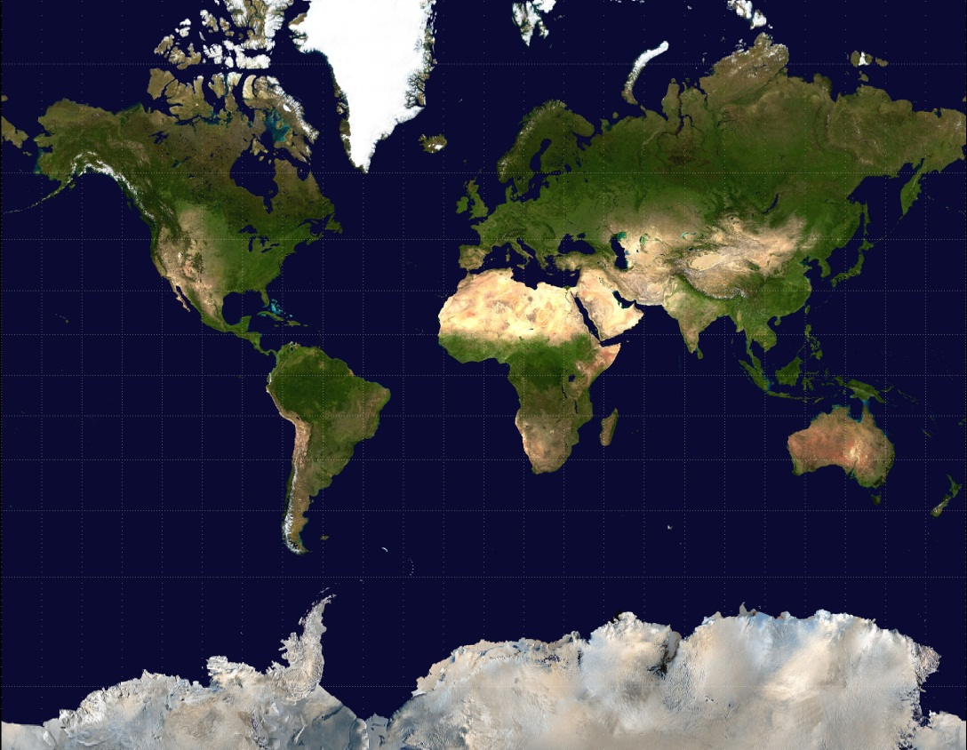
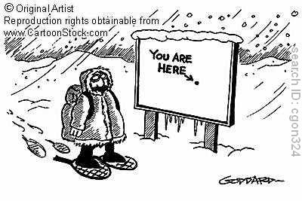

Map Projections and Map Terms
IES SAN JUAN BAUTISTA
MARÍA SANZ

Slide 2



What happens when you peel an orange?
Hi…….
Please don’t eat me
……..

Slide 3

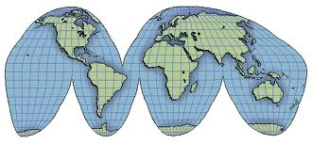


What happens when you peel the world?

Slide 4
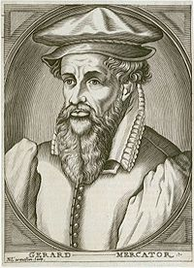
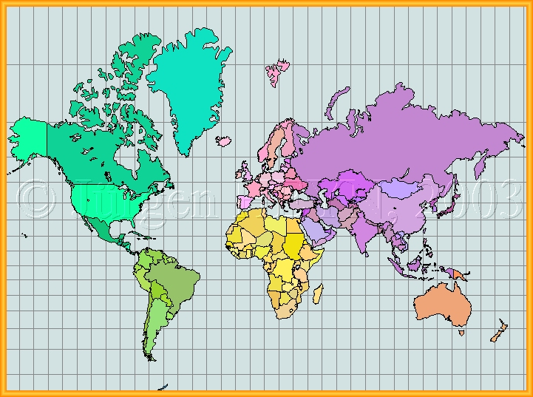

I got this!!!!! Just stretch it out
………………

Slide 5
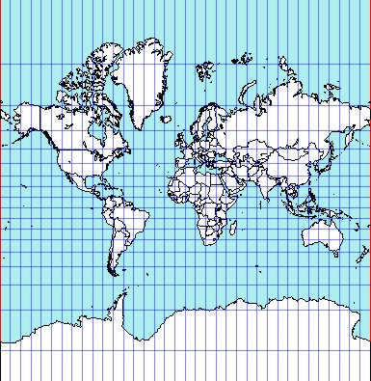

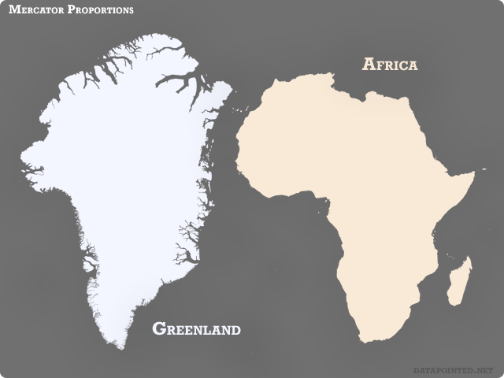
Mercator Projection
Greenland is HUGE!!!!!!!
Wow!! North America makes South America look puny.

Slide 6
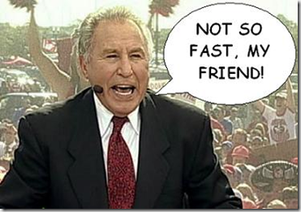

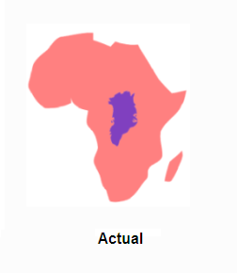
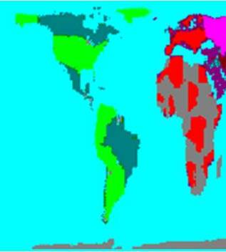

It’s all about the ships yo!!!!
..……………

Slide 7

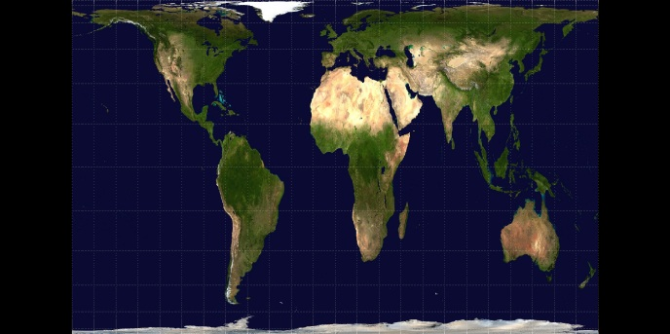
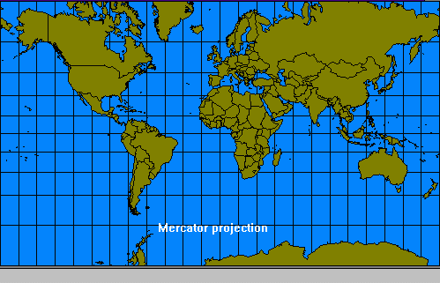
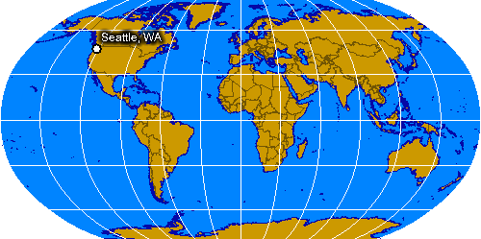
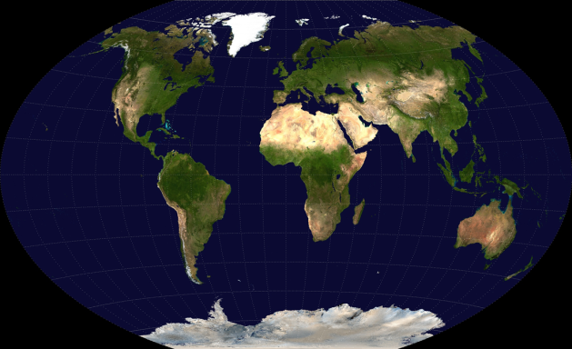
Map Projection
Peters
That just happened!!
………….
Robinson
Mercator
Winkel Tripel

Slide 8
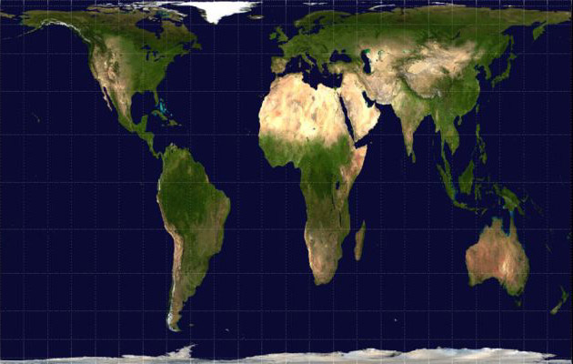

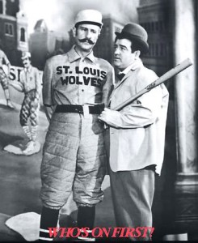
Who’s on first???
Yes!!!
http://www.youtube.com/watch?v=vVX-PrBRtTY

Slide 9



Map projection – taking a three dimensional object (Earth), and representing it in a two dimensional aspect (Map).
Mercator Projection – exaggerated land features to maintain accuracy in water features and straight lines. There were no planes, trains, and automobiles back then. Think ships and keeping them on course

Slide 10
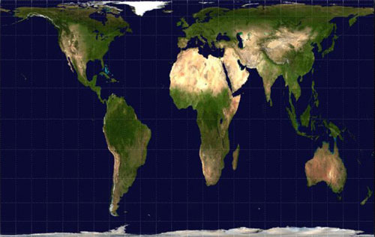


Peters Projection – land surface is represented more
accurately, but in doing so, elongates the continents to
achieve this.
Peter

Slide 11


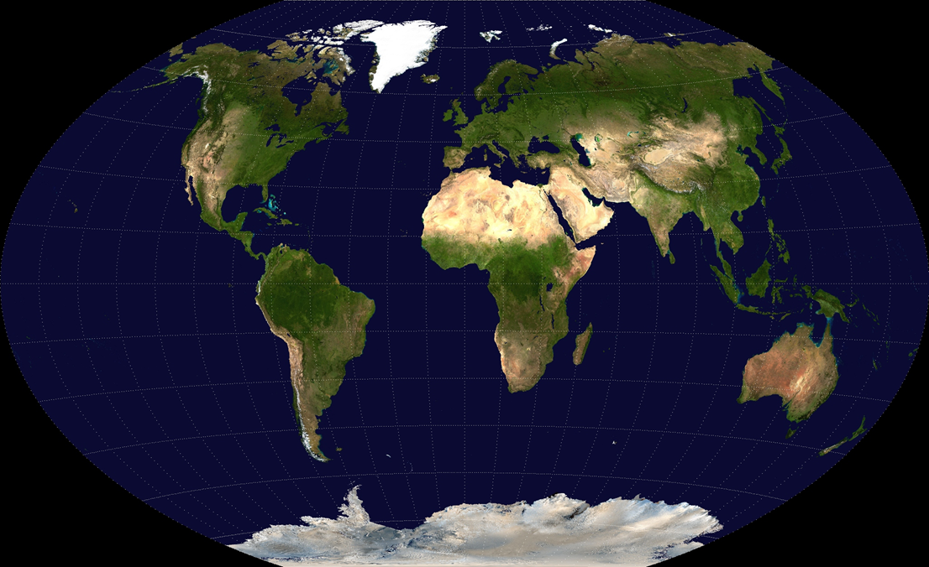
Winkel Tripel Projection – and others similar are versions that attempt to eliminate the distortion in square maps and maintain more accurate size and proximity

Slide 12


Maps Maps Maps Maps Maps
So now that we know why a map looks like it does, let’s work on map terms and types of maps
Compass Rose
Arctic Circle
Scale
Latitude/Parallel
Key/Legend
Longitude/Meridian
Antarctic Circle
Equator
Tropics of Cancer and Capricorn
International Date Line

Slide 13

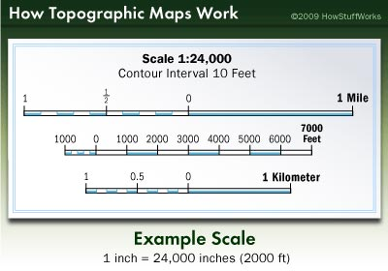
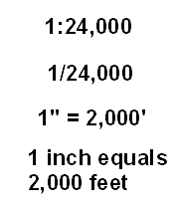
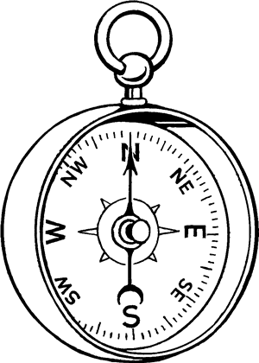
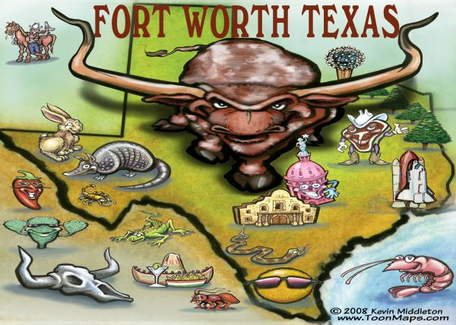
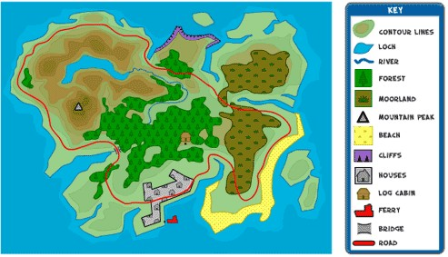

Compass Rose
Scale
Map Key
+

Slide 14


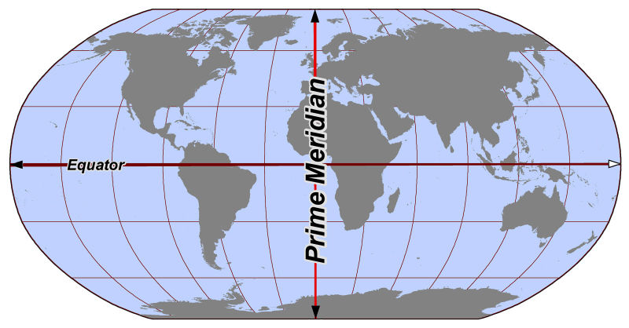

Latitude/Parallel
Longitude/Meridian
(East and West)
(North and South)
Equator – the main belt…zero line of latitude
Prime Meridian – the main buttons…zero line of longitude

Slide 15
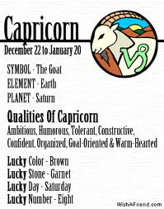

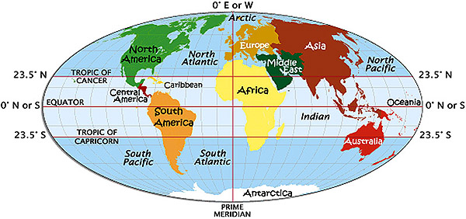
Tropics of Cancer and Knee Capricorn

Slide 16
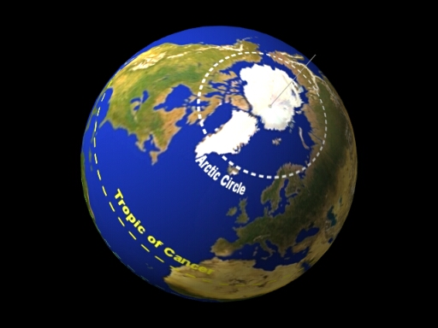
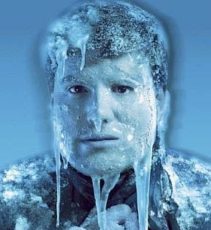
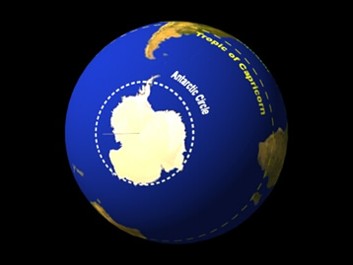
Arctic Circle
Cold
By the way North
By the way South
Just as Cold
Antarctic Circle

Slide 17
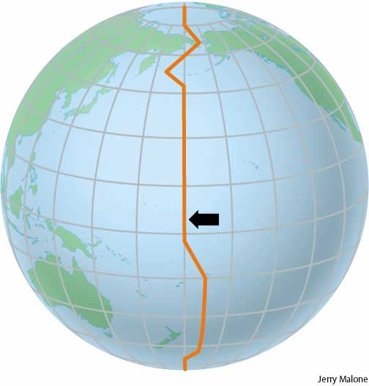

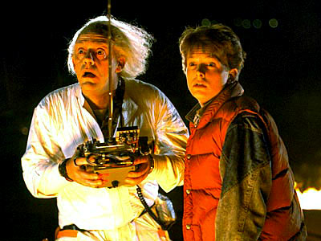
International Date Line
Hour 24
Hour 1

Slide 18
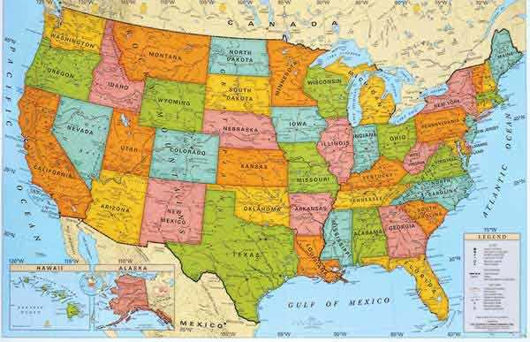
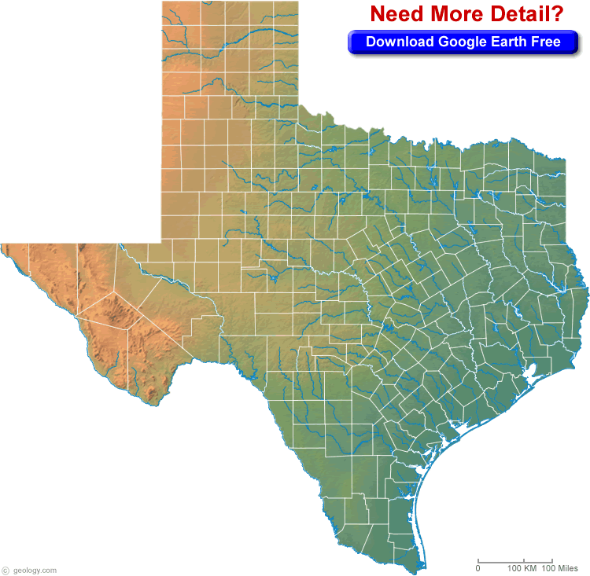
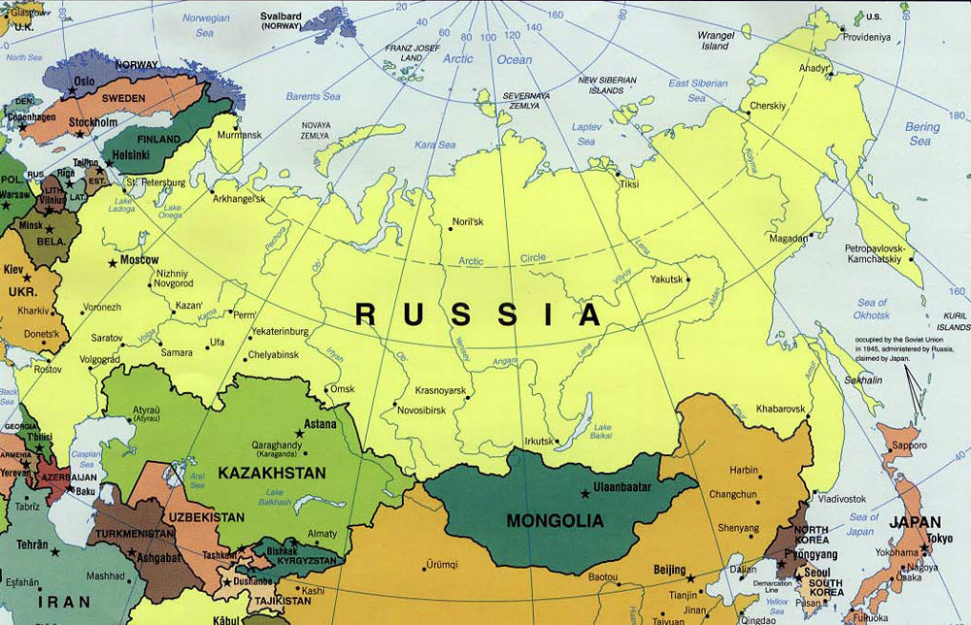
Types of Maps
Political Map
Hint – shows borders of
nations, states, counties
etc…

Slide 19
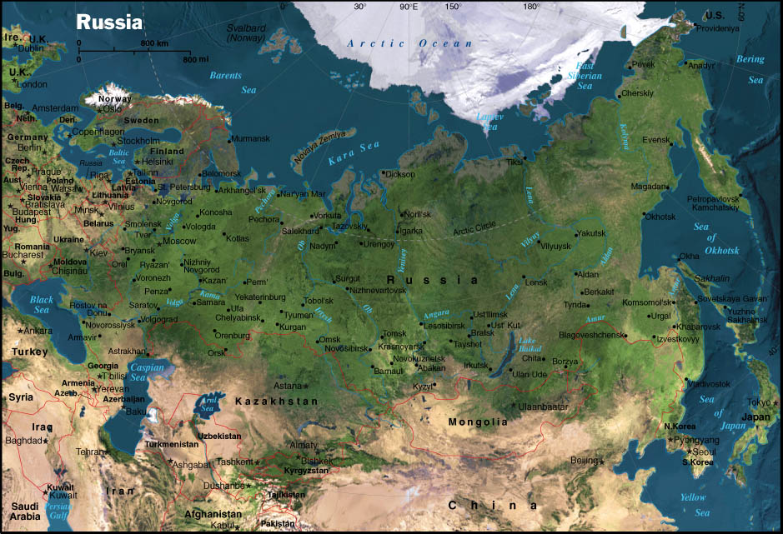
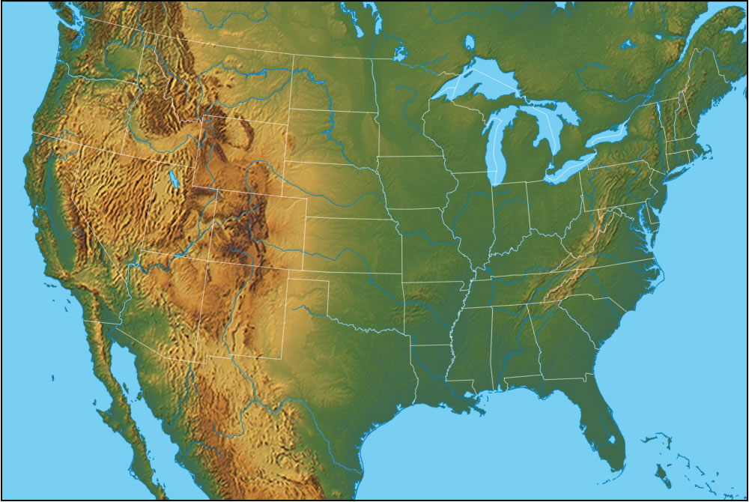
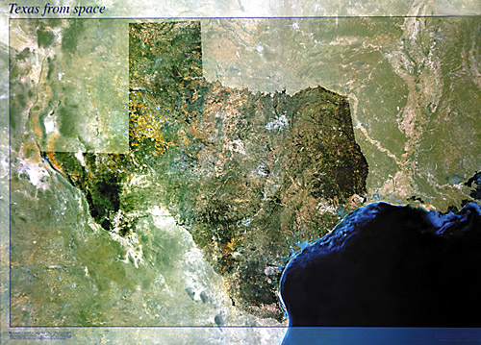
Physical Map
Hint – physical
features. Water,
mountains, plains
etc….

Slide 20
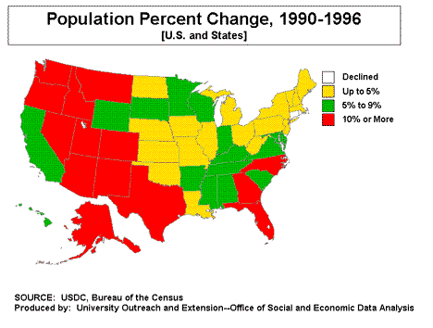
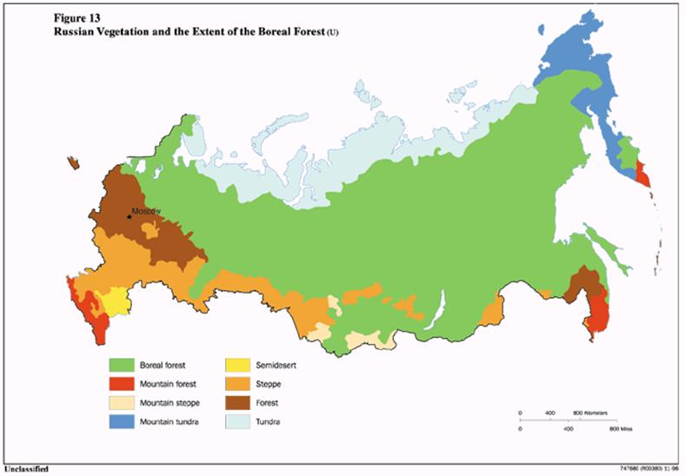
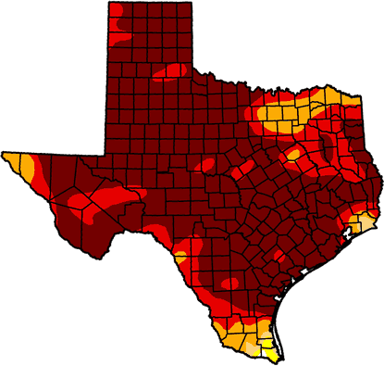
Thematic Map
Hint – there is some
type of theme

Slide 21

That’s All Folks

