Slide 1
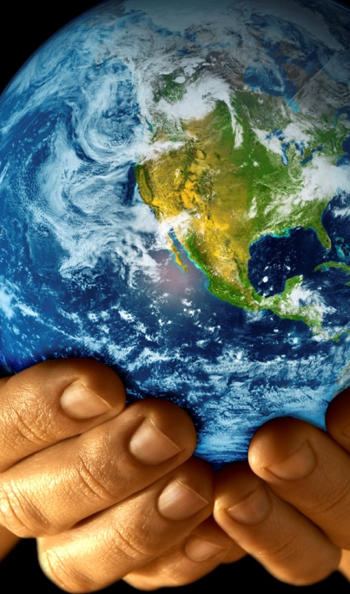
Different Landforms

Slide 2
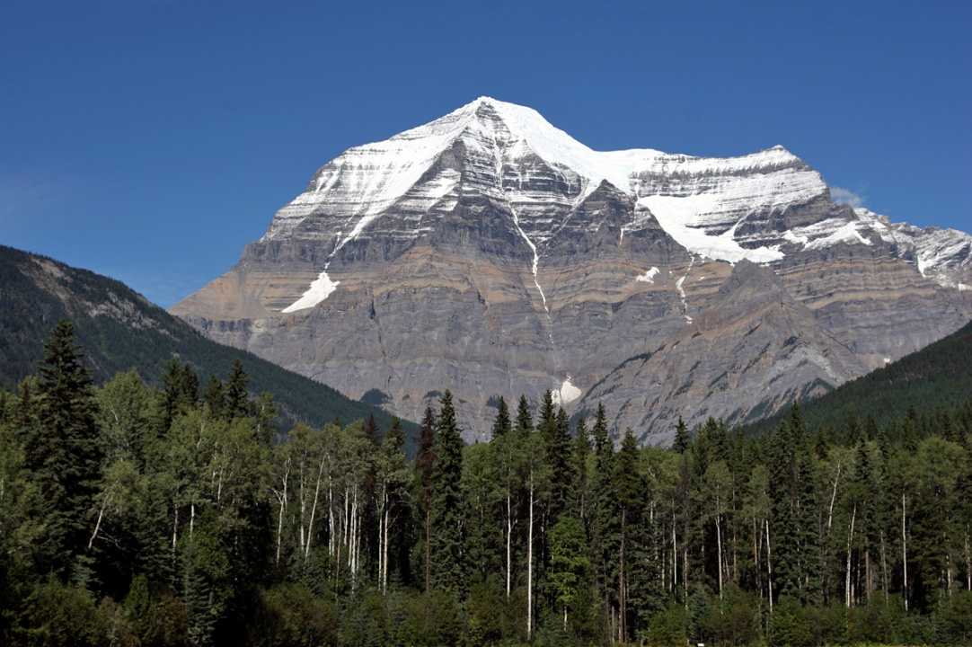
mountain
A mountain is a place on Earth’s surface that is much higher than the land around it.

Slide 3
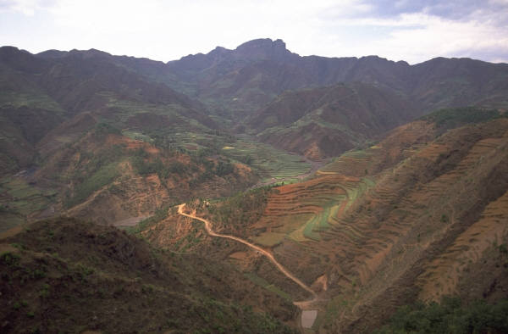
valley
A valley is a low area between higher lands such as mountains.

Slide 4
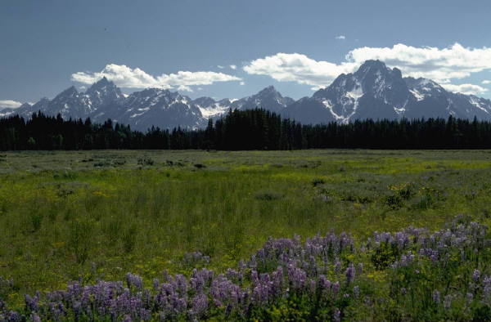
plain
A plain is a flat area on Earth’s surface.

Slide 5
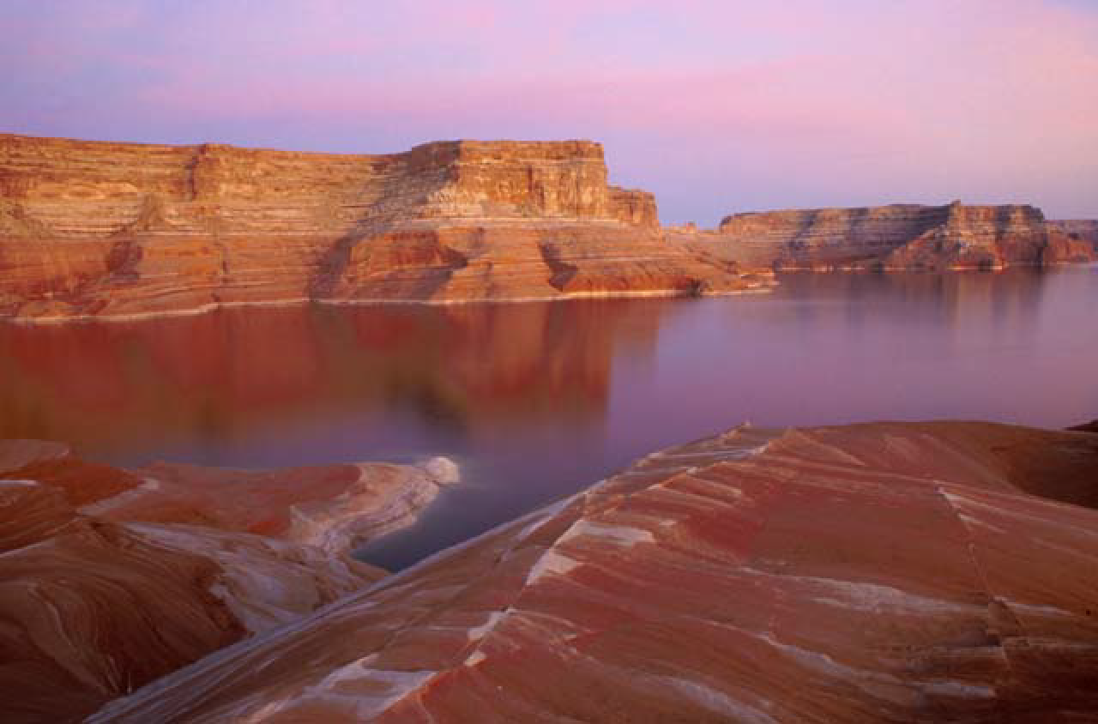
plateau
A plateau is a flat area higher than the land around it.

Slide 6
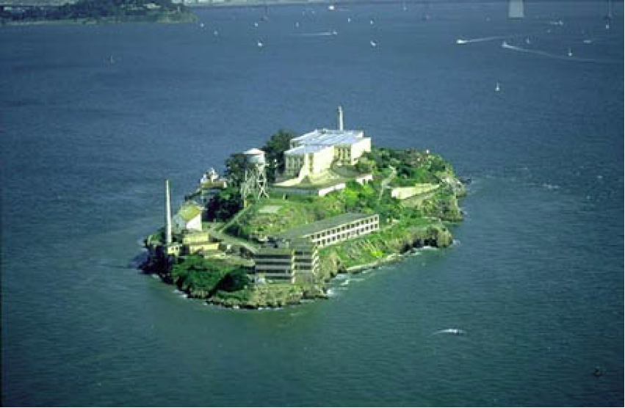
island
An island is land that has water all around it.

Slide 7
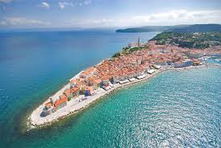
peninsula
A strip of land that extends out into a body of water

Slide 8
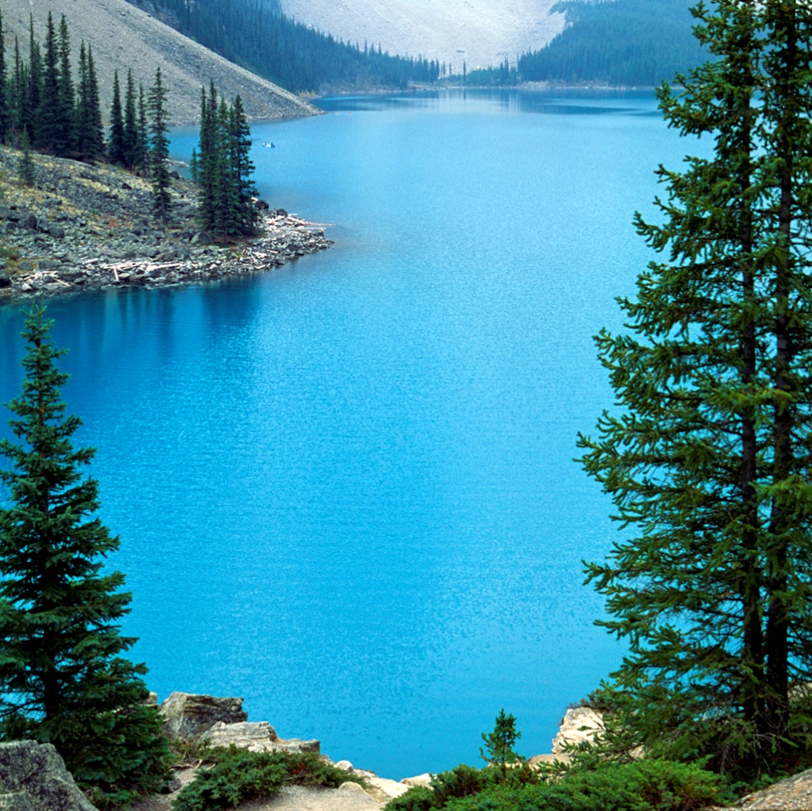
lake
A lake is water that has land all around it.

Slide 9
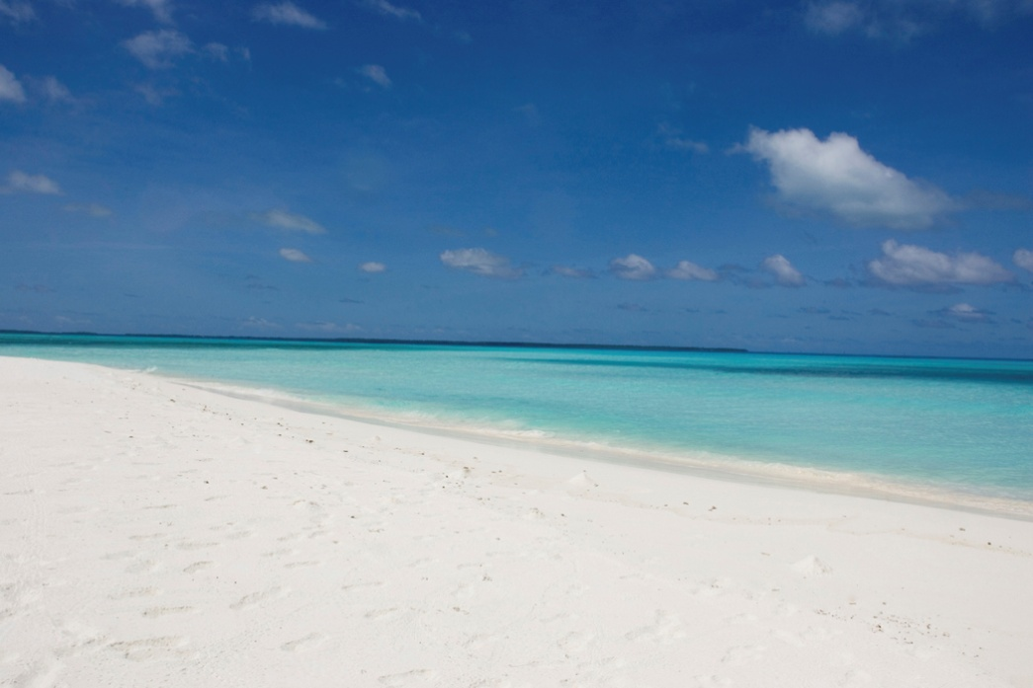
ocean
Oceans are the largest bodies of water on earth.

Slide 10
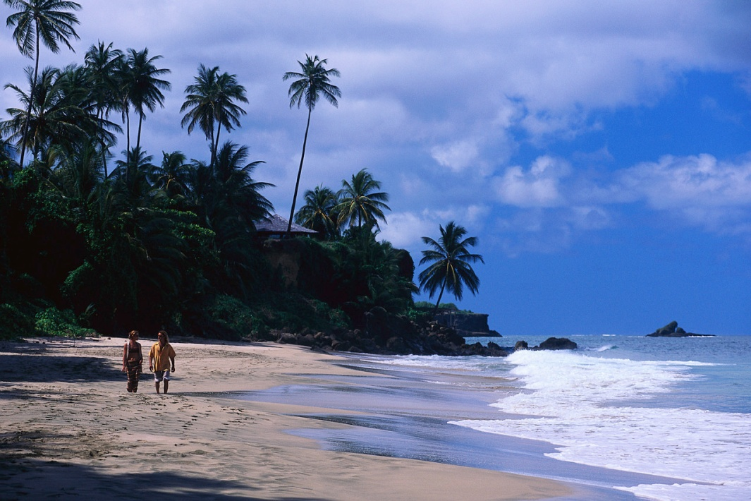
coast
A coast is the area where the ocean touches the land.

Slide 11
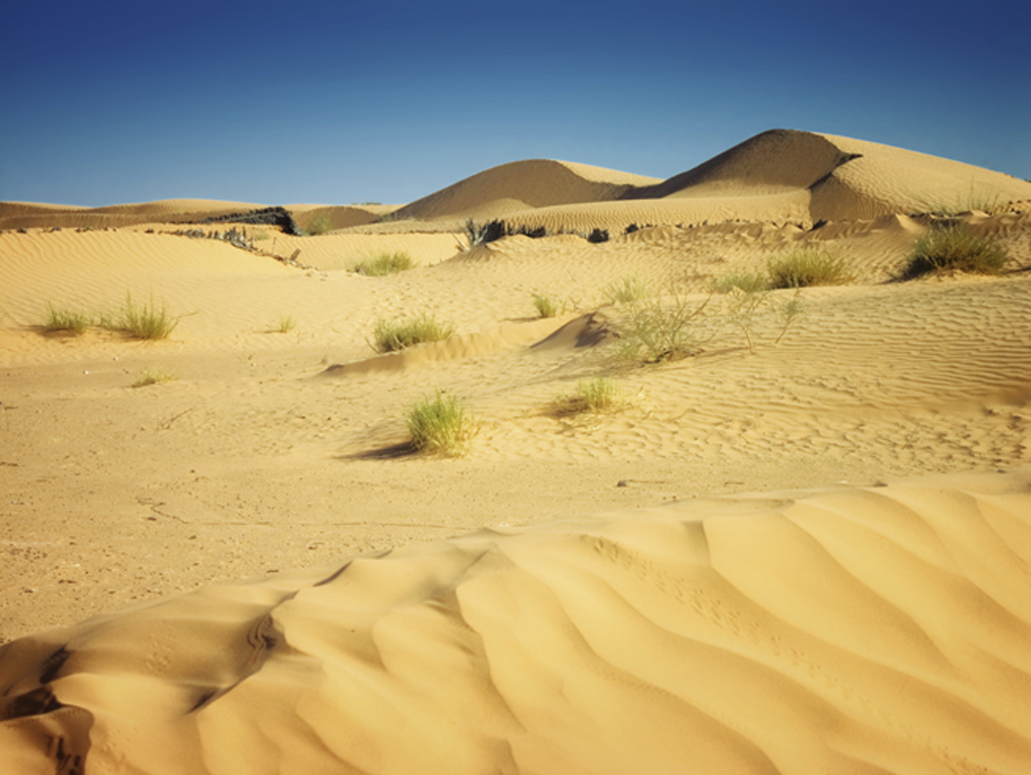
desert
A desert is a hot dry place with little or no rain.

Slide 12
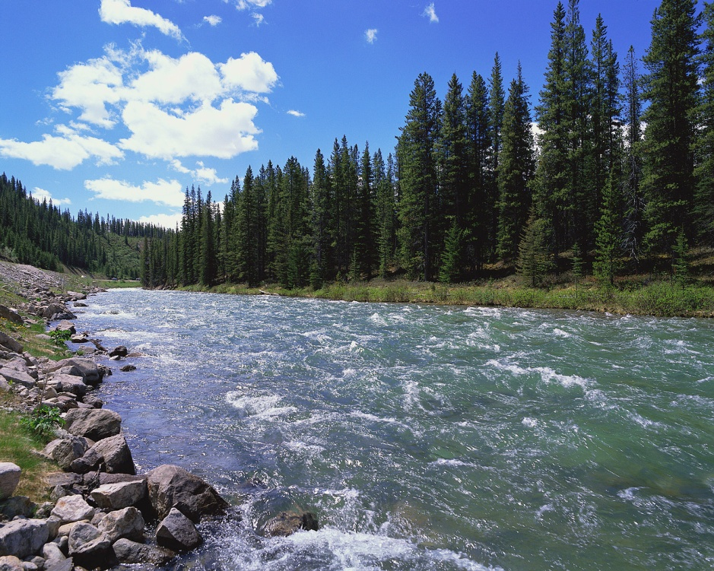
river
A river is a long flowing body of water.

Slide 13
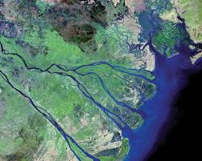
delta
low, water area that is formed at the mouth of a river

Slide 14
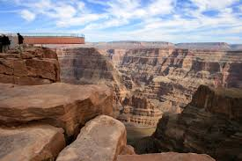
canyon
A large crack in the earth formed by a river or earthquakes

Slide 15
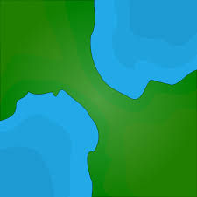
isthmus
A narrow strip of land that connects two large areas of land

Slide 16
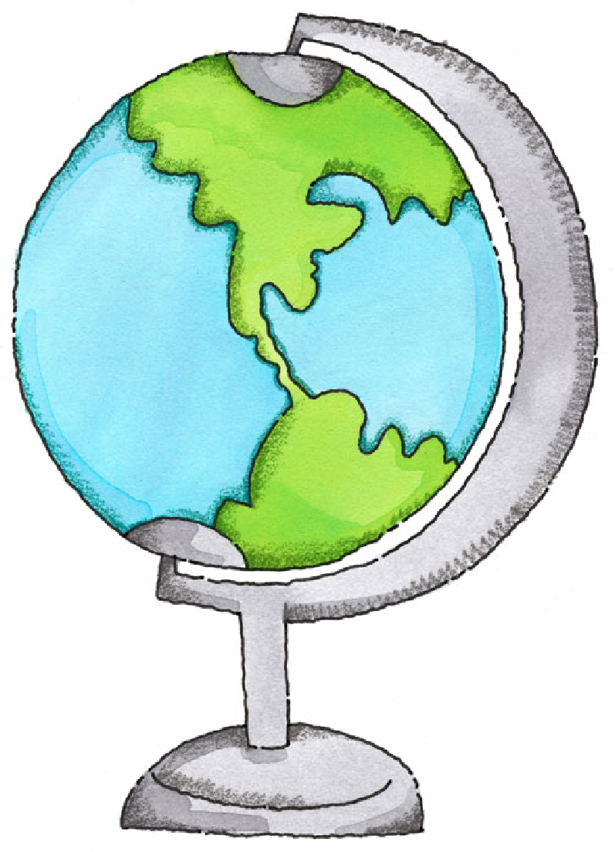
Now let’s review!

Slide 17

A _________ is water with land all around it.
Ocean
Island
Lake
Hint

Slide 18

What is the largest body of water on Earth?
Ocean
Lake
River
Hint

Slide 19

A _______ is higher than the land around it.
Island
Mountain
Valley
Hint

Slide 20
What is a flowing body of water?
Plateau
Lake
River
Hint

Slide 21
I am land and have water all around me. What am I?
Island
Coast
Desert
Hint

