Slide 1

How are different types of maps distinguished?
MARÍA SANZ

Slide 2
Political Maps
Usually colored by country or by state, region or province
Political colors make it easy to compare size, shape, and location
Bold letters often make the country names stand out
Symbols make it easy to tell capitals from other cities
Political maps also name certain physical features, such as rivers and lakes

Slide 3
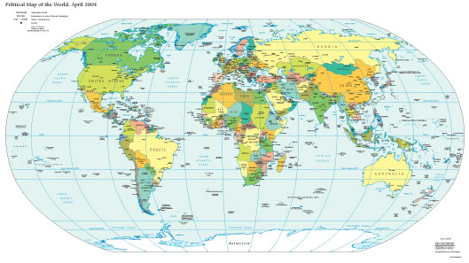
World Political Map

Slide 4
Physical Map
Has colors that make natural patterns stand out
The colors on the map can stand for types of vegetation, mountain, and natural features
Names of big natural features are easy to see
Physical maps also include some political information, such as boundaries

Slide 5
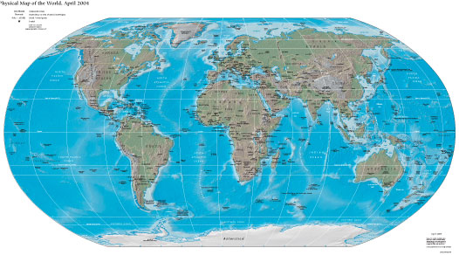
World Physical Map

Slide 6
Climate Map
The climate of a place is the weather it has season by season, year after year
Rainfall and temperature are climate’s main ingredients
Climate is affected by elevation, distance from the ocean, and latitude

Slide 7
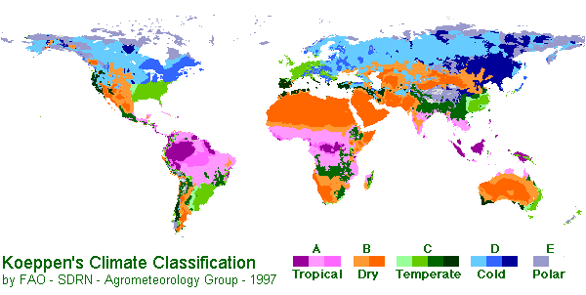
World Climate Map

Slide 8
Land Use Resource Map
These maps show how land is being used. This might refer to:
vegetation
crops being grown
forest vs. Agriculture
mines and wells
city zoning.

Slide 9
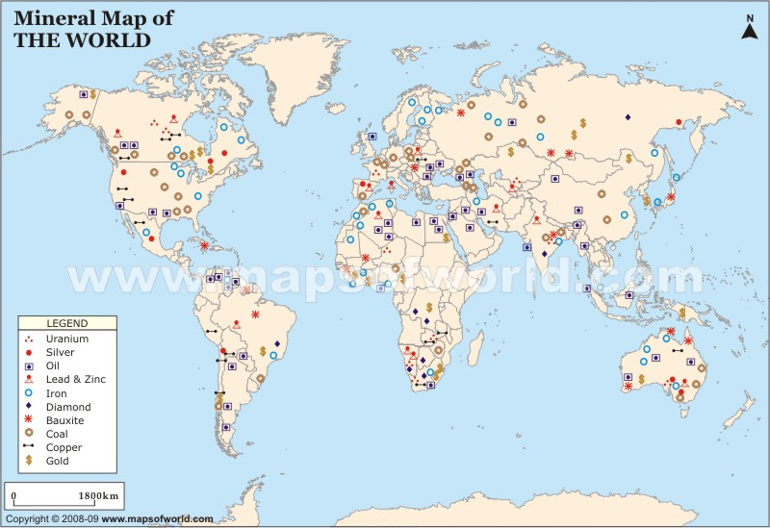

Slide 10
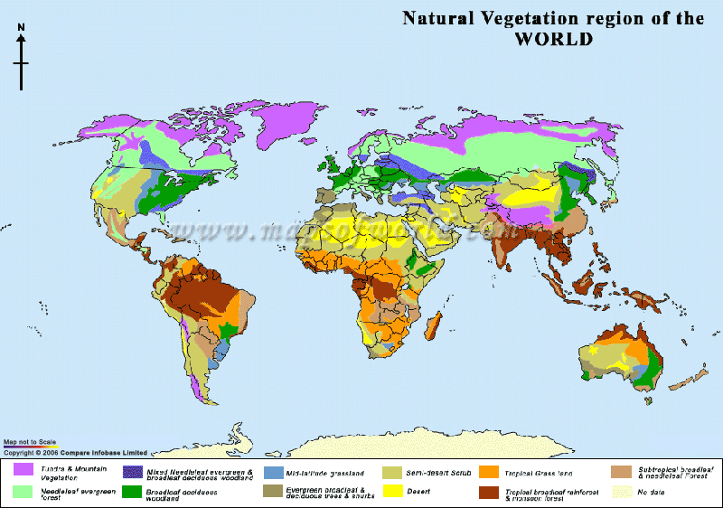

Slide 11
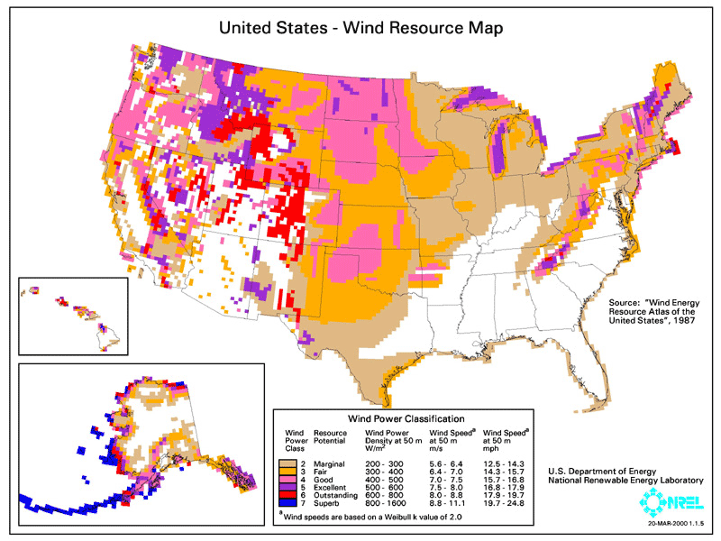

Slide 12
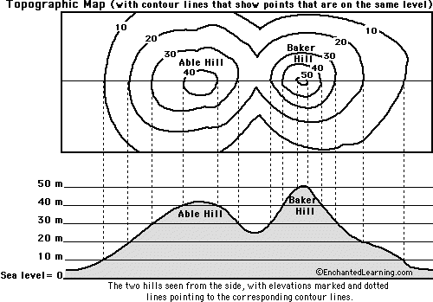
Contour maps
Contour lines represent the
elevation at that line. If you
were to walk across a line, you
are changing elevation.

Slide 13
Contour map

Slide 14
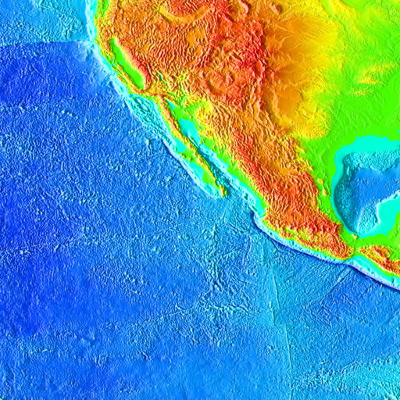
Elevation Maps
Maps that show elevation change by using color or shading.

Slide 15
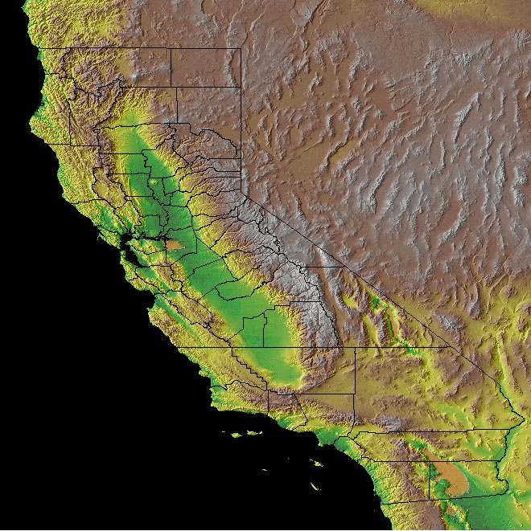
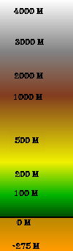
Elevation Map
Notes:
What is the elevation of the San Joaquin Valley?

Slide 16
Topographic Map
These maps generally represent a small area with a lot of detail. They show elevation with contour lines, natural and man-made features.

Slide 17
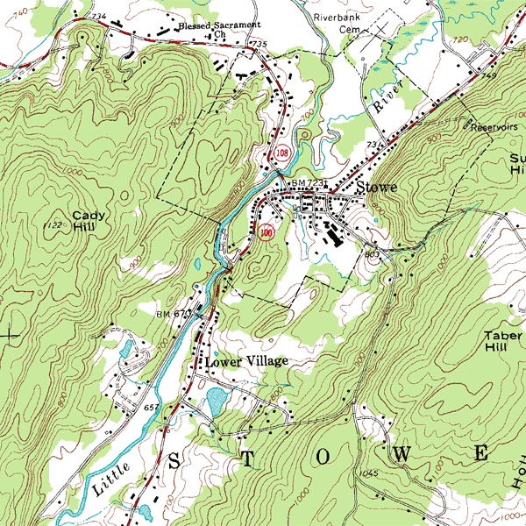
Topographic Map

Slide 18
Types of Maps
This map represents a small area with lots of detail. It has contour lines as well as natural and man-made features. _______________
This map uses colors to show height above sea level. ____________________________
These colorful maps show lines that people use to divide countries and states. They also show major cities. _____________________
These maps show physical features on the Earth like rivers, mountains, and deserts. ____________________________
These maps show how land is being used. For example, they might show which crops are being grown or what animals are being raised. __________________________
These maps show climate regions. ___________________

