Slide 1
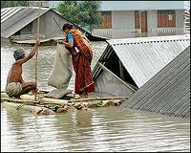

Slide 2
What causes rivers to flood?
Today, we are going to answer:
1. What are floods?
2. What causes floods?
3. What increases the risk of flooding?

Slide 3
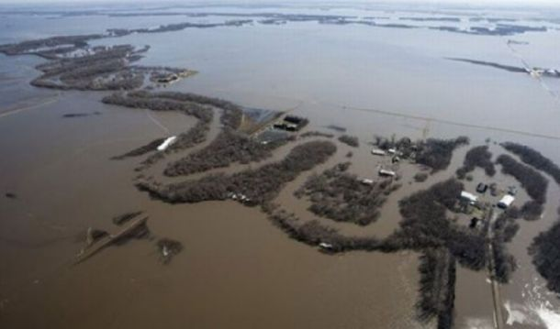
What are floods?
Floods happen when a river gets more water than the river channel can hold. The water flows over the banks and onto the river flood plain.
http://apps.sepa.org.uk/floodlinekids/rivers/flooding.html

Slide 4
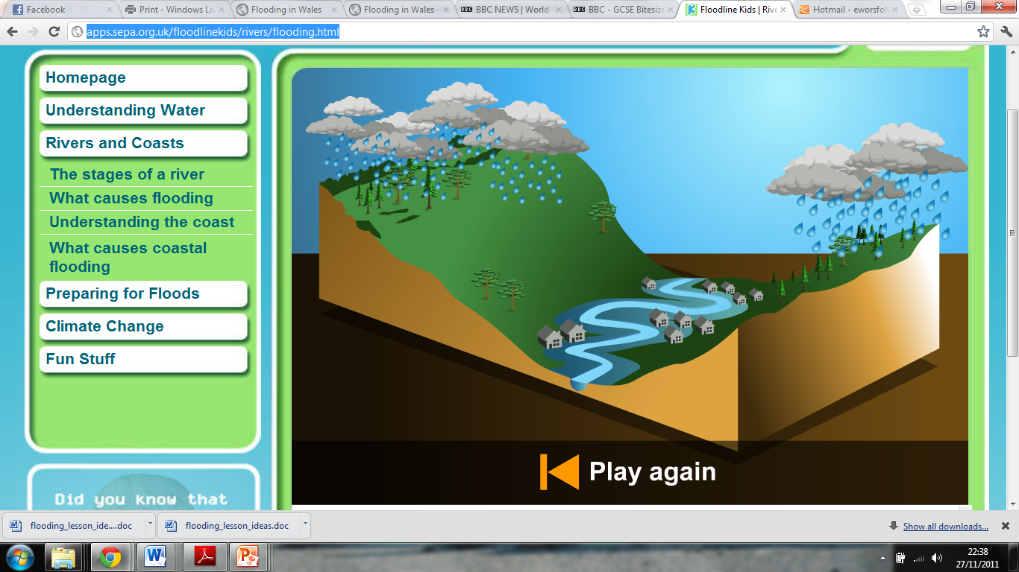
1. Rainfall is heavy.
2. Rain can’t soak into the ground fast enough, so it runs over the surface
3. Water runs into the river, causing the river level to rise. The river floods.

Slide 5
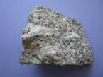
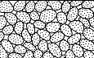
What increases the chance of flooding?
Impermeable Rock
(Rock that water
can’t flow through)

Slide 6
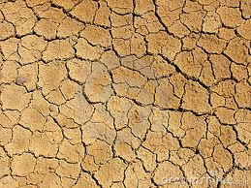
Hard Dry Soil

Slide 7
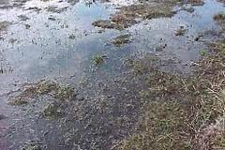
Very Wet Soil

Slide 8
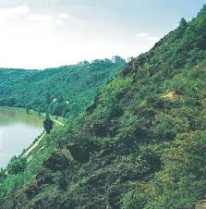
Steep Slopes

Slide 9
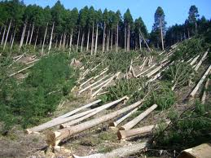
Deforestation (Cutting down trees)

Slide 10
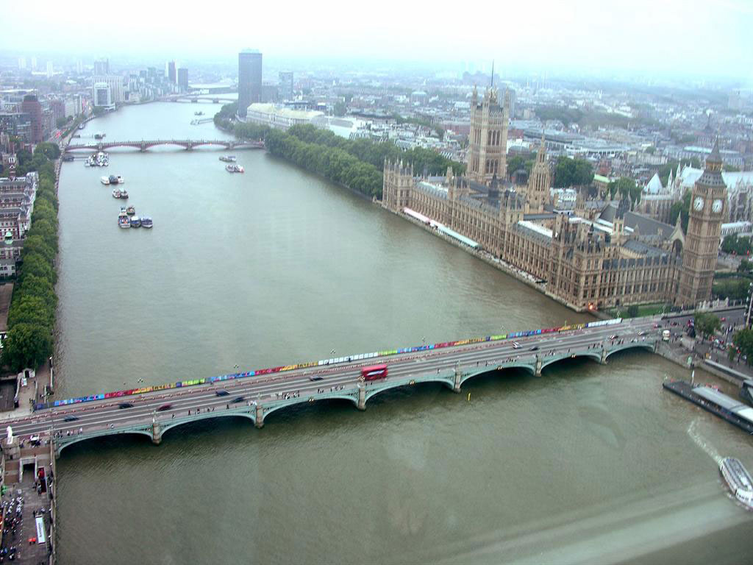
Building in the Drainage Basin

Slide 11
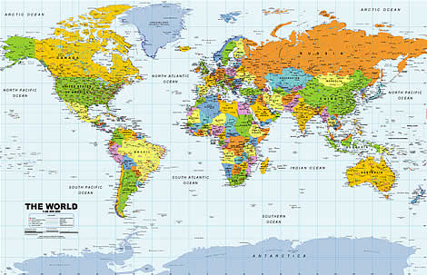
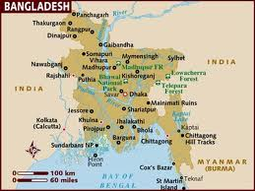

Slide 12
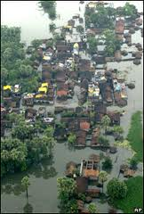
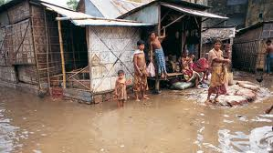
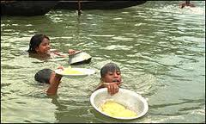

Slide 13
