Slide 1
Weather and Climate
TEMPERATURE

Slide 2
Topic 1 - TeMPERATURE
Essential Questions | Definitions | Learning outcomes
What is the difference between weather and climate? Why do different places experience different temperatures? Why do places at the same latitude have different temperatures? | Weather refers to a specific condition of the atmosphere at a particular place and time while climate refers to the long term weather condition. | Differentiate between weather and climate Explain daily and seasonal variations in temperature at a particular location Compare and explain with the aid of well-labelled diagrams variations in temperature between different locations.

Slide 3
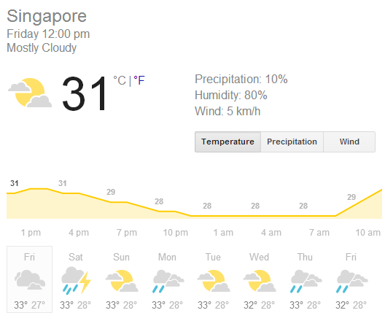


1A. Difference between weather and climate
What is the weather of Singapore?
What is the climate of Singapore?
Condition of a place at a certain time (daily)
Condition of a place over a long period (30 years)

Slide 4
WEATHER ELEMENTS
ELEMENTS | DEFINITION | INSTRUMENTS
Temperature | Degree of hotness or coldness | - Thermometer
Wind | Movement of air from high to low pressure area | Anemometer Wind vane/rose
Precipitation (Rainfall) | Water that falls to from atmosphere to surface | Rain gauge
Air pressure | Force exerted on earth’s surface due to air | Barometer
Relative humidity | Amount of water vapor in the air | - Sling psychrometer (wet and dry bulb)
Clouds | Evaporated water vapour in air | NIL

Slide 5
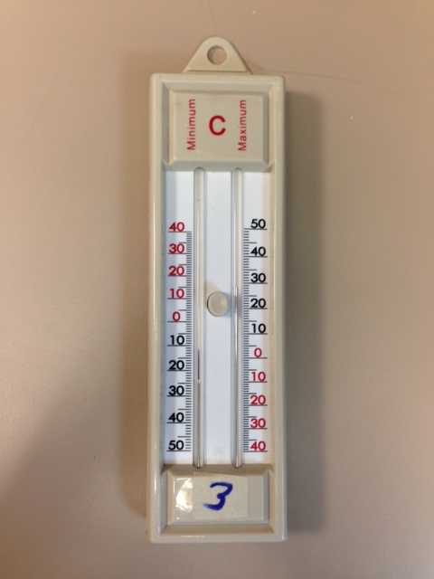
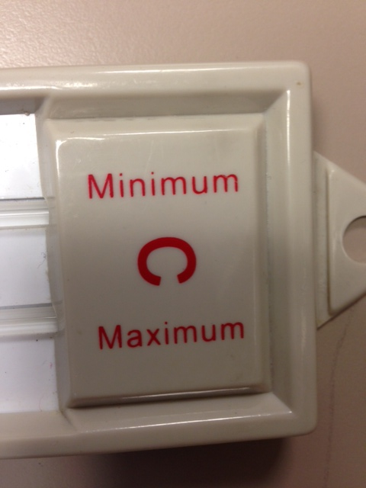
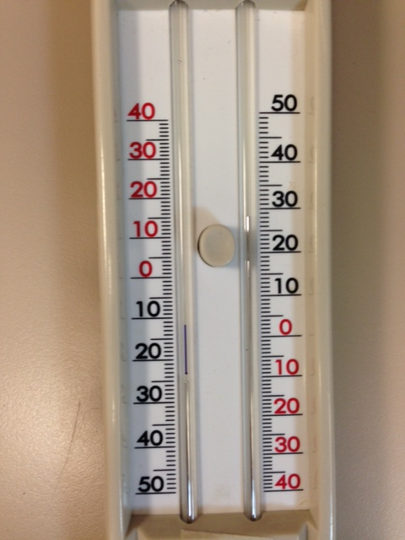
Can you guess what weather instrument is this?
A minimum and maximum thermometer is a thermometer that will tell you the minimum and maximum temperature in a given time period. This thermometer is U-shaped. One half is filled with alcohol, while the other filled with an alcohol vapor or contains a vacuum

Slide 6
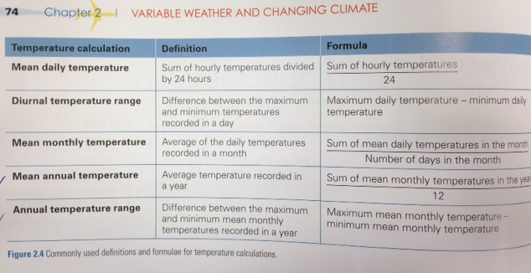
Temperature calculations
= average
= daily
= difference

Slide 7
307 Classroom
Month | Jan | Feb | Mar | Apr | May | Jun | Jul | Aug | Sep | Oct | Nov | Dec
Temp | 23 | 22 | 20.5 | 16.5 | 14 | 10.5 | 10 | 11 | 12.5 | 14 | 17.5 | 21
Mean Annual Temperature
= Total of mean monthly temperature / 12
= (23 + 22 + 20.5 + 16.5 + 14 + 10.5 + 10 + 11 + 12.5 + 14 + 17.5 + 21 ) / 12
= (192.5) / 12
= 16.04 ºC
Annual Temperature Range
= Highest Temperature – Lowest Temperature
= 23 – 10
= 13 ºC

Slide 8
1B. Why do different places experience different temperatures?
Latitudes
Altitudes
Distance from the sea
Cloud cover
Little Ahmad Dislikes Class

Slide 9
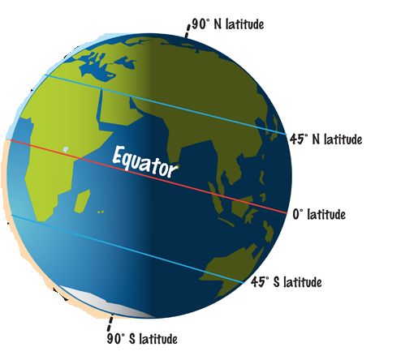
LATITUDE
Imaginary lines from east to west around the earth

Slide 10
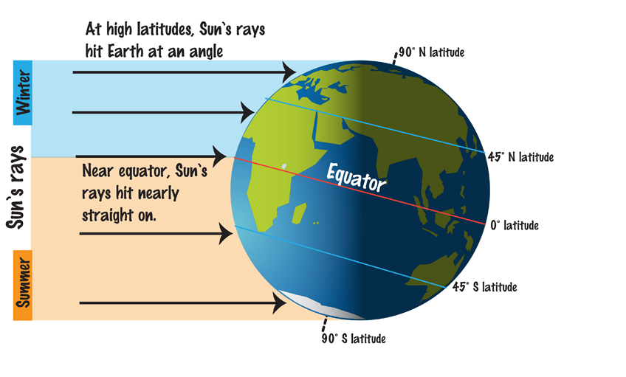
LATITUDE
Places nearer and further from the Equator have different temperatures because of the angle at which the sun’s rays strike the Earth’s surface

Slide 11
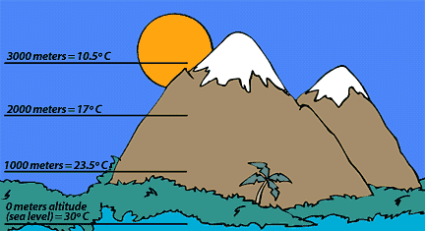
ALTITUDE
Height of a place
- Temperature decreases with altitude

Slide 12
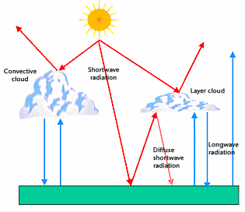
Why does Temperature drops at higher Altitude?
Shortwave radiation
Solar energy that hits the earth surface
Results in Earth’s surface becoming hotter as it absorbs solar energy
Longwave radiation
Heat that the Earth surface emits or give out

Slide 13
Why does Temperature drops at higher Altitude?
Air : Less Dense
Less compact
Less ability to absorb heat
Lower temperature
Air : Dense
More compact
Higher ability to absorb heat
Higher temperature

Slide 14
Distance from the sea
1. Maritime effect
  Large ocean bodies affects climate of coastal areas.
  Causes smaller annual temperature range
  Coastal areas: Results in cooler summer and warmer winters
Season | Summer | Winter
Temperature | Air over the sea is cooler than air over the land | Air over the sea is warmer than air over the land
Reason | Land heats up quickly while sea heats up slowly | Sea cools more slowly than land

Slide 15
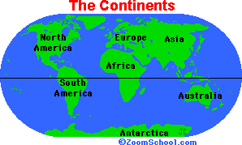
Distance from the sea
2. Continental effect
  Continental surface affecting climate of inland areas
  Causes larger annual temperature range
  Located further away from the sea = therefore temperatures are not influenced by the sea water
  Results: Warmer summers and colder winters

Slide 16
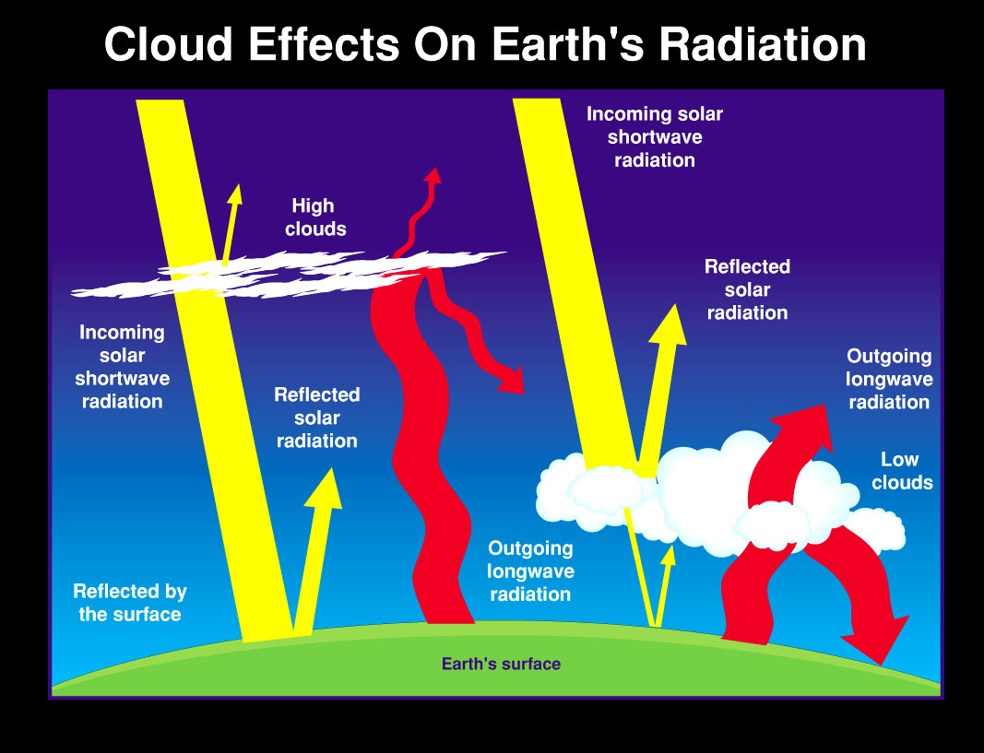
Cloud Cover
Extent of the sky that is covered by the clouds
Affects the temperatures in the day and night

Slide 17
Cloud Cover
 | Day | Night
More clouds cover = smaller difference in day and night temperatures | Clouds reflect a large portion of sun’s energy back to space Clouds absorb heat radiated from earth’s surface = cooler temperature | Clouds absorb more heat radiated from earth and prevent it from escaping into space = warmer temperature
Less clouds = bigger difference in day and night temperature | Large amount of sun energy to reach earth Earth surface heats up quickly = warmer temperature | More heat to be radiated from earth’s surface = cooler temperature

Slide 18
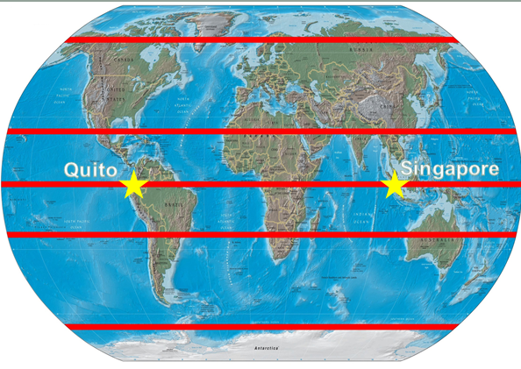
1C. Why do places at the same latitude have different temperatures?
Temperatures are also affected by other factors such as :
    Altitude
    Distance from the sea
    Cloud cover
Little Ahmad Dislikes Class

Slide 19

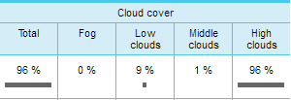
Comparing Singapore and Ecuador
 | Singapore | Ecuador
Mean monthly temperature | 27.5 degrees celsius | 14.0 degrees celsius
Highest Altitude | 537 feet (163.63 metres) | 9,200 feet (2804.16 metres)
Distance from the sea | Surrounded by Straits of Malaysia | Pacific ocean on west coast
Cloud cover Time: 12pm Date: 14/6/14

Slide 20
Homework 1
What is the difference between weather and climate? [1]
Why do different places experience different temperatures? [4]
With the aid of a well-labelled diagram, explain why do places at the same latitude have different temperatures? [3]

