Slide 1
TYPES OF CLOUDS
MARÍA SANZ

Slide 2
Clouds
Form when air rises, cools to its dew point, and becomes saturated
Shape and height of clouds vary with temperature, pressure, and water vapor in atmosphere

Slide 3
Clouds
Shape
  Stratus-smooth, even sheets or layers at low altitudes
  Cumulus-puffy, white clouds, often with flat bases
  Cirrus-high, thin, white feathery clouds made of ice crystals
Height
  Cirro – high clouds
  Alto – middle-elevation clouds
  Strato – low clouds
  Nimbus clouds are dark and so full of water that sunlight can’t penetrate them

Slide 4
Clouds
LOW CLOUDS – form at 2,000 m or less in altitude
  Cumulus – puffy clouds formed when air currents rise and carry moisture
  Stratus – layered dull, gray sheets that can cover the entire sky
  Nimbostratus – low, dark, thick layers that hide the Sun

Slide 5
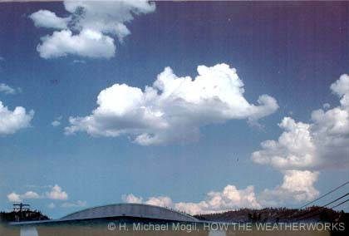
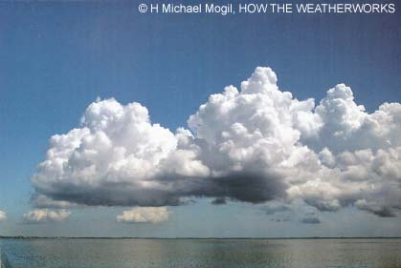
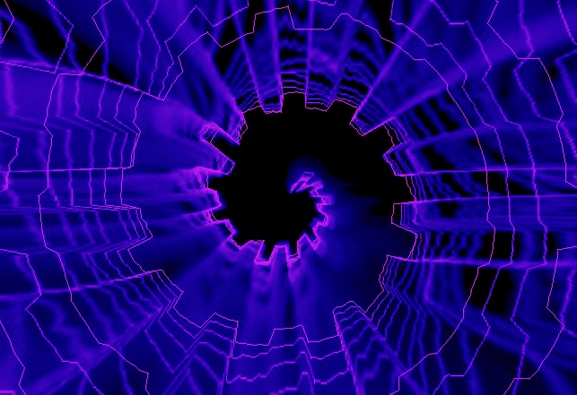
Clouds
Cumulus
· Clouds formed at medium or low elevation.
· Cumulus clouds are puffy with flat bottoms.
· When cumulus clouds are white they often signal fair weather, but when they are darker, they may signal rain or thunderstorms.

Slide 6
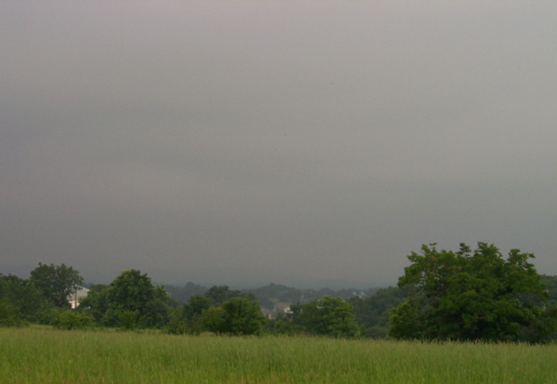
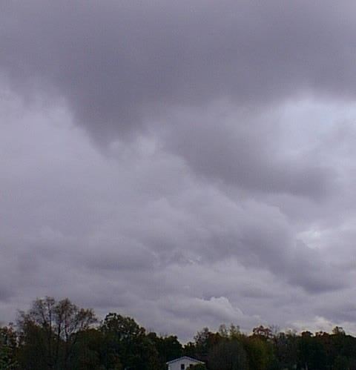
Clouds
Stratus
Clouds formed at medium or low elevation; spread out layer upon layer covering a large area
As stratus clouds thicken, precipitation usually occurs over that area.

Slide 7
Cumulus

Slide 8
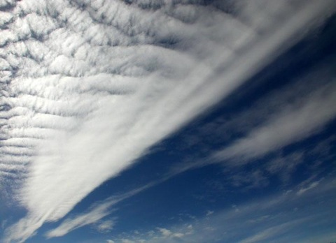
Stratus

Slide 9




Nimbo-stratus clouds

Slide 10
Clouds
MIDDLE CLOUDS – form between 2,000 m and 8,000 m in altitude
  Most are layered
  Names have alto- prefix (altocumulus and altostratus)
  Can produce light precipitation

Slide 11
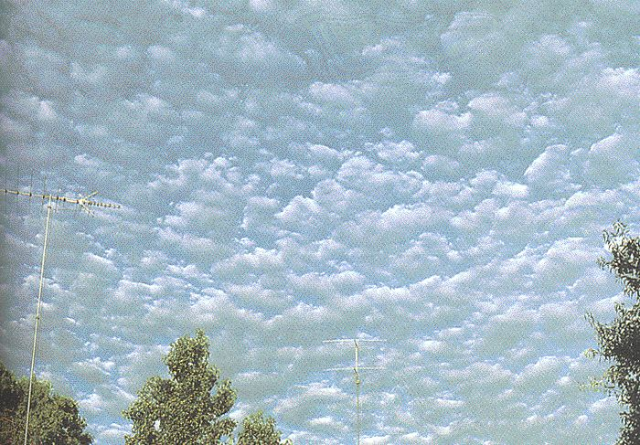
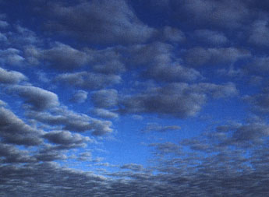
Alto-cumulus clouds

Slide 12
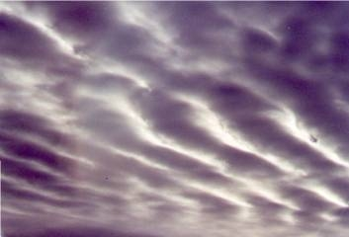

Alto-stratus Clouds

Slide 13
Clouds
HIGH AND VERTICAL CLOUDS
  Cirrus – wispy, high-level clouds
  Cirrostratus – high, layered clouds that can cover the sky
  Cumulonimbus – known as thunderstorm clouds; produce heavy precipitation

Slide 14
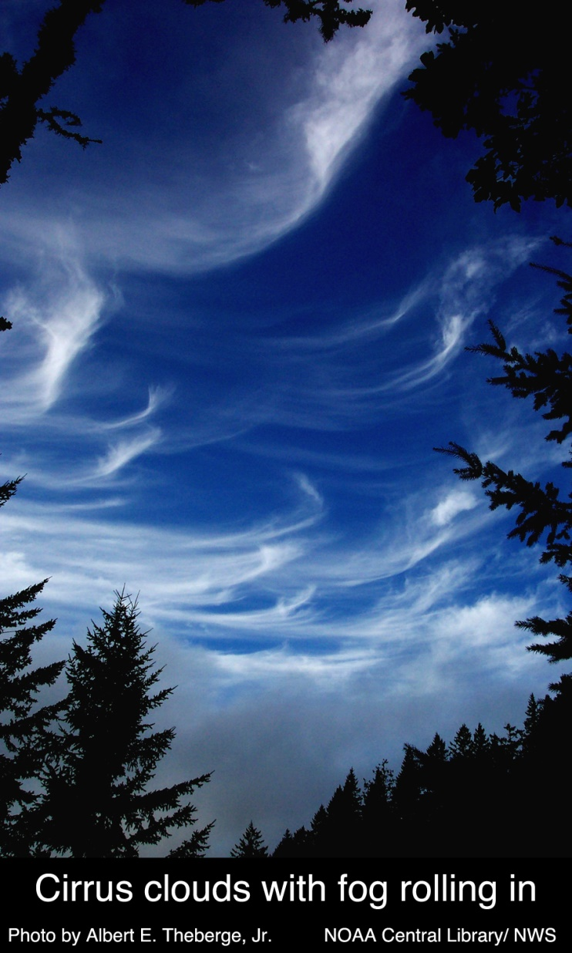

Clouds
Cirrus
Clouds formed at high elevations; wispy clouds usually consisting of ice crystals that signal fair weather or may also signal an approaching warm front.

Slide 15
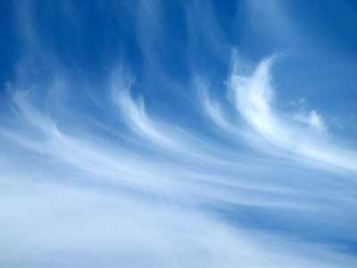
Cirrus

Slide 16
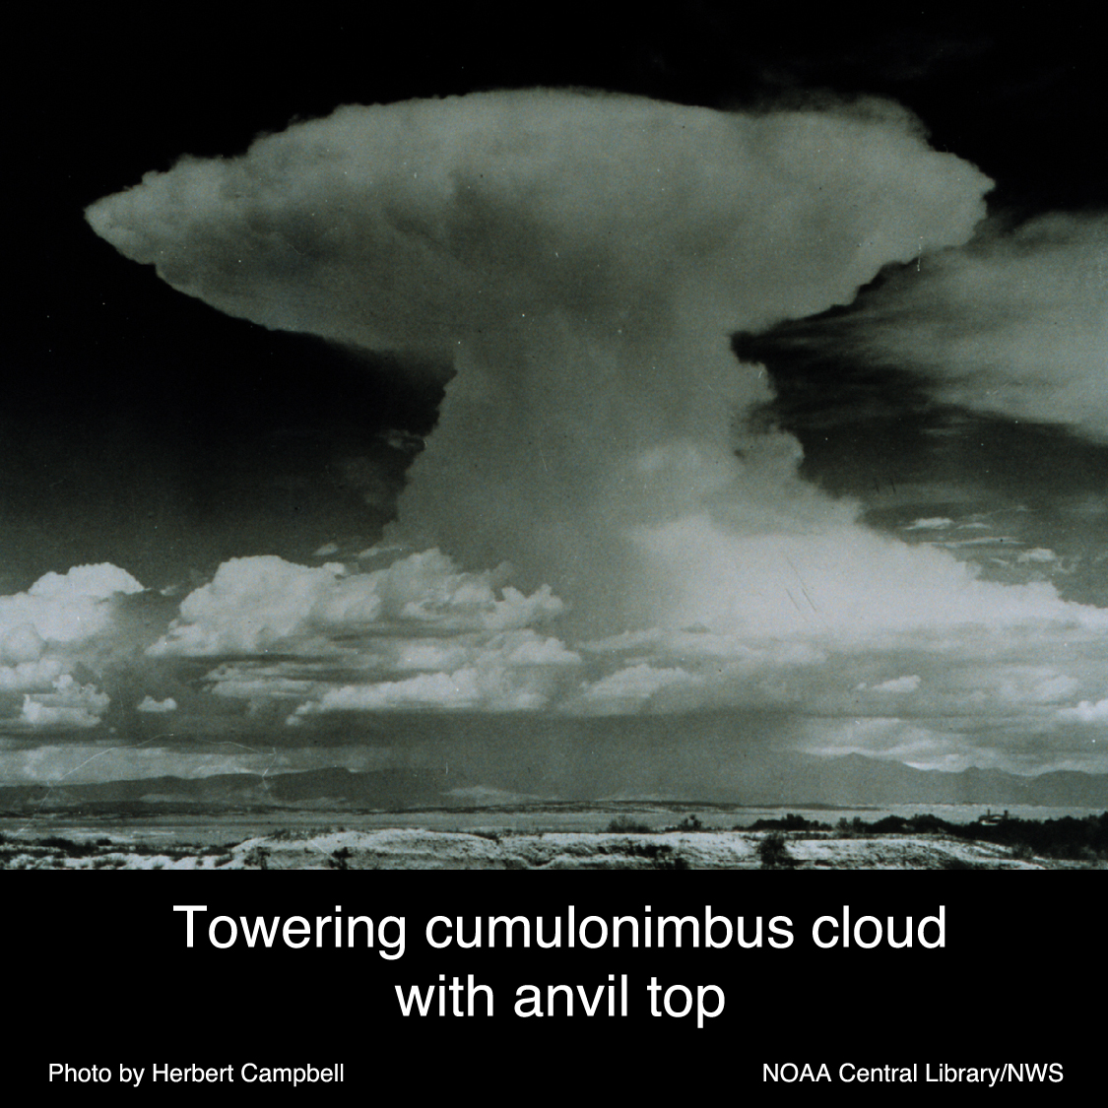
Cumulo-nimbus
Clouds
aka:
Thunderheads

Slide 17
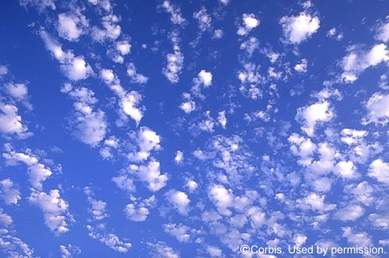
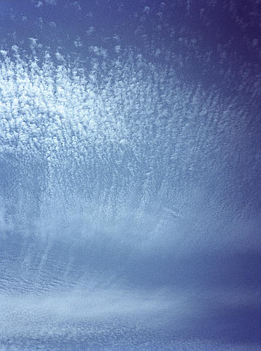
Cirro-cumulus clouds

Slide 18
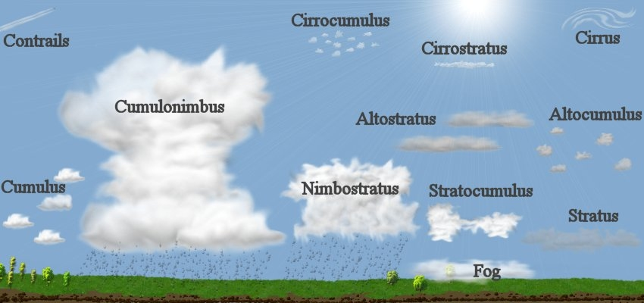

Slide 19
