Slide 1
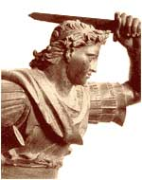
Alexander the Great
María Sanz

Slide 2

Why “the Great”?
In ten years, Alexander of Macedonia created the largest empire in the world up to that time
Alexander spread Greek culture, ensuring cultural diffusion and the survival of the qualities of classical Greece

Slide 3
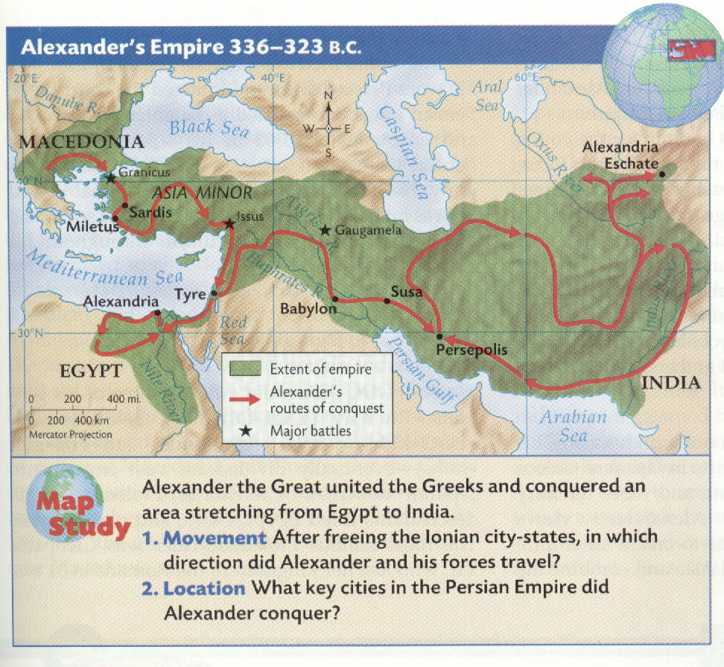
Alexander’s Empire

Slide 4

Alexander’s Origins
Born in Pella, Macedonia
Tutored by the Greek
philosopher, Aristotle
His father, Philip, was king of Macedonia, and had conquered the Greek city states during his 27 year reign

Slide 5
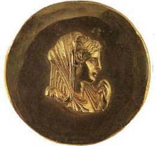
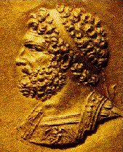
Olympia
Alexander’s mother
Philip
Alexander’s father

Slide 6
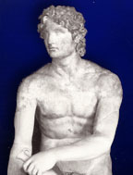
Alexander Rules
Philip was murdered in 336 B.C. by an assassin…maybe hired by his wife, Olympia…
So Alexander was only 20
when he became king of
Macedonia

Slide 7

Securing his father’s empire
Alexander finished rebellions in the northern regions to the Danube River.
In the process of reconquering the Greek city states, his forces destroyed Thebes

Slide 8
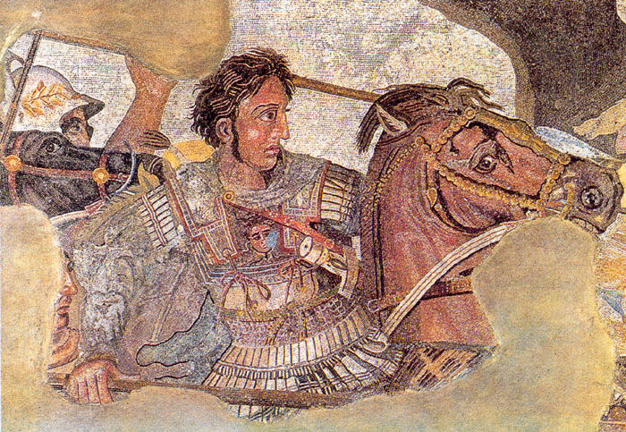
From Pompeii mosaic

Slide 9
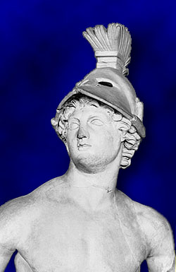
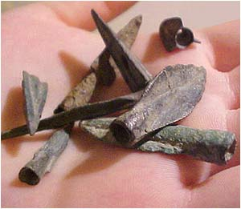
Expanding the Empire
Alexander’s forces of over 40,000 crossed at the Dardanelles into Asia, where he declared that the whole of Asia would be won by the spear

Slide 10

The Gordian Knot
The Gordian Knot: the legend behind the ancient knot was that the man who could untie it was destined to rule the entire world.
Alexander simply slashed the knot with his sword and unraveled it.

Slide 11
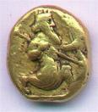
Defeating Darius of Persia
Alexander’s forced defeated the Persian army, losing only 110 men (legend)
Again Alexander was victorious, and Darius was forced to flee, abandoning his mother, wife and children to Alexander

Slide 12
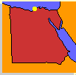
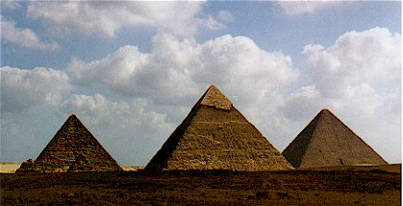
Major cities in Asia Minor and along the Phoenician coast surrendered to Alexander
Alexander proceeded to Egypt, where he established the city of Alexandria and was made pharaoh

Slide 13
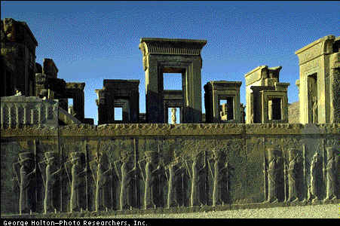
#3: Yet again, Alexander’s forces defeated Darius, this time in Mesopotamia…
Alexander was proclaimed king of Persia and Darius’s royal city and palace were burned to the ground…
Persepolis

Slide 14
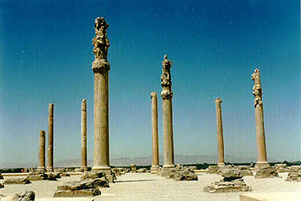
When Darius was found murdered by his own men, Alexander executed the assassins and gave Darius a royal funeral
Ruins of
Persepolis

Slide 15
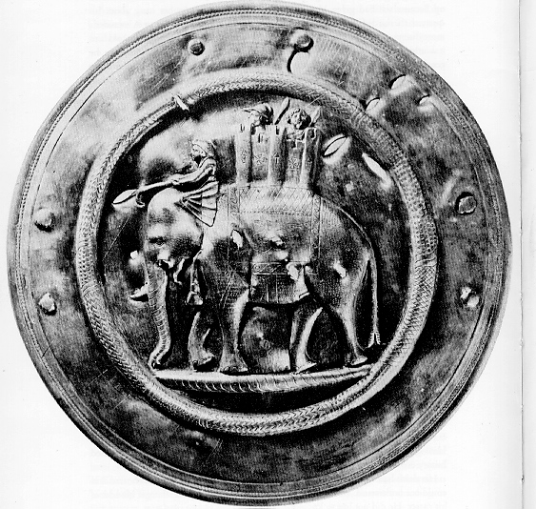
The limits of expansion
In the spring of 327 BC, Alexander and his army marched into India
As he conquered regions he allowed rulers to continue to govern in his name

Slide 16
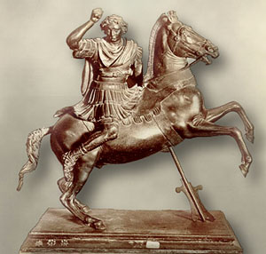
In India, Alexander’s horse was killed…
Bucephalus
He mourned his loss and named a city in his honor
'O my son, look thee out a kingdom equal to and worthy of thyself, for Macedonia is too little for thee.'
Alexander on his favorite horse, Bucephalus
Philip to Alexander (Plutarch, Alexander 6.8.)

Slide 17
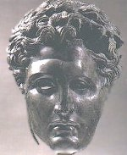
Retreat
At the Indus, the Macedonians rebelled and refused to go any farther
The forces travelled down the Indus and began the arduous journey back to Mesopotamia
His best friend, Hephaestion, died of a fever; to console himself, Alexander led a ferocious military campaign and went on a drinking binge

Slide 18
Securing a legacy
Alexander made Babylonia the capital of his Empire
He married one of Darius’ daughters and “encouraged” 10,000 of his soldiers to take Persian wives
He died the following year at 33 before he could produce an heir and his kingdom was divided among 3 of his generals

Slide 19
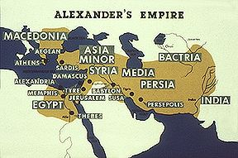
Antigonus
Seleucus
Ptolemy

Slide 20
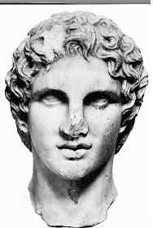
The mystery of Alexander’s death
Alexander died of a fever at 33… but why?
Plutarch reports that he was had been plagued by several bad “omens”
Some others from the time claimed Alexander was poisoned during the drinking binge

