Slide 1
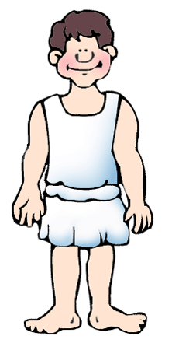
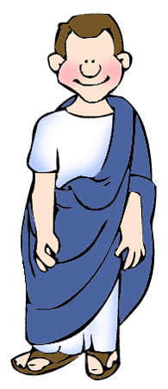
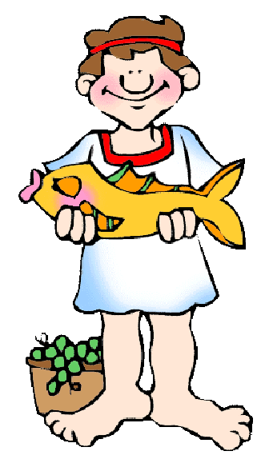
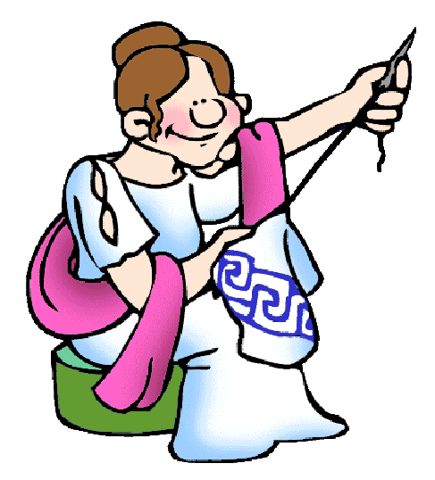
Ancient Greece:
Economy and Society

Slide 2
Greek Economy
ECONOMY
Agriculture
Craft Work
Metallurgy
Fishing
Trade

Slide 3
Greek Economy: Agriculture
The soil was not very fertile along the coastline. The ancient Greeks used systems of irrigation to help solve that problem.
People in the countryside worked in agriculture and were very poor. Many farms were very small.
All over Greece, the people grew olives, grapes, and figs. They kept goats, for milk and cheese. In the plains, where the soil was more rich, they also grew wheat to make bread. Fish, seafood, and home-made wine were very popular food items.
In some of the larger Greek city-states, meat could be purchased in cook shops. Meat was rarely eaten.

Slide 4
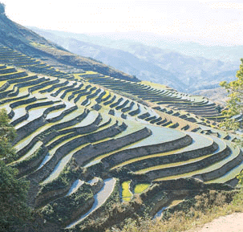
Terracing saves water and soil in mountainous environments

Slide 5
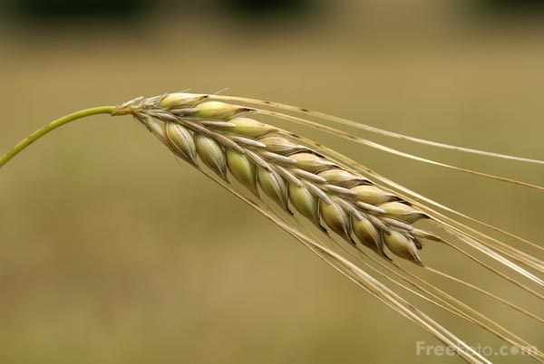
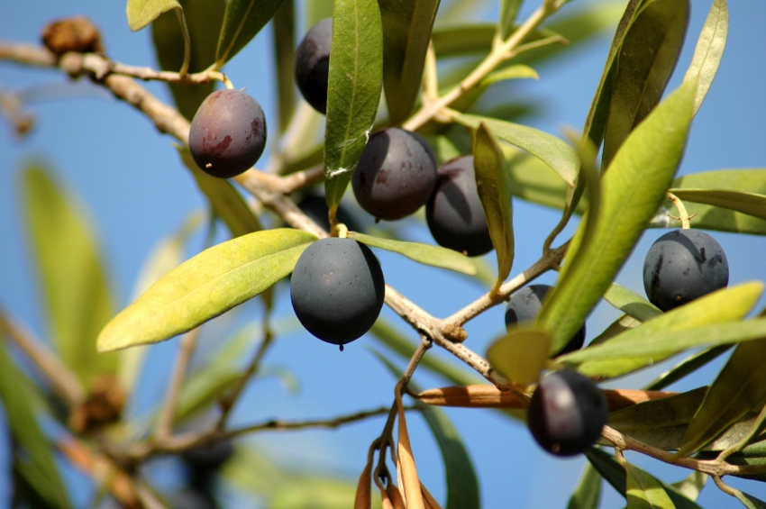
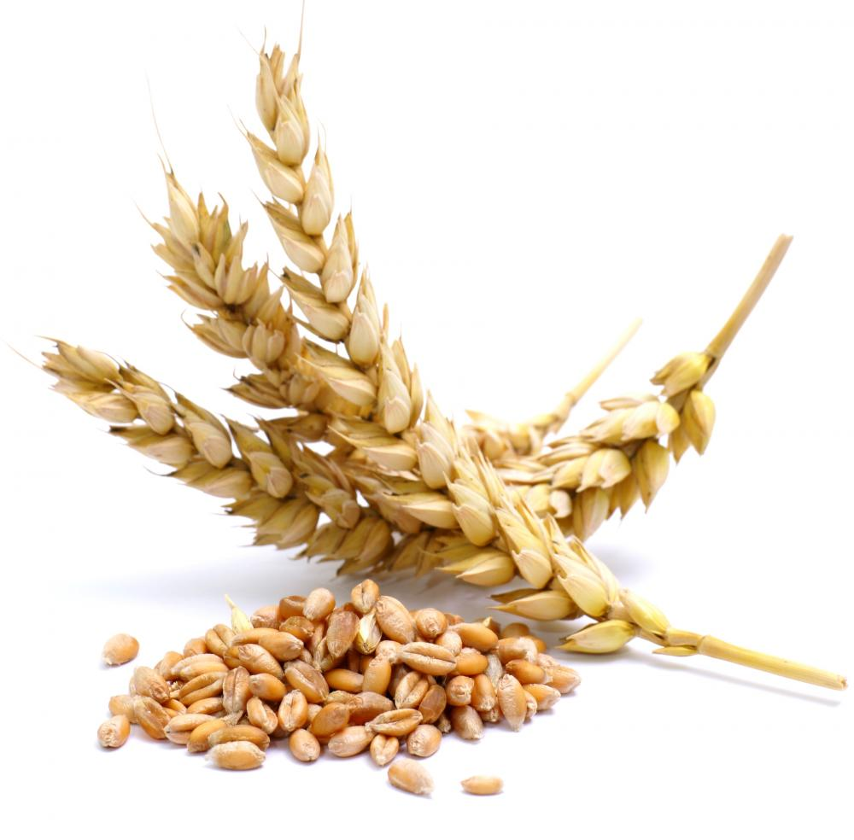
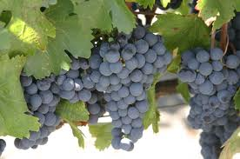
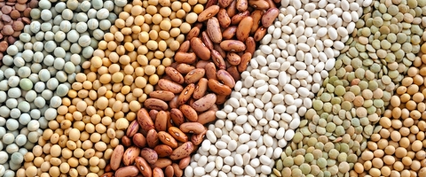
Farming Products

Slide 6
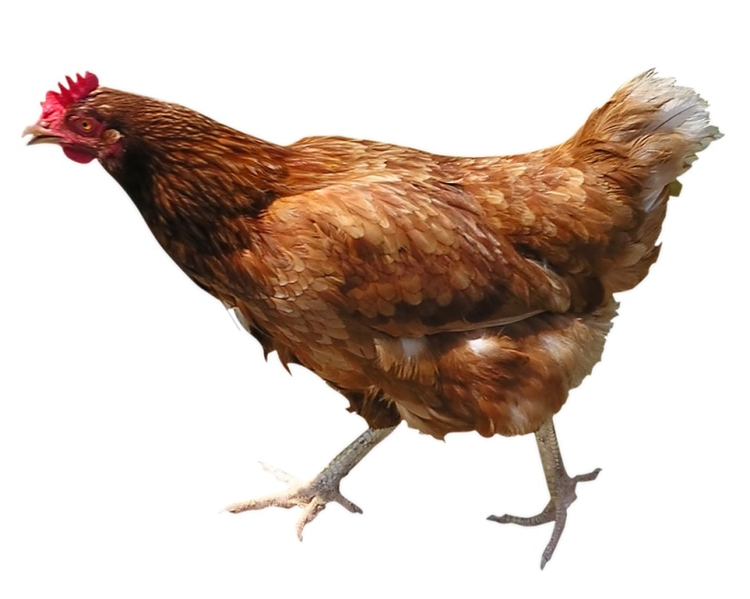
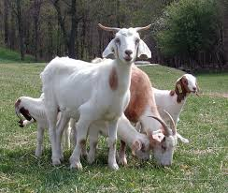
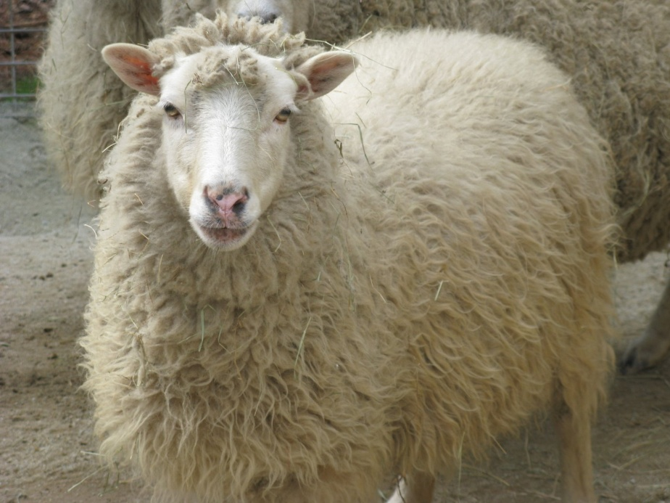
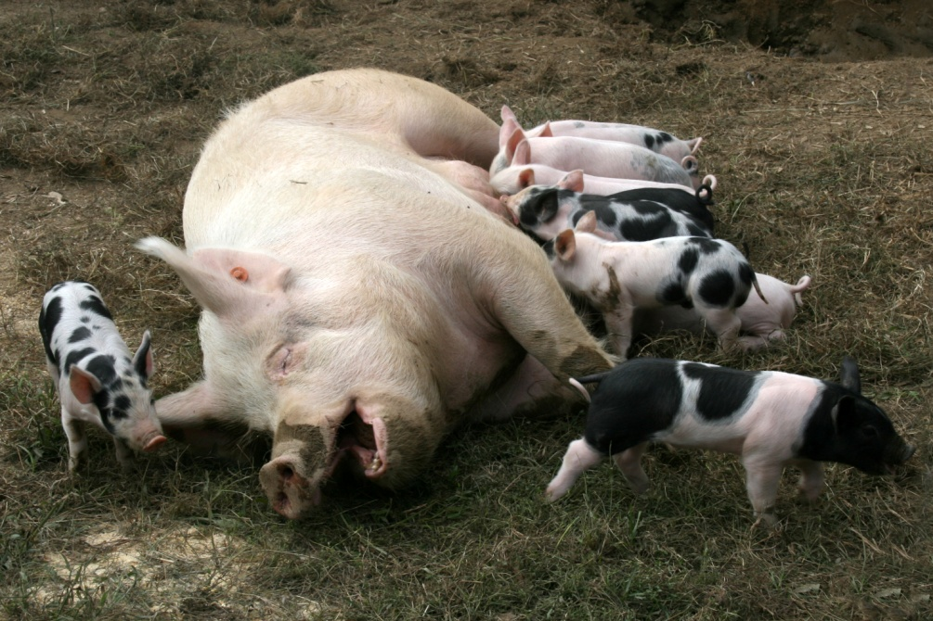

Slide 7
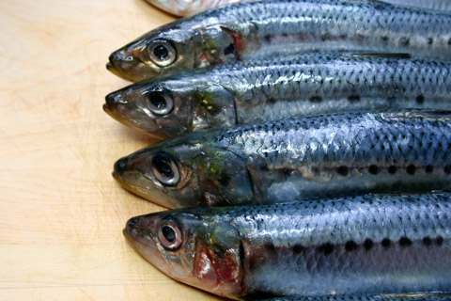
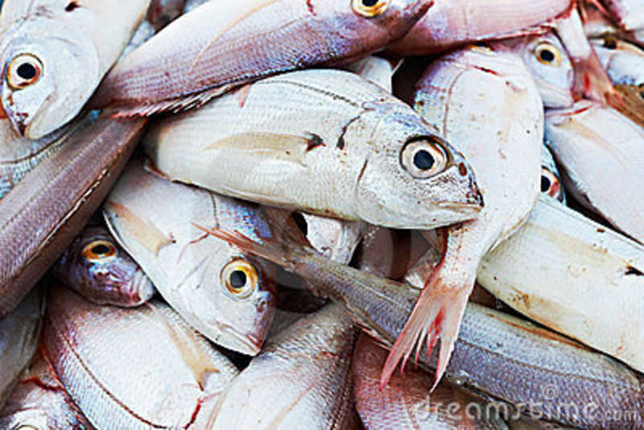
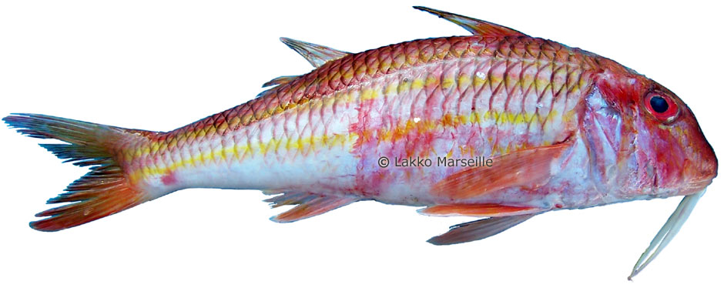
… and of course, fish

Slide 8
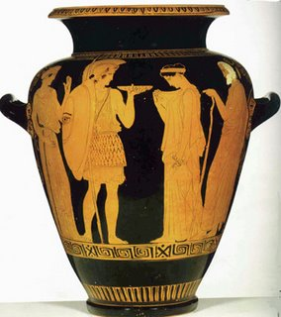
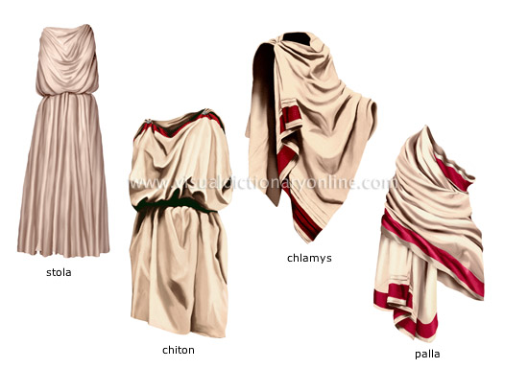
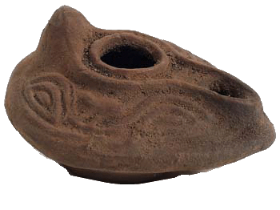
Crafts
The Greeks made excellent pottey, which they exported
They also worked with leather and textiles

Slide 9
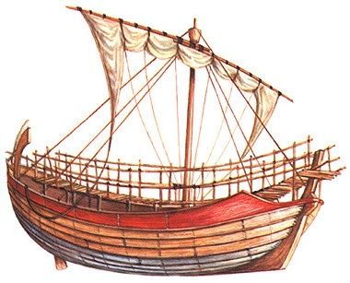
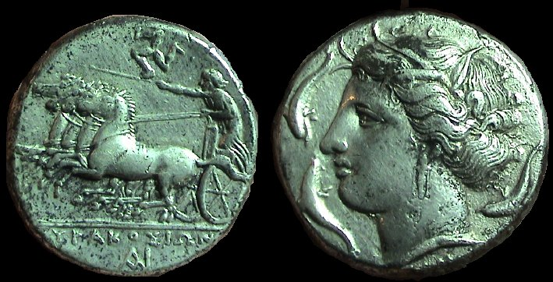
Trade
Long distance trade
  Rich merchants had ships and sailed across the Mediterranean Sea
  Products from Greek cities were sold and food, wood and copper were imported
  They used silver coins (each poleis had its own currency)

Slide 10
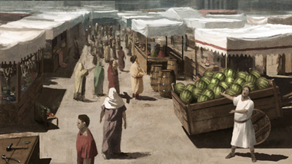
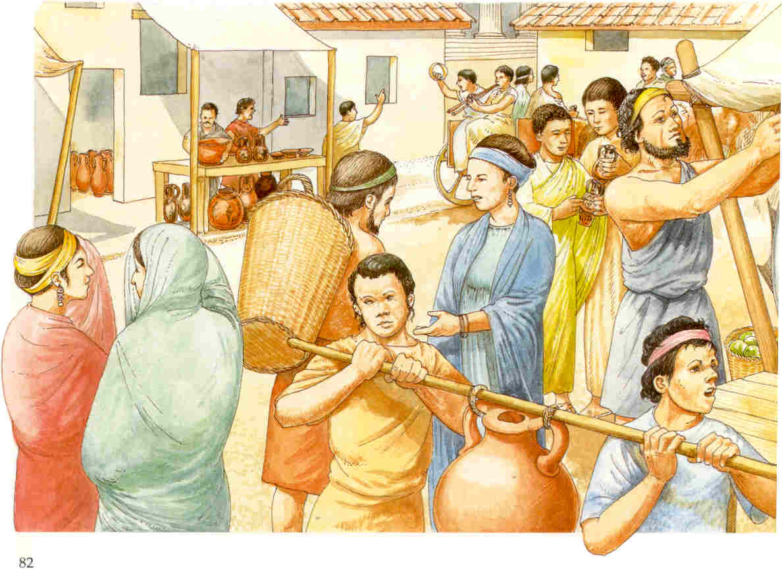
Trade
Local commerce
  There were small shops in Greek cities
  Peasants went to the cities to sell their crops
  Craftsmen sold their products in their workshops

Slide 11
Greek Economy: answer the questions
What were the main economic activities?
Why do you think the Greeks bought food from other people?
What was life like in the countryside?
What crops did the Greek grow?
Did they have currency?

Slide 12
Society: complete the pyramid
Citizens
Women
Metics
(foreign residents)
Slaves

Slide 13
Society
they were men, older than 18 years old
took part in politics, participated in the government
enjoyed many rights
payed taxes
could own property (land, slaves)
they did not work
Citizens
Women
Metics
(foreign residents)
Slaves
could be free or slaves, but had no rights
could not participate in politics, vote or go to public shows
under the rule of a man, father or husband
rich women stayed at home; poor women worked
they were free
payed taxes and fought in the army of the city
not allowed to own land or houses
usually worked in trade
they were not free –considered property like animals or objects-, woked for the family that owned them
usually prisioners of war or children of slaves
worked in agriculture or domestic work

Slide 14
Society: Who am I?
I work in a shop in the Agora selling figgs my master produces in his orchard ________
My husband leaves every morning to work in the fields while I take care of our family and the animals_______
I meet other men every week to discuss the problems of our city _____________
I have three ships and I sail them around the Mediterranean to buy products I sell in the city ____
I supervise our slaves, the children and the house in the city –it can be quite a job sometimes _________

