Slide 1
The Visigothic invasion of Spain

Slide 2
Who were the Goths?

Slide 3
Migration Theory
Germanic peoples from southern Sweden and the Baltic Coast of Poland migrate southward into Roman Territory
Gothic Language similar to Swedish

Slide 4
376 A.D. The Roman Emperor Valens invited the Goths cross the Danube in the Balkans into the Eastern Roman Empire as a buffer to the expanding Huns

Slide 5
The Romans had not prepared enough food and supplies to support their new military allies in the region.
100,000 armed Goths revolted for two years

Slide 6
Gothic leader Fritigern defeated the local Romans and pillaged the Thracian countryside

Slide 7
Fritigern defeated the Roman Emperor Valens at the Battle of Adrianople in 378 A.D.

Slide 8
A treaty with Rome required these semi-autonomous Germanic tribes to supply troops for the Roman army in exchange for peace, the access to cultivatable land, and freedom from Roman legal strictures.

Slide 9
Later Gothic King Alaric sacked Rome in 410 A.D.
The Goths desired a permanent homeland/kingdom within the Roman Empire

Slide 10
Alaric took Roman Princess Palcidia and persuaded the Visigoths to migrate to Spain
Palcidia married Ataulf “Alaric’s successor” and moved into the royal palace in Barcelona

Slide 11
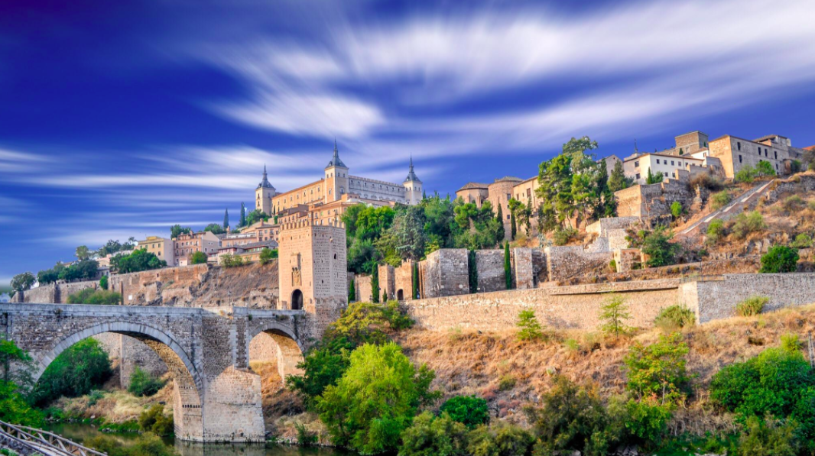
Visigothic Germanic/Roman Kingdom in Southern France and Eastern Spain was created

Slide 12
300,000 Visigoths settled in a population of about 7,000,000 Hispano-Romans

Slide 13
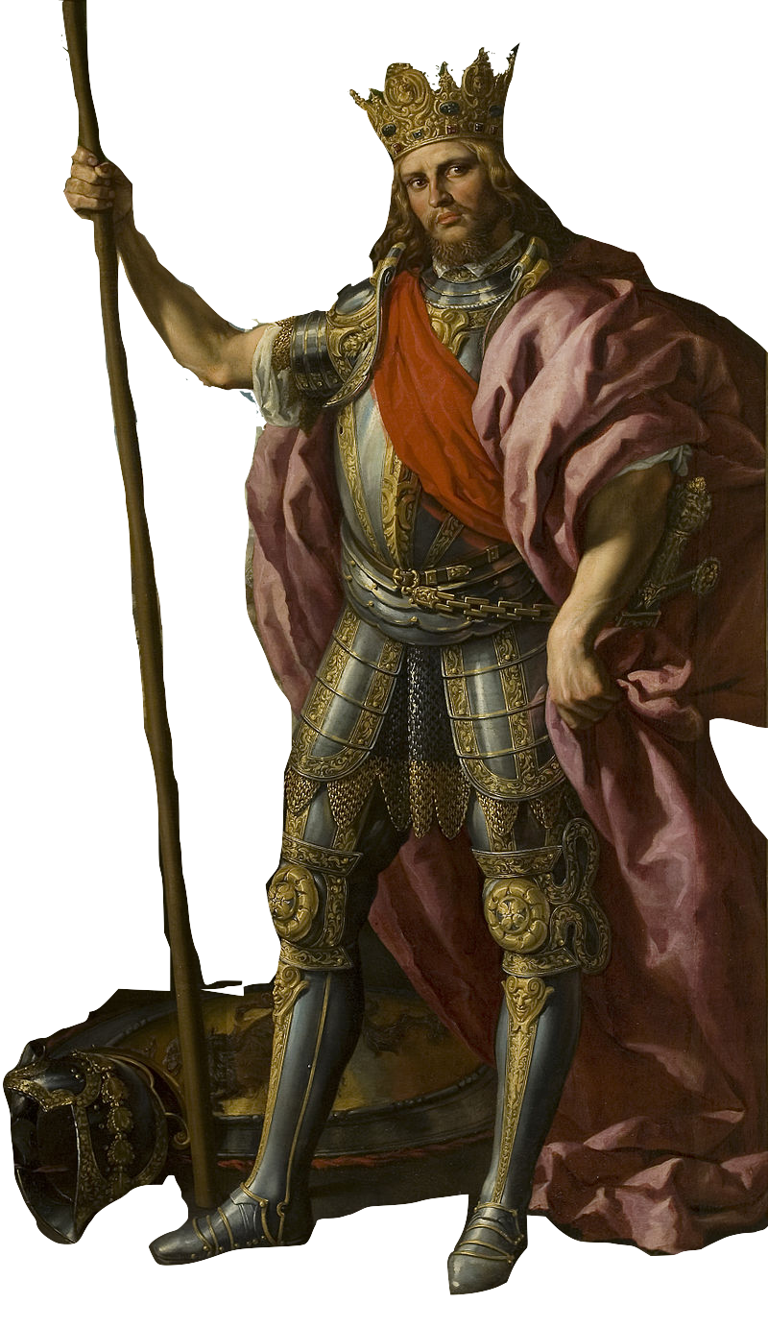
Visigothic King Theodoric I

Slide 14
The Visigoths renounced Arian Christianity and embraced Roman Catholicism in 587 A.D.
Conversion of King Reccarred

Slide 15
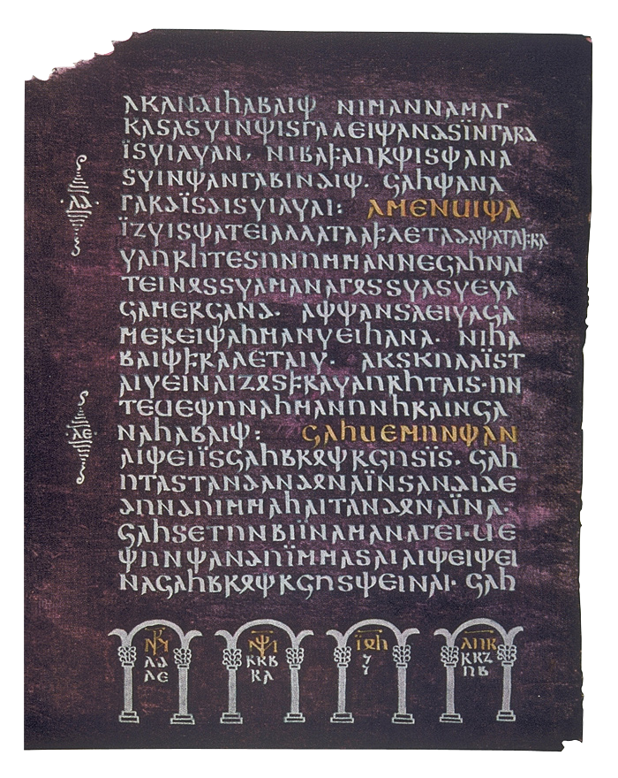
The Visigoths rejected the Arian Gothic Bible and started using the Latin Bible thus marking the beginning of the end of the Gothic Language in Spain

Slide 16
The Two Cultures Blend
Gothic Roderic -------> Latin Rodrigo -------> Surname Rodriguez

Slide 17
Roman and Germanic Law Blends
Germanic Wergeld: Price paid to recompense a crime “Written Code 475” blended with Roman Legislation

Slide 18
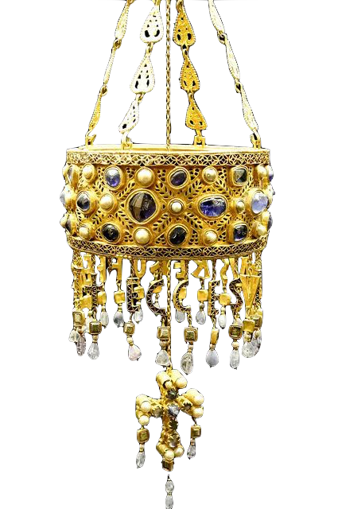
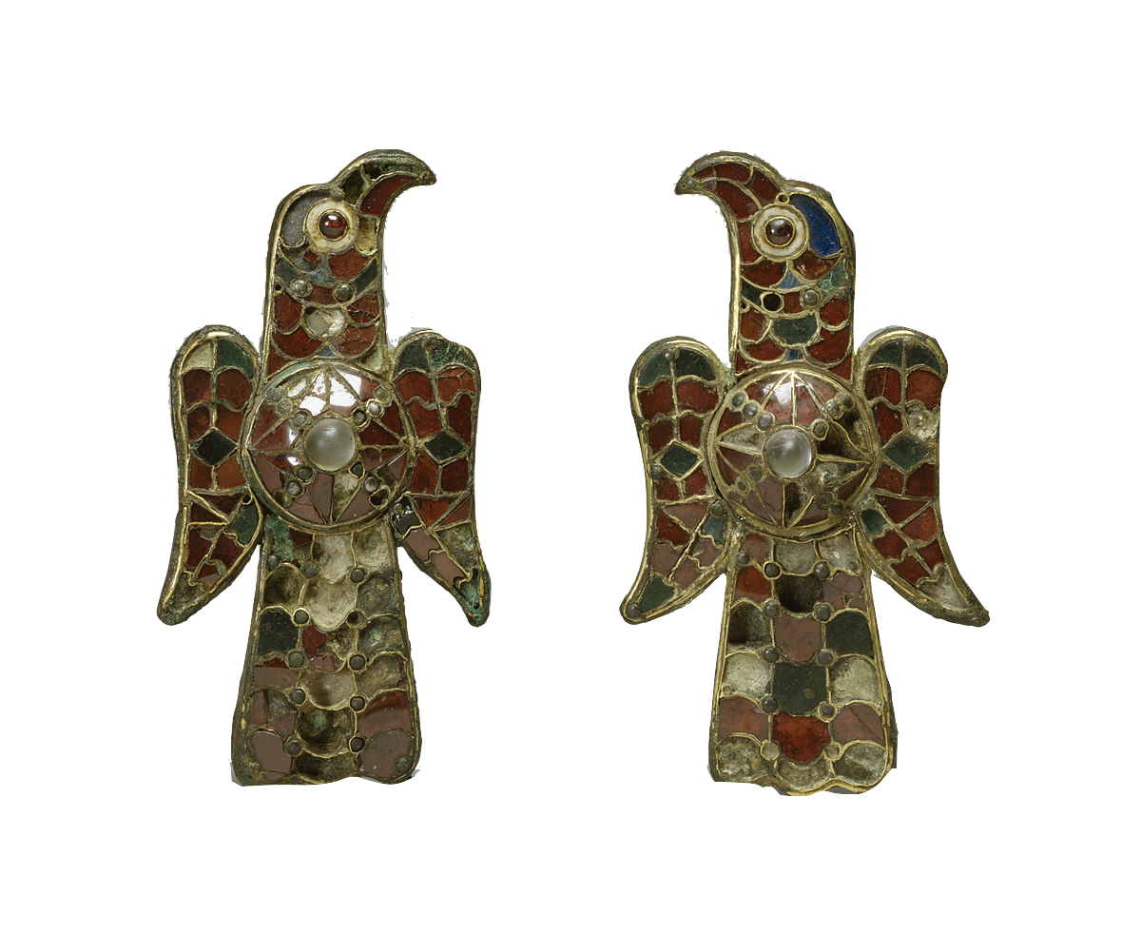
Visigothic Art

Slide 19
Visigothic Church

Slide 20
Sevilla becomes an intellectual center blending roman and Gothic Learning. Saint Isidoro

