Slide 1


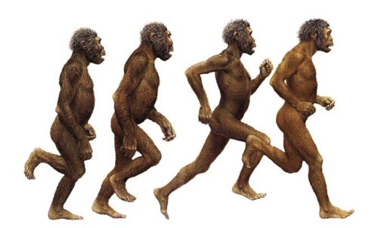
EARLY HUMANS
MARIA SANZ

Slide 2
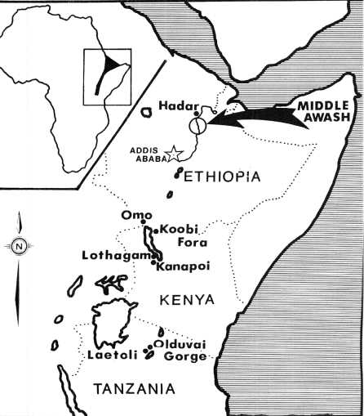
Early humans appeared in africa

Slide 3
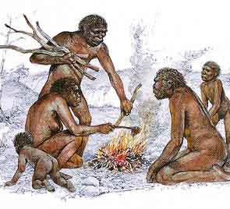
hominids
Human-like creature that walked upright
Lived in Africa 4 million years ago
Existed for millions of years; changed over time
Louis and Mary Leaky discovered them
“Lucy” was the first hominid

Slide 4
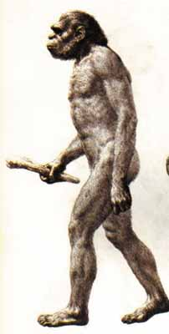
Homo habilis
2.5-1.6 million years ago appeared
“Handy Human” or HOMO HABILIS
May have used stone tools
Discovered near Olduvai George was the first homo habilis found.

Slide 5
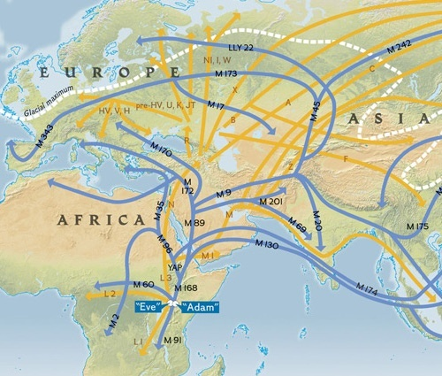
HOW HUMAN
BEINGS SPREAD ALL OVER THE WORLD

Slide 6
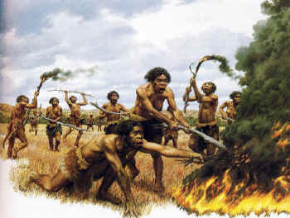
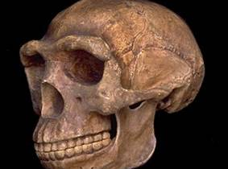
HOMO ERECTUS, THE ONE WHO DISCOVERED THE FIRE
“Upright Human”
Appeared aorund 1.8 to 100,000 years ago
Had arms and legs in modern human proportion
First human to leave Africa

Slide 7
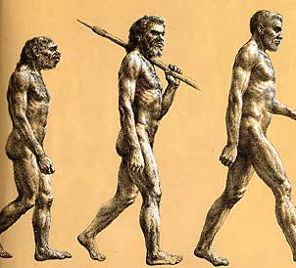

Slide 8
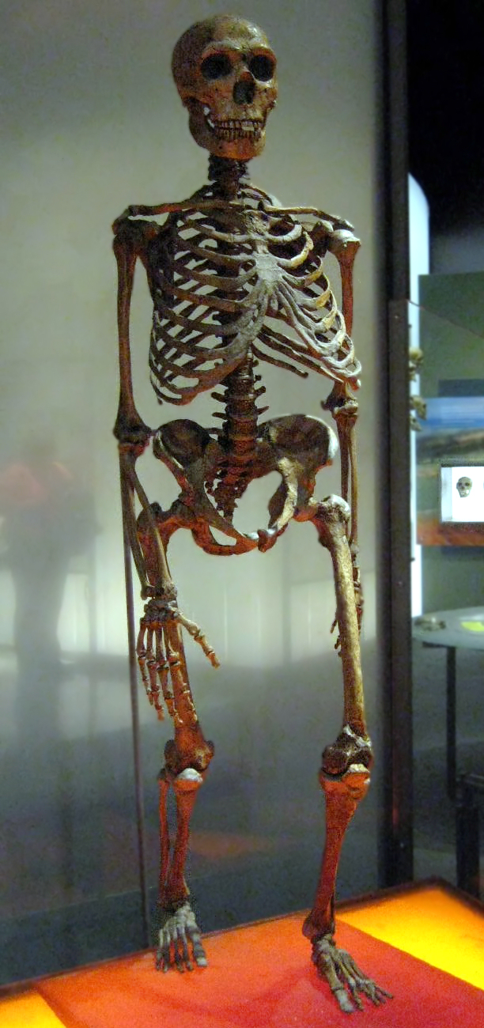
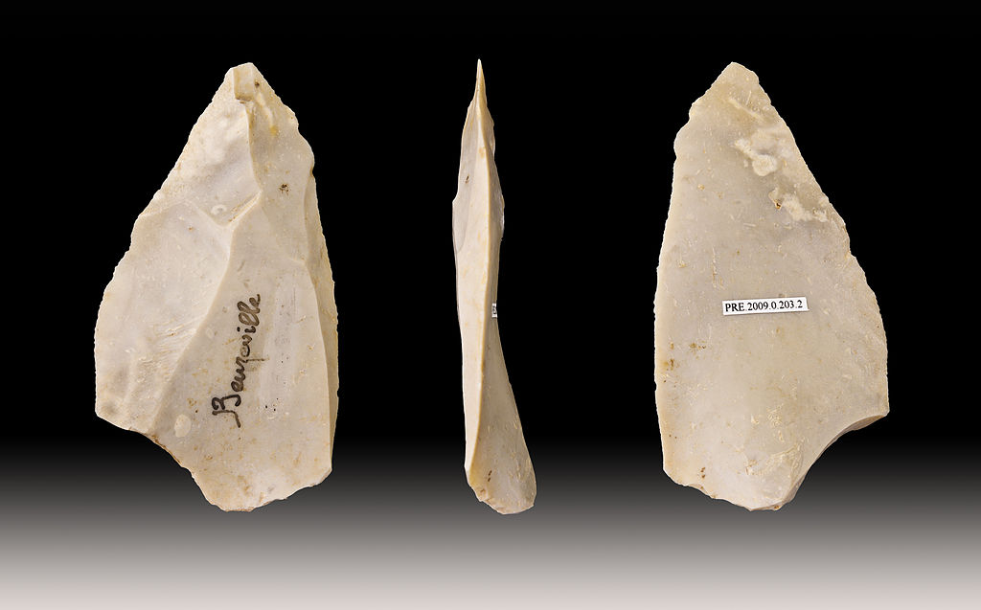
Homo neanderthal
HAD A ROBUST COMPLEXION
Neanderthals made stone tools, used fire, buried their dead ones and were hunters.

Slide 9
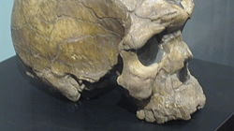
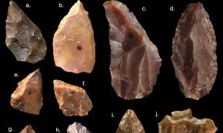
HOMO SAPIENS
THEIR BODIES ARE SIMILAR TO
OURS.
BURIED THEIR DEADS
PAINTED THE CAVES
MADE TOOLS OF BONE AND
STONE

