Slide 1

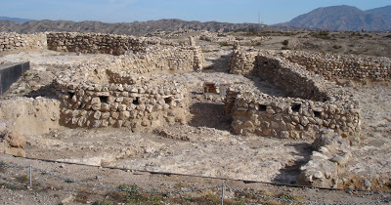
Neolithic Revolution

Slide 2
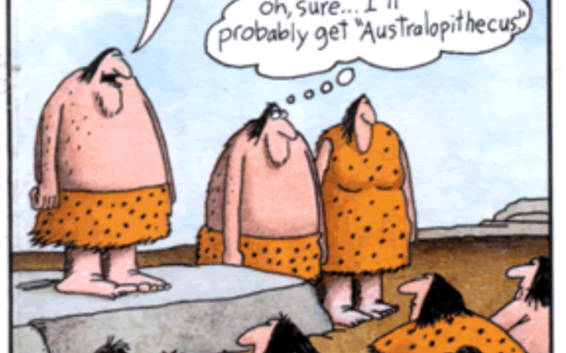

Paleolithic Era
Also known as Old Stone Age
Began 2 million years ago
Humans during this period:
  Were nomadic
  Were hunter-gatherers
  Lived in small clans
  First to make simple tools and weapons
  Mastered use of fire
  Developed spoken language
  Egalitarian

Slide 3

Neolithic Revolution
Also known as the Agricultural Revolution
Societies move from hunting and gathering to farming
Was this mankind’s biggest mistake???
  Poorer health
  Shorter lifespans
  Harder labor for the majority of people

Slide 4
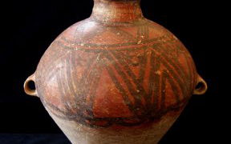
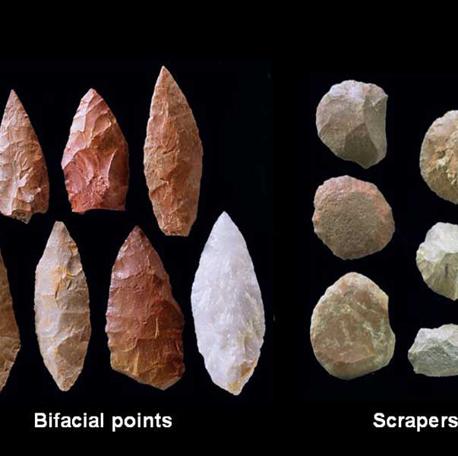
Neolithic Revolution
First permanent human settlements emerged
Agricultural Revolution involved the domestication of plants and animals
  Agriculturalists domesticate both
  Pastoralists domesticate only animals
Literally translates to New Stone Age – still used stone tools but more refined
First permanent human settlements emerged (sedentary)
Pottery is used
SLOW transition spanning thousands of years
Less variety
Ratchet Effect
  Evidence: Bantu speaking populations

Slide 5
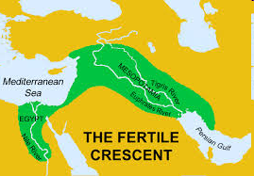
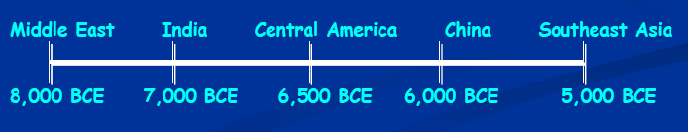
“Fertile Crescent” Was First
End of last Ice Age
Started in the Fertile Crescent (modern day Iraq)
  Also known as Mesopotamia
  Located between the Tigris and Euphrates Rivers
Warming climate allowed for wild grasses to abundantly grow
  Grasses very close to domesticated varieties we have today

Slide 6
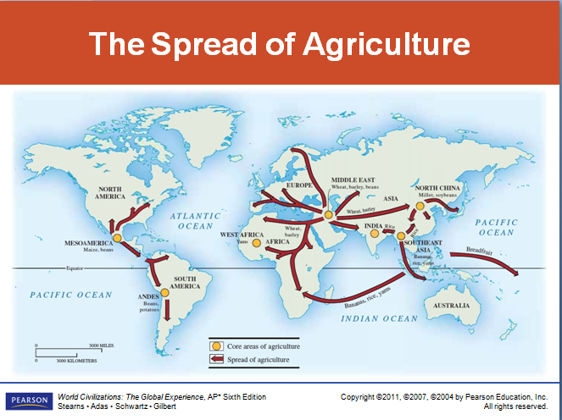

Slide 7
How Did Agriculture Develop?
Availability of calories determines how humans get their food (dependent on local flora and fauna)
End of ice age → Plants thriving
Intensification – Humans began “helping” plants along and selecting for traits with ultimate goal of increasing calories gathered
Certain plants were abundant and provided many calories → Humans actively chose those

Slide 8
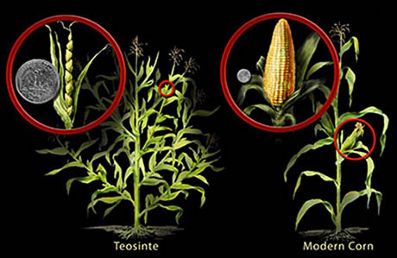

Slide 9

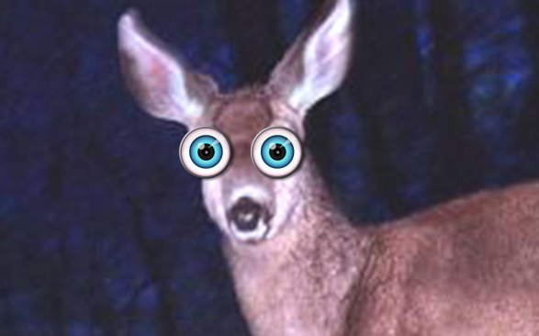
Domestication of Animals
What is it? An animal will breed where and when we want it to and often
  It learns to come to us for food
  It’s not aggressive
Non-Examples: Deer and Tigers

Slide 10
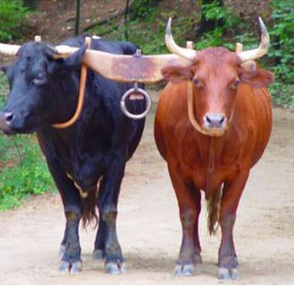
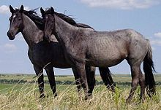
Important Domesticated Animals
Horses
Cows
Pigs
Sheep
Goats
Chickens
Oxen
Elephants
All from Eurasia!

Slide 11
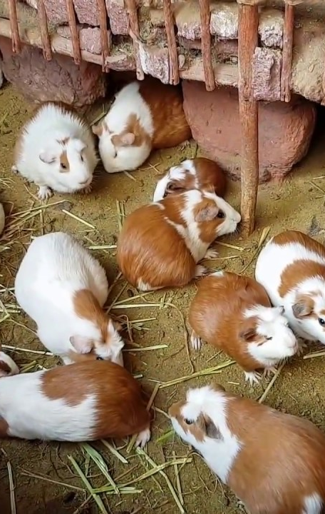
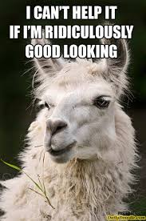
What Did the Americas Have?
Guinea pigs, turkeys, and LLAMAS!!!
Some places at a disadvantage with regards to local flora and fauna ☹ For example, Highland New Guinea had no animals available to domesticate; had long-term impact on their development

Slide 12
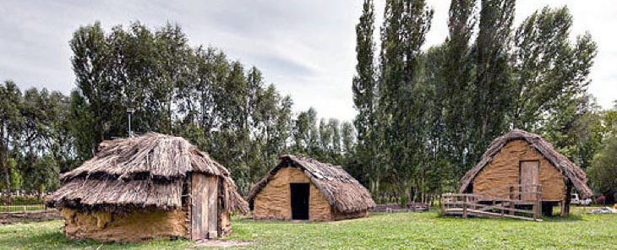
Agriculture’s Impact
Sedentary lifestyle
Close-knit society and the need for cooperation & group effort
Land becomes more efficient resulting in a surplus of food
Allows for specialization, development of tools and weapons
Increased population and material possessions
New social organization – from egalitarian to social stratification (social heirarchies)
Patriarchy (Rule by males/women viewed as needing protection or control)

Slide 13
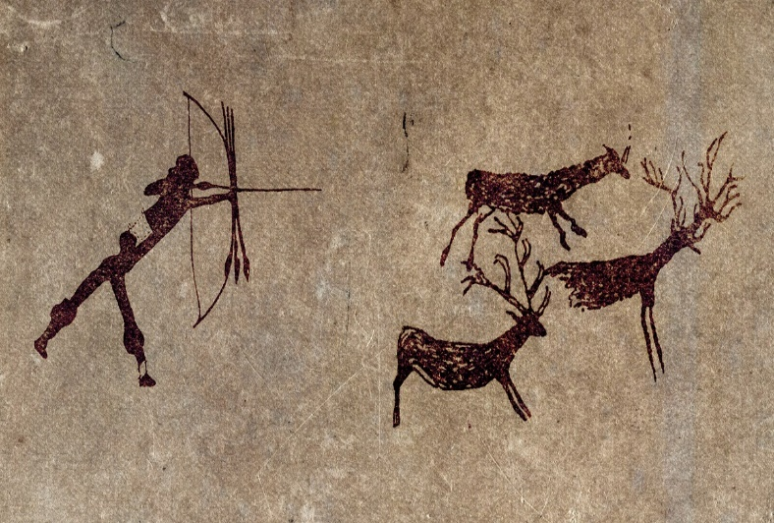
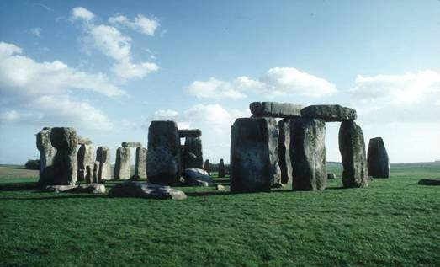
Was This Change for the Better?
Hunter-Gathering Societies:
  More free time
  Temporary shelter
  Small Groups (less conflict)
  Public land
Agricultural Societies
  Constant work but food source more reliable
  Long-term homes
  Larger groups (more conflict; disease)
  Private land
  More stability

Slide 14
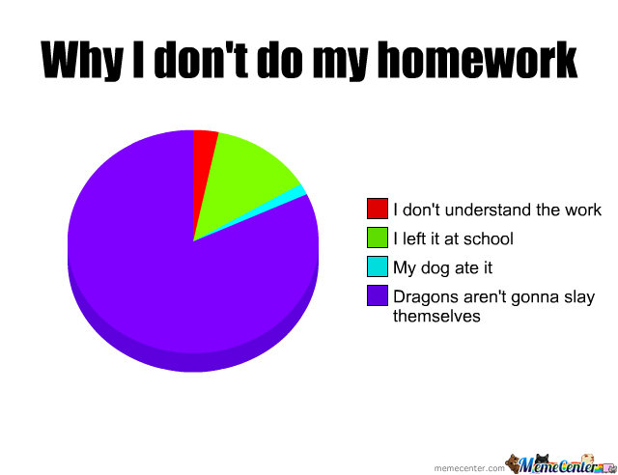
Just a Friendly Reminder…
Homework: look for important Neolithic settlements in Spain.
Do your homework..

