Slide 1
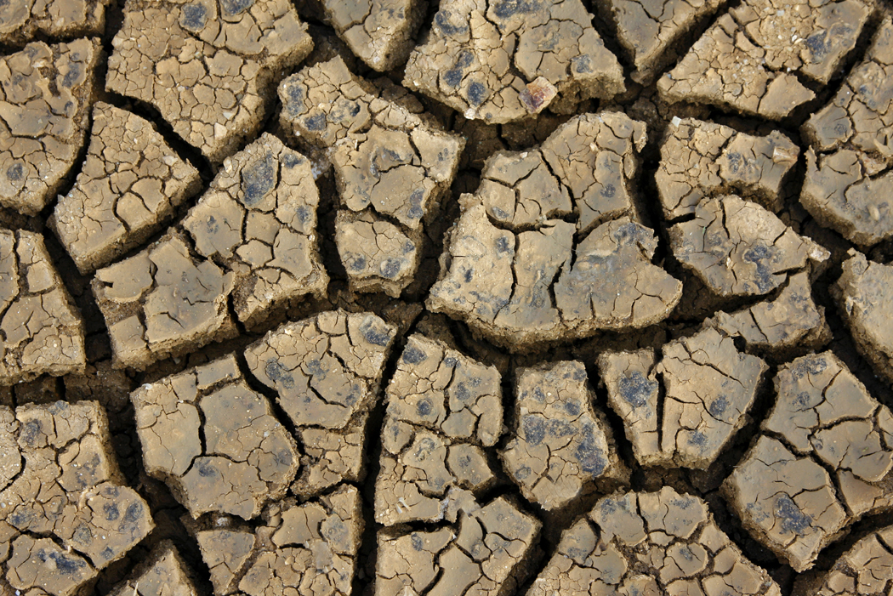

and
The Neolithic

Slide 2
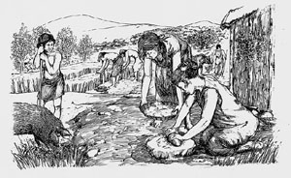

The New Stone Age
(The Neolithic)
The New Stone Age or The Neolithic lasted from 8,000 to 6500 years before Christ.

Slide 3
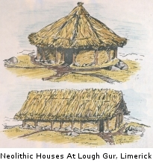
The New Stone Age (The Neolithic Era)
During the Neolithic, people began to settle in one place.

Slide 4
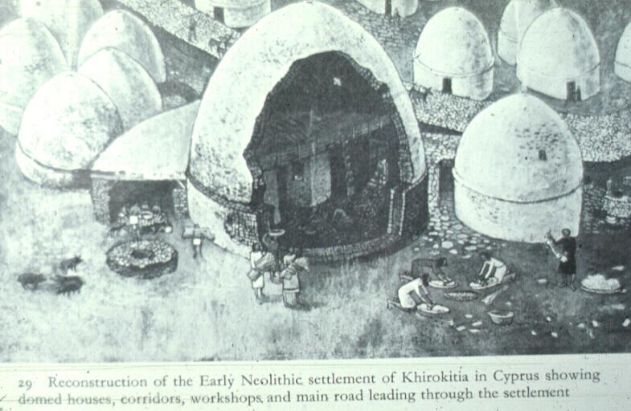

Slide 5
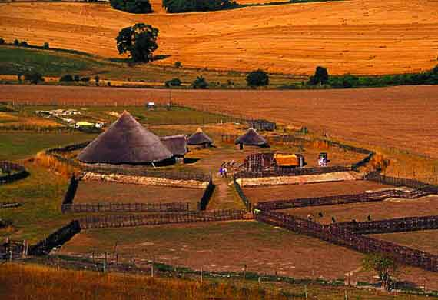
Neolithic Era Settlement

Slide 6
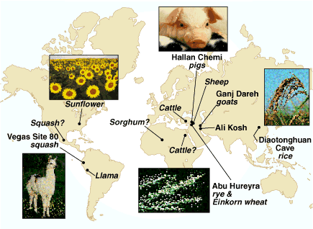
Man began to change his diet and eat grains and small animals and manipulate the environment around him.

Slide 7
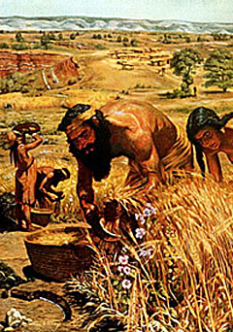
The Development of Agriculture
Agriculture is the raising of crops and animals.
The development of agriculture began over a long period of time and in more than one place.
People no longer needed to travel great distances to gather food.

Slide 8

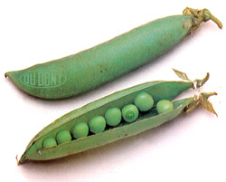
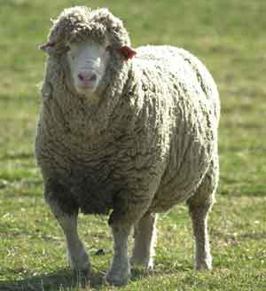
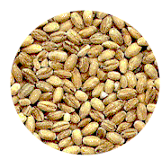
People learned how to domesticate plants and animals.
To domesticate means to train something to be useful to people.
Early people learned to care for plants such as wheat, barley, peas, and lentils.
The first farmers also domesticated wild goats, cattle, and sheep (pastoralism)

Slide 9
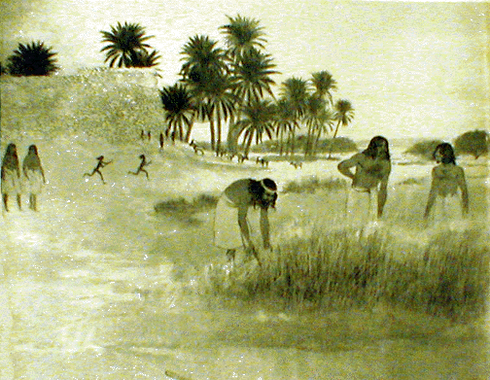
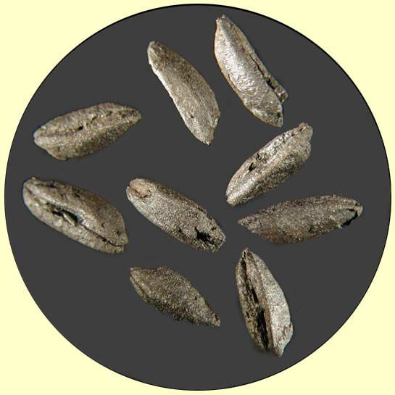
Wheat
Ancient charred wheat grains are shown in the picture above.
Man domesticated wild wheat.

Slide 10
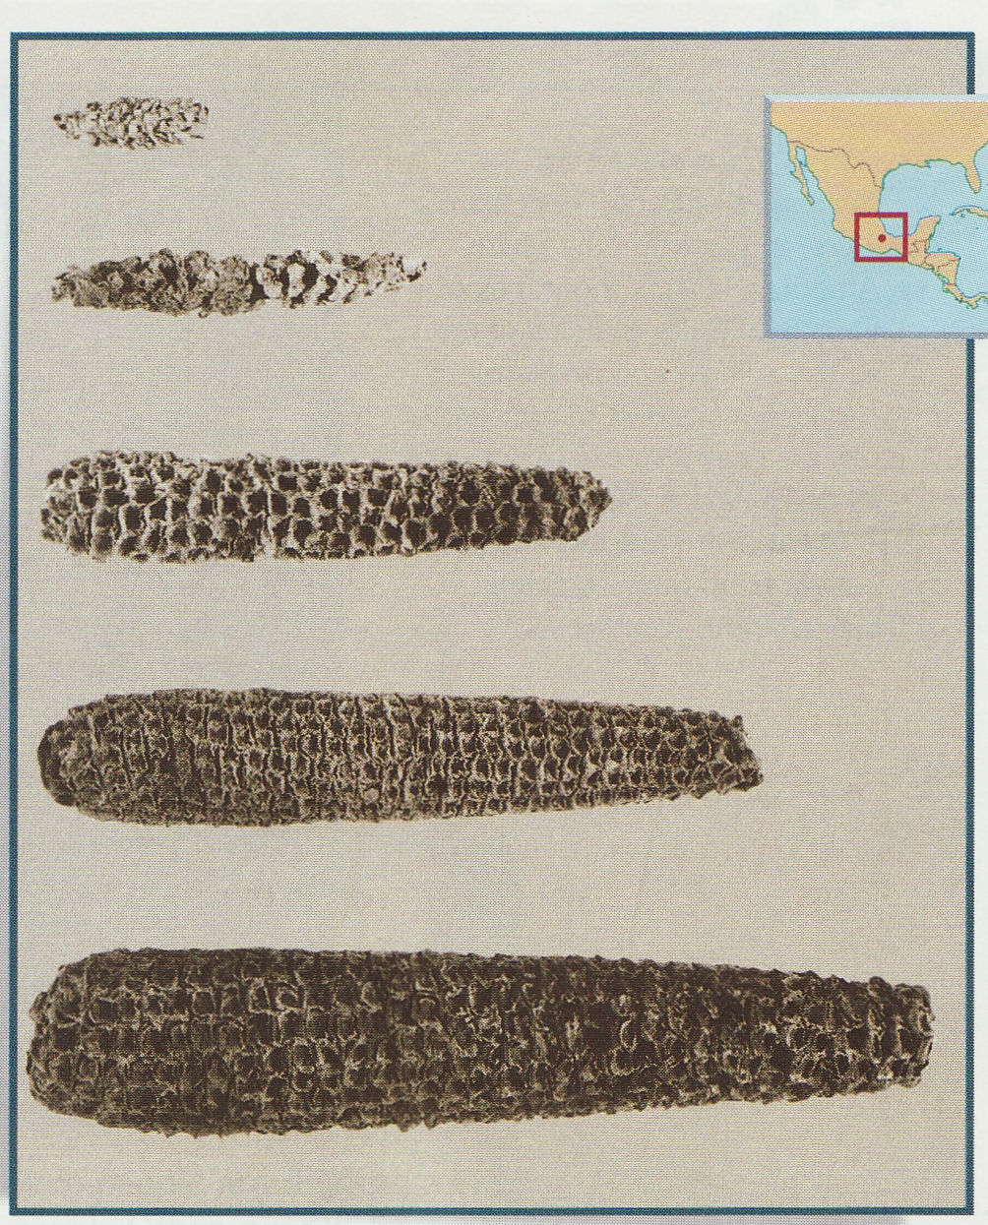
Domesticated
Corn
Thousands of years ago, an ear of corn did not make much of a meal. (top)
It took thousands of years of careful breeding for ears of corn to reach their present size. (bottom)

Slide 11

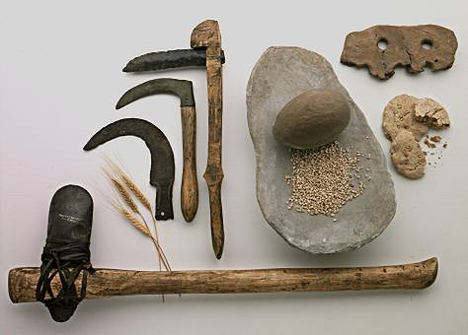
Advanced Tools
These early farming tools date back to around 8,000 years ago. The axe, bottom, was used for clearing; flint sickles, left, were used for harvesting cereal crops; a flat rock and rounded stone, center, were used for grinding flour; and perforated clay slabs, upper right, were probably used to ventilate bread ovens.

Slide 12
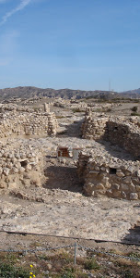
Independent Innovation & Cultural Diffusion
Independent innovation and cultural diffusion led to adoption of agriculture around the world.
As societies increased the domestication of animals and plants, techniques were borrowed and handed on
Seeds and crops were also exchanged, increasing what was grown and traded
Agricultural Advantages:
  Surplus of food meant more dependable supply
  More dependable supply meant greater population growth
  Population growth led to social stratification as societies became more sedentary
  Specialization of labor and private property are natural results of settled lifestyles
  Specialization of labor led to more complex and hierarchical social structures

Slide 13
Cities in the Metal Ages
Agriculture required greater effort and organization so long-lasting settlements formed
Early societies grew into civilizations
  Civilizations were result of # of factors:
    Permanence of population
    Agricultural stability
    Innovation
Cities grew out of cultural sophistication and social complexity
  A city is more than a large group of people living together.
    The size of the population alone does not distinguish a village from a city
      Cities have specialized workers/artisans
      Cities have complex institutions
      Some people became responsible for record keeping
      Technological innovations
  Cities offered:
    Protection and defense
    Points of trade and economic activity
    Centers of political leadership
    Enabled exchange of ideas, information, values and religious beliefs

