Slide 1

The Three age system

Slide 2
The Three age system describes the three prehistoric periods of mankind
Each age is described by the most advanced technology of the time
  Stone tools in the stone age
  The invention of metal working with Bronze in the Bronze age
  The invention of iron working and steel in the Iron age
The Stone age is split into 2 stages;
  The Paleolithic – Old stone Age
  The Neolithic – The New Stone Age
Farming began in the Neolithic and was developed through the Bronze and Iron Ages
People still used stone tools in the Bronze and Iron ages

Slide 3
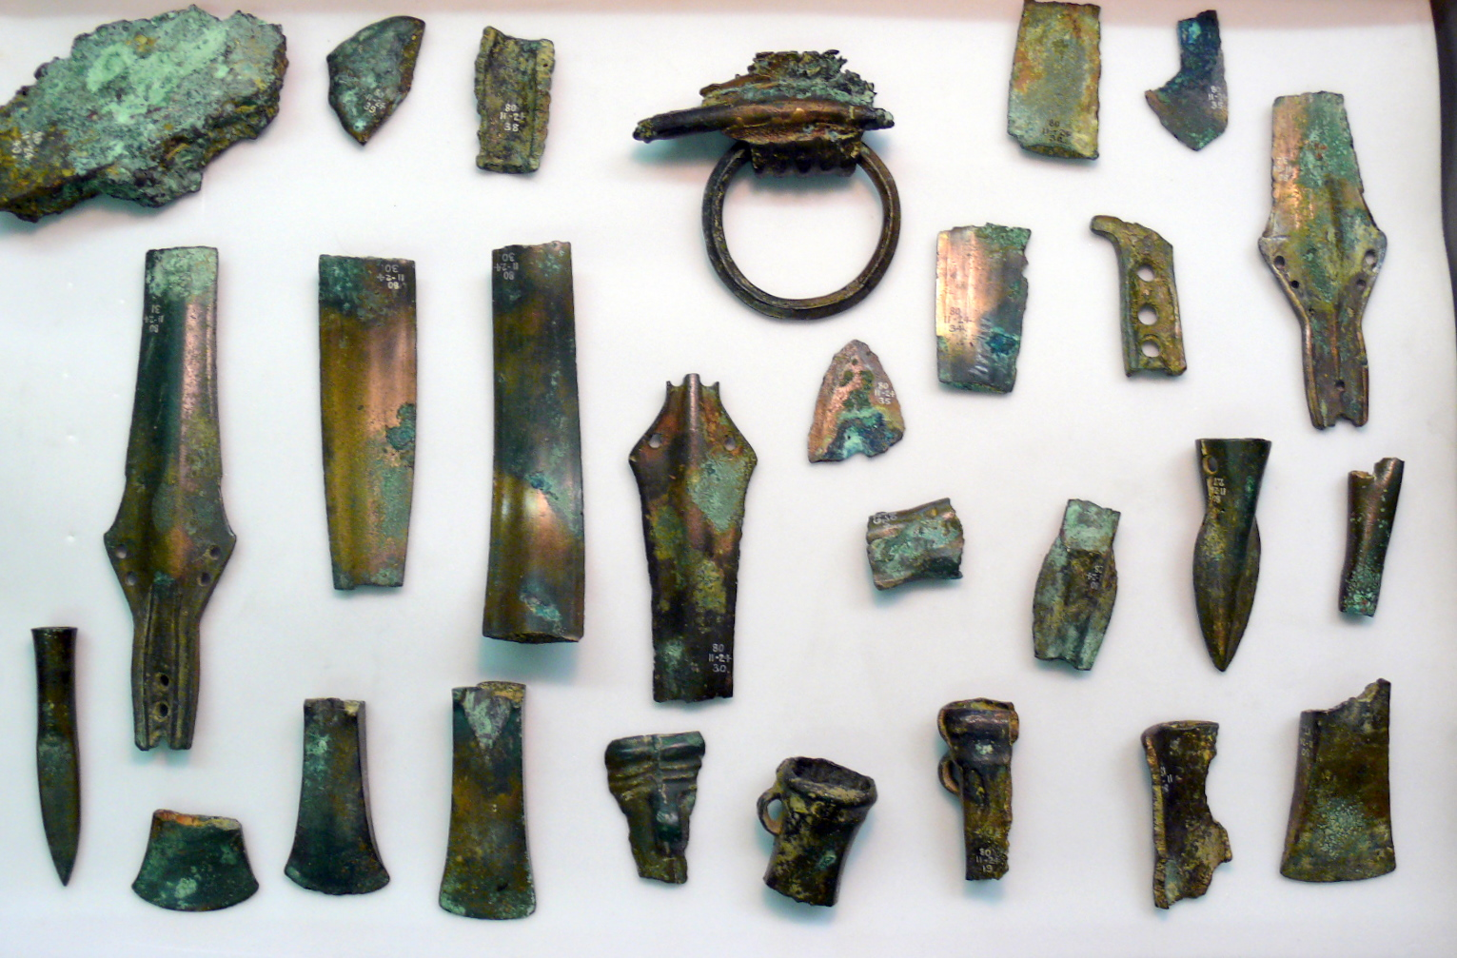
LO: To learn about the three age system
COPPER AGE

Slide 4
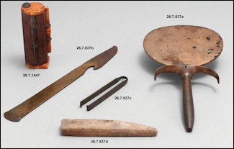
COPPER AGE TOOLS

Slide 5
COPPER WAS THE FIRST METAL TO BE USED. IT STARTED IN THE FERTILE CRECENT. EDGED WEAPONS SUCH AS KNIVES, SWORDS AND AXES WERE MADE OF COPPER AS WELL AS BROOCHES, PINS , BELTS AND VESSELS FOR FOOD AND DRINK.

Slide 6
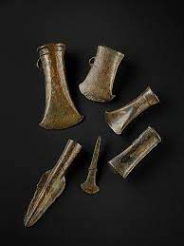
LO: To learn about the three age system
BRONZE AGE

Slide 7
Bronze Age
LO: To learn about the three age system
People started making tools from Bronze
Bronze is a mixture of copper and tin
People began to organise themselves into settlements (small villages) with specialist manufacture of tools.
Farming was more labour intensive than hunting but it allowed people to create food reserves and start building communities.

Slide 8
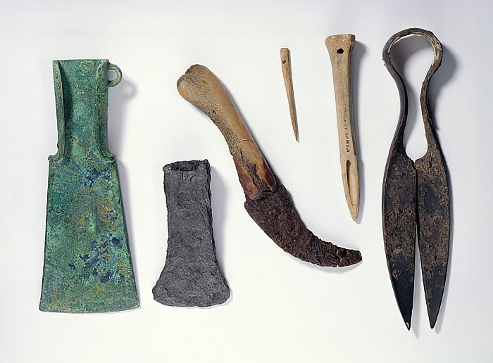
LO: To learn about the three age system
Iron Age

Slide 9
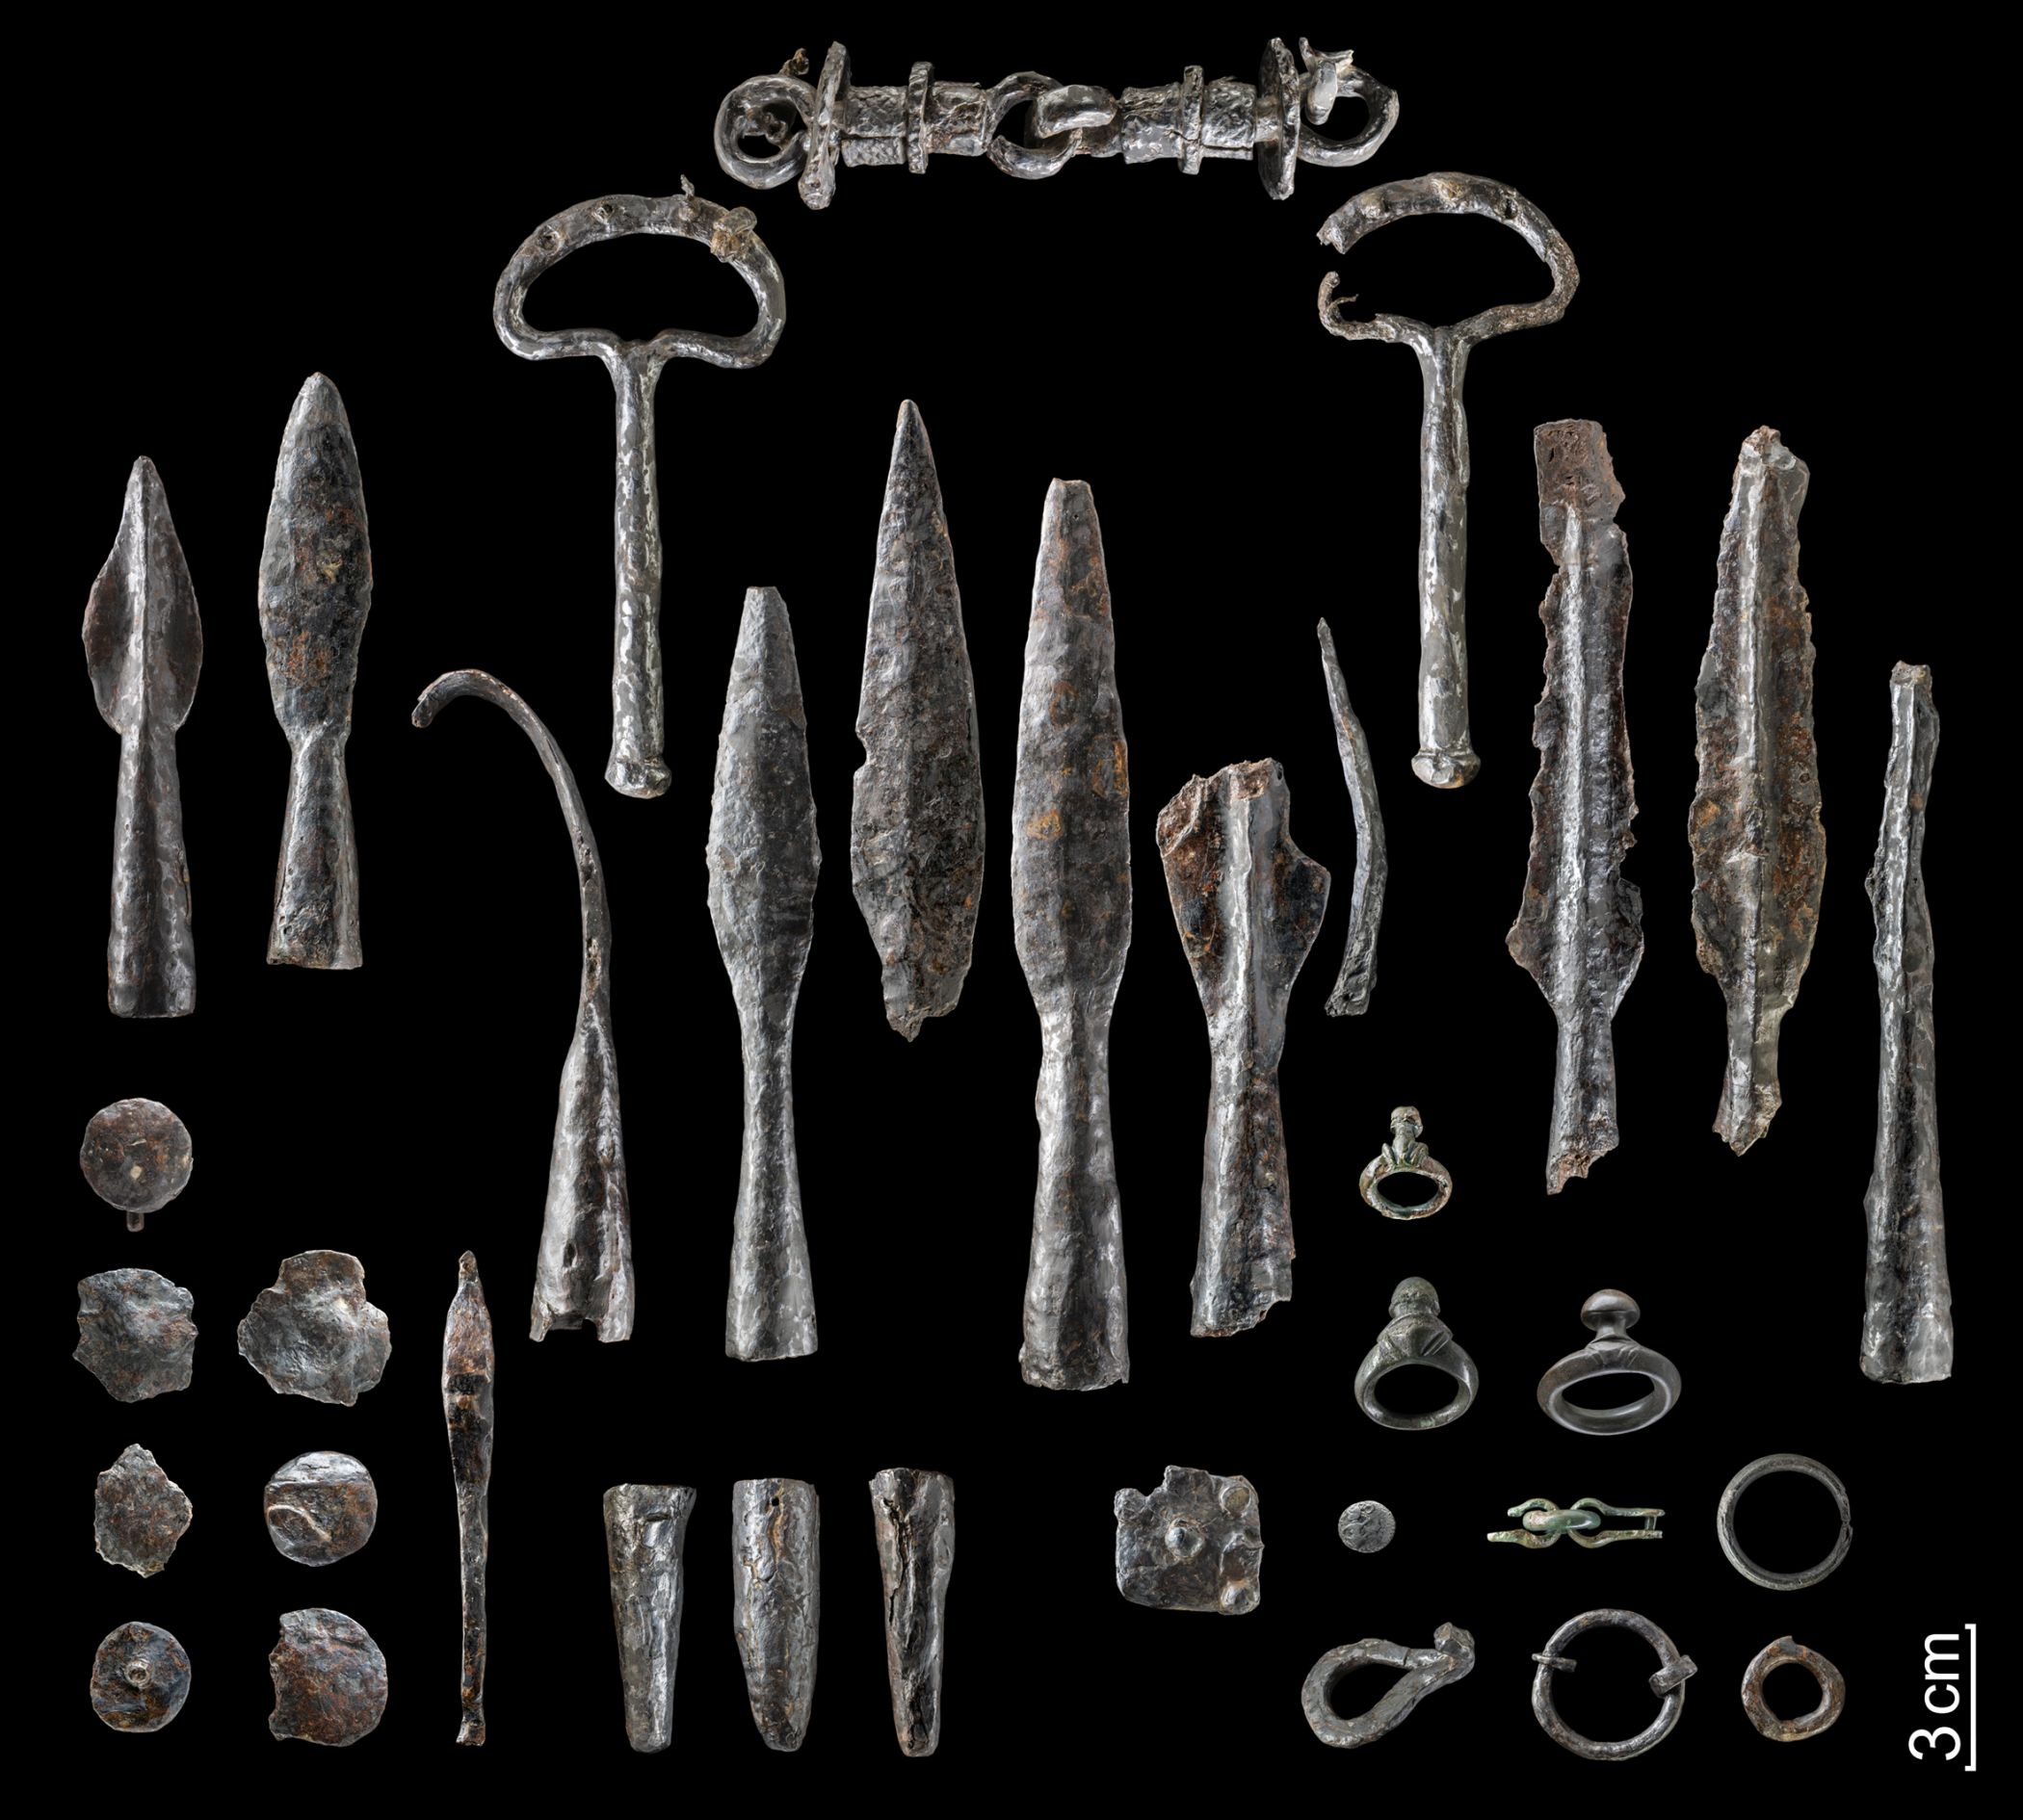
IRON AGE
WEAPONS

Slide 10
LO: To learn about the three age system
Iron Age
Iron is harder to make into tools than Bronze because it melts at higher temperatures
But it is much harder than bronze so if you can make Iron tools you can make much stronger and better tools.
This allowed farming to become more efficient
Iron weapons where much deadlier than bronze weapons and societies with Iron weapons could overpower societies with bronze weapons and armour.

Slide 11
LO: To learn about the three age system
Task: Write 1 Paragraph about the 3 age system and draw a timeline of the 3 age system in your books.
WT: Describe the three age system and draw a timeline using the support sheet.
WA: Draw the timeline and describe the three age system with at least 1 fact about each of the three ages.
GD: Draw the timeline and describe the three age system with at least 2 facts about each of the three ages. Try and describe the transition between the three ages.

