Slide 1
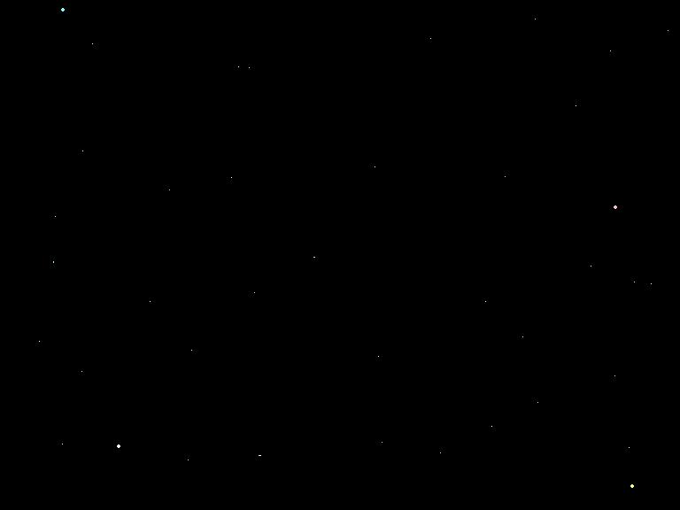
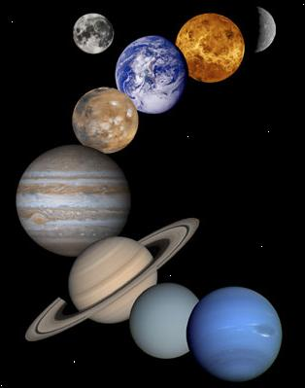
The Solar System
MARÍA SANZ

Slide 2
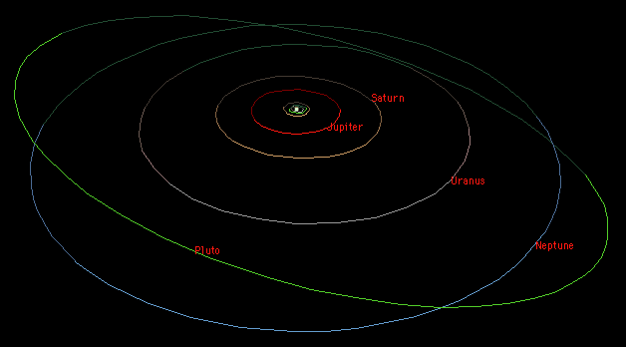
Overview
There are eight planets in our solar system that orbit around the Sun. Pluto is considered a dwarf planet.
SUN
ORBITS

Slide 3
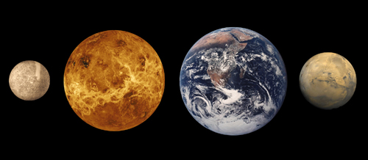
The 1st Four Planets
These first four planets are all terrestrial planets.
MERCURY
MARS
VENUS
EARTH

Slide 4
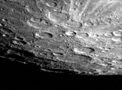
1. Mercury
Mercury is the closest planet to the Sun.
Because Mercury is so close to the Sun, it is hard to see
from Earth except during twilight.
Its surface temperature ranges from 467°C to -183°C because it has no atmosphere.
Surface: similar to the Moon’s.
This planet has no satellites.
Interior: nickel-iron core.

Slide 5
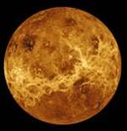
2. Venus
Venus is the brightest planet in the sky.
Venus is very similar to Earth in size, mass, composition, and distance from the Sun.
It is the hottest planet.
The major components of Venus’s atmosphere is made up of carbon dioxide and nitrogen, this produces a greenhouse effect.
Similar to Earth, Venus has clouds. However, they are made of sulfuric acid.
Surface: Smooth because of lava flow.
Interior: Liquid metal core.
This planet has no natural satellites.

Slide 6
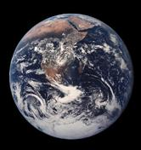
3. Earth
Our home planet is the only planet in the solar system known to harbor life.
Our moderately dense atmosphere is composed of primarily of nitrogen and oxygen.
Earth’s axis is tilted.
Surface: Is solid with water.
Interior: Mantle (molten rock) Core (solid iron and nickel).
This planet has 1 natural satellite called the Moon.

Slide 7
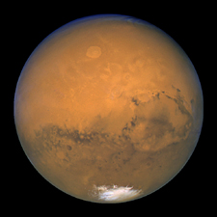
4. Mars
Like the other terrestrial planets, Mars is small and rocky.
It has volcanic activity and tectonic motion, just like Earth.
Mars has red soil because of the Iron Oxide (rust).
Its atmosphere is very similar to that of Venus. Though it is very thin it is very turbulent , so that there is a constant wind on Mars.
There are canyons and dried rivers suggesting that water once existed here.
Mars is home to Olympus Moons, the largest volcano in our solar system.
Interior: Iron, nickel and possibly sulfur.
This planet has 2 natural satellites.

Slide 8
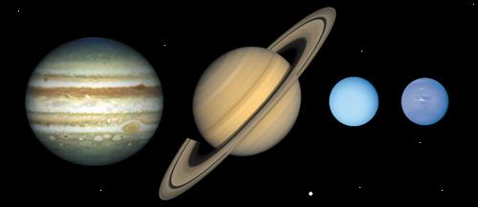
Planets 5, 6, 7, & 8
These four planets are all giant gas planets.
URANUS
NEPTUNE
JUPITER
SATURN

Slide 9
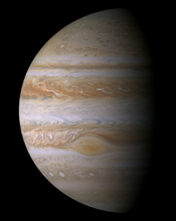
5. Jupiter
Jupiter is the largest of the planets.
Natural Satellites: 16 composed of ice and rock.
Atmosphere: composed of hydrogen and helium and has a magnetic field.
Surface: contains BELTS (low, warm, dark colored clouds) and ZONES (high, cool, light colored clouds).
Rotation: 10 hours making it the shortest day in the solar system.
Great Red Spot: a storm on Jupiter for the last 300 years.
RED SPOT

Slide 10
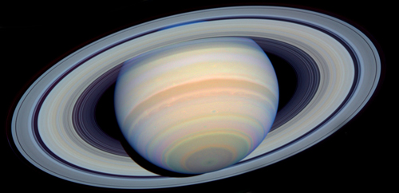
6. Saturn
Atmosphere: mostly hydrogen and helium with a magnetic field.
Surface: has Zones and Belts as well with winds of
Rings: there are 7 rings composed ice and rocks.
Natural Satellites: 7

Slide 11
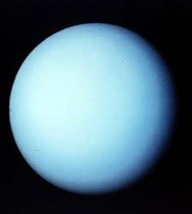
7. Uranus
Atmosphere: Hydrogen and Helium with Methane gas giving its blue/green color.
Rings: 10 made of ice and rocks.
Natural Satellites: 18
Surface: completely fluid with a magnetic field.
Core: small and solid.
AKA: the sideways planet.

Slide 12
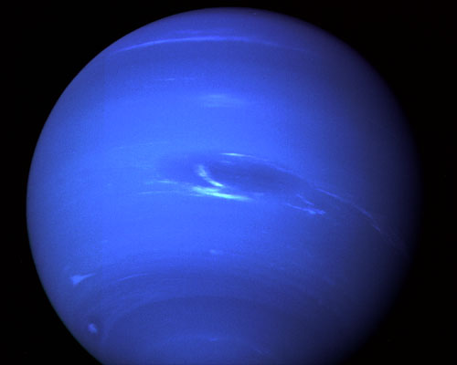
8. Neptune
Atmosphere: is mainly composed of methane, giving Neptune its bluish color. It also has Belts and Zones.
The Great Dark Spot: a storm.
Natural Satellites: 8

Slide 13
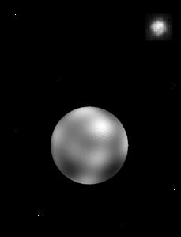
Pluto, a dwarf planet-
NOT A PLANET ANY MORE
Pluto is so small, and so far away that it is hard to photograph and study.
Atmosphere is made up of Nitrogen and Methane.
Natural Satellite: 1
Surface: very similar to the Gas Giants.
It is now know as a Dwarf Planet.
Natural Satellite

Slide 14
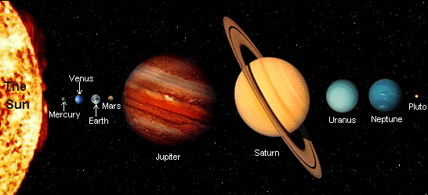
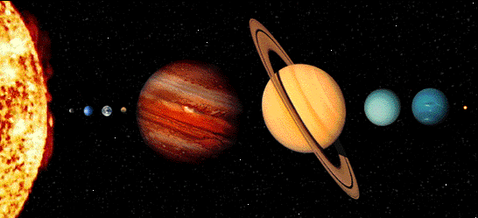
Recap of the Planets
My Very Enthusiastic Mother Just Served Us Nine Pizzas

Slide 15
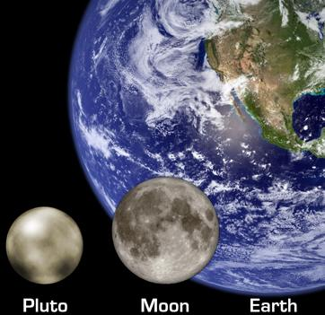
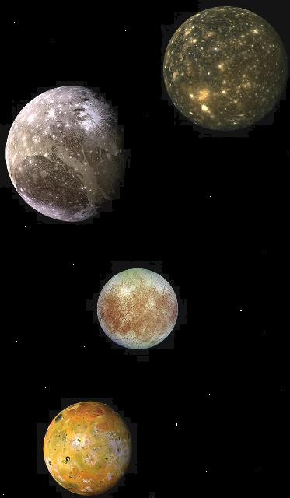
Moons
What’s the difference between a moon and a small planet?

Slide 16
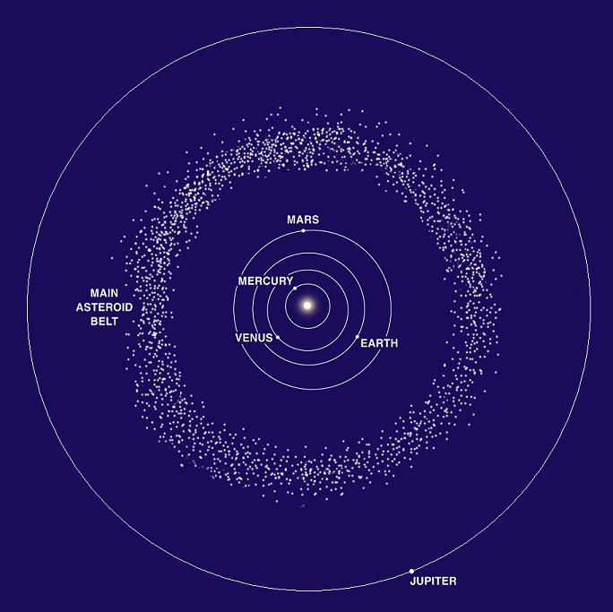
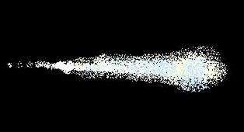
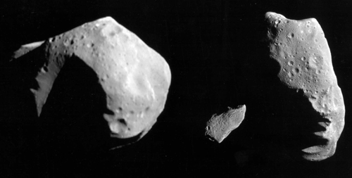
Other Stuff in our Solar System
Meteors
Asteroids

