Slide 1
DROUGHT

Slide 2
Throughout this presentation you will learn

Slide 3
INTRODUCTION TO DROUGHT
MITIGATION OF DROUGHT
CAUSES OF DROUGHT
CONTENT
TYPES OF DROUGHT
EFFECTS OF DROUGHT
HISTORY OF DROUGHT

Slide 4
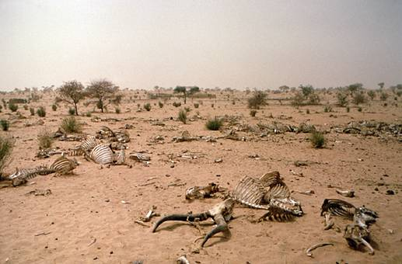
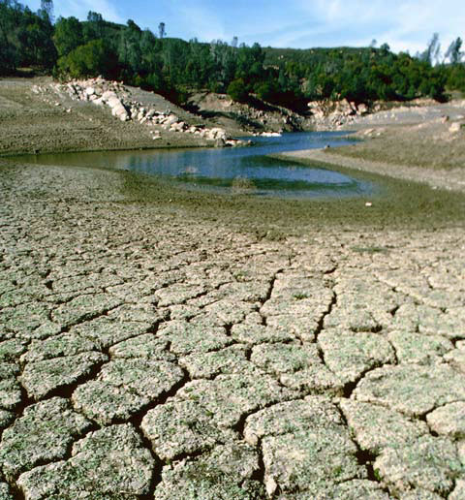
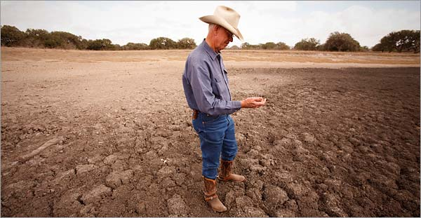
Look at the pictures and tell what you observe?

Slide 5
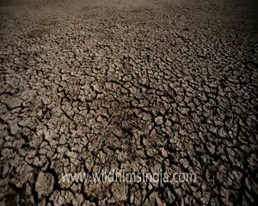
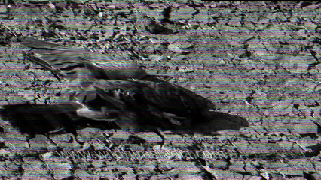

Slide 6
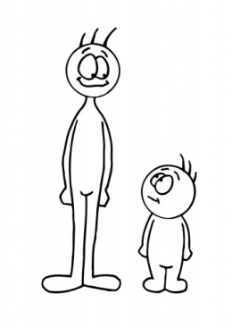
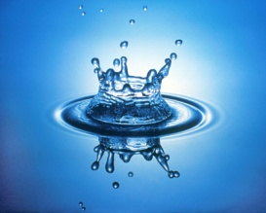
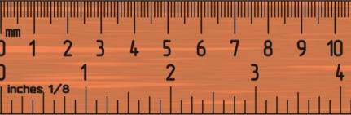

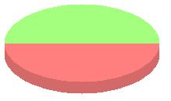
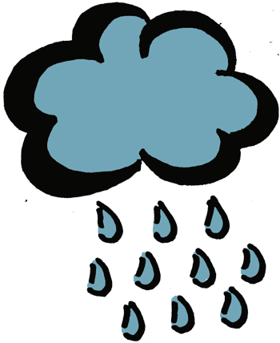
Drought Is
A lack or of for an unusually period of , involving less than the usual over 3 months
A lack or shortage of water for an unusually long period of time, involving 50% less than the usual rainfall over 3 months

Slide 7
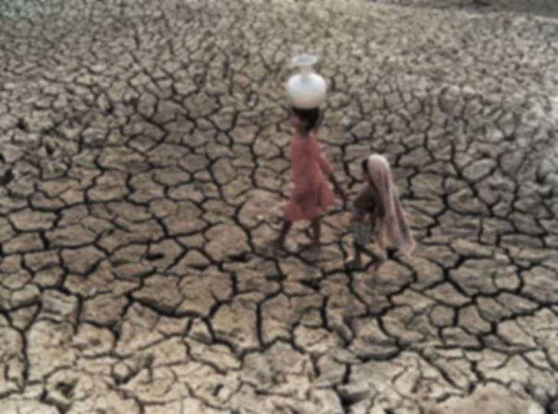
The land is barren and covered in thin dust. Cracks appears in the earth’s.
This is drought

Slide 8
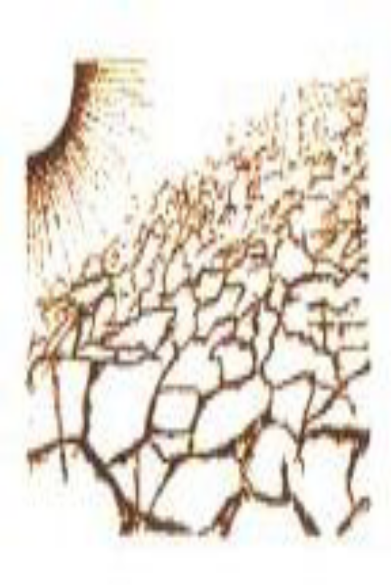
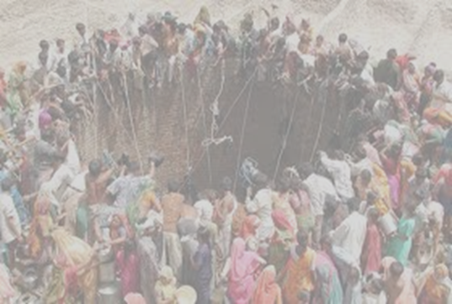
DROUGHT
What do you mean by drought?
The word drought instantly brings image of dry, parched land, no rainfall, crop failures, starvation and bad living conditions to our mind.
In simple terms, drought is a condition of acute scarcity of water, food, fodder, and employment due to scanty rainfall in an area.

Slide 9
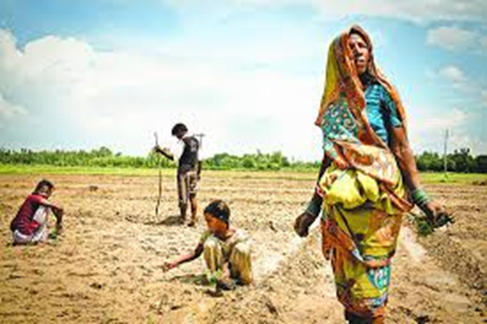
Are we all vulnerable to drought?
It is one of the most widespread disaster affecting more than 70% of cultivable land.
Often, people do not react to drought like they do to other sudden disasters such as earthquakes, cyclones, and floods.
Since drought conditions develop over period of time, and without immediately perceptible changes to environment.

Slide 10
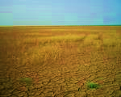

How a drought starts
A drought starts when total rainfall is well below average for several months
Other signs of drought include:
Very dry soil
Trees have a sign of dying
Weather getting hotter and hotter
Very dry soil

Slide 11
CAUSES OF DROUGHT
Deficiency Of Rain Water
Deforestation
Soil Erosion
Global Warming

Slide 12
Types of drought
There are 3 types of drought. They are as follows:
Meteorological Drought
Hydrological Drought
Agricultural Drought

Slide 13
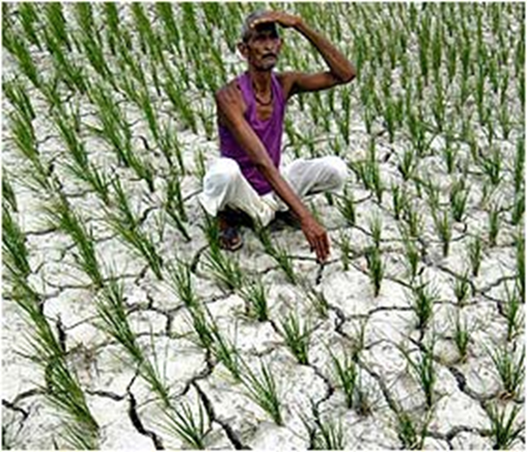
Meteorological Drought
Meteorological drought is generally defined by comparing the rainfall in a particular place and at a particular time.
This happens when the actual rainfall in an area is significantly less than the climatological mean of that area.
Meteorological drought leads to soil moisture and this always has an effect on crops production.

Slide 14
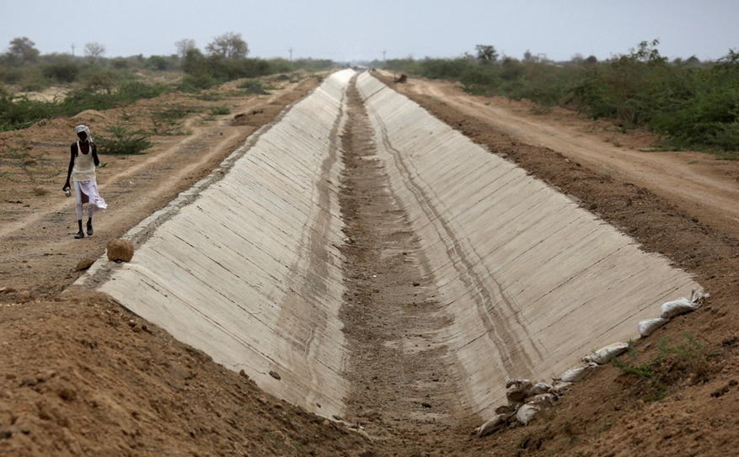
Hydrological Drought
Hydrological Drought is associated with the affect of low rainfalls on water level in reservoirs, rivers & lakes .
This type of drought are noticed sometimes after a meteorology drought.
A hydrological drought change in water level affects eco-system.

Slide 15
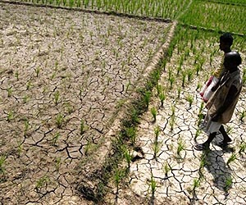
Agricultural Drought
Agricultural drought occurs when there isn’t enough water for a crop to grow at the particular time.
This type of drought doesn’t depend only in the amount of rainfalls where water is used carelessly for irrigation and other purpose.

Slide 16
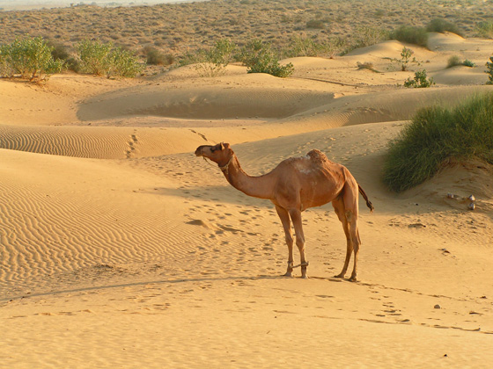

Slide 17
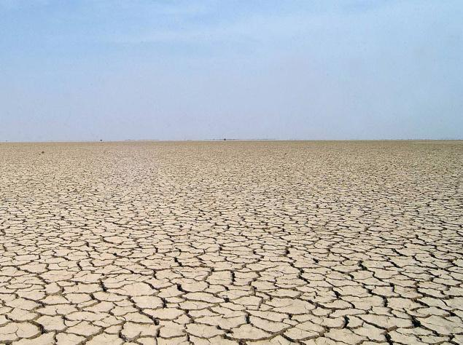

Slide 18
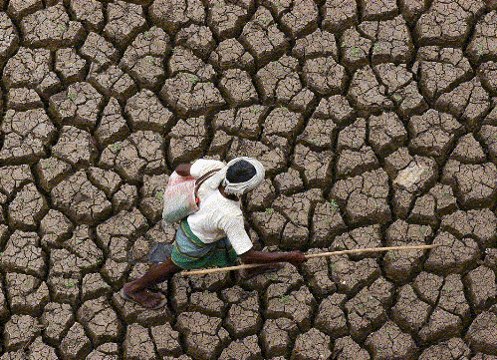

Slide 19
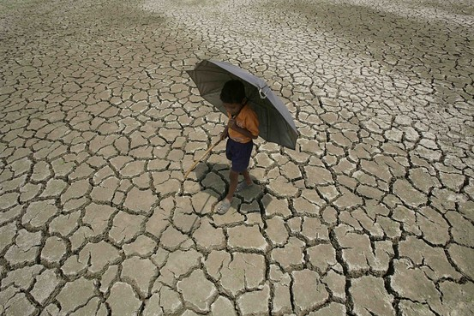
Drought-in-Odissa: Mayurbhanj-Balasore

