Slide 1
WEATHERING, EROSION AND DEPOSITION
IES SAN JUAN BAUTISTA
MARÍA SANZ

Slide 2
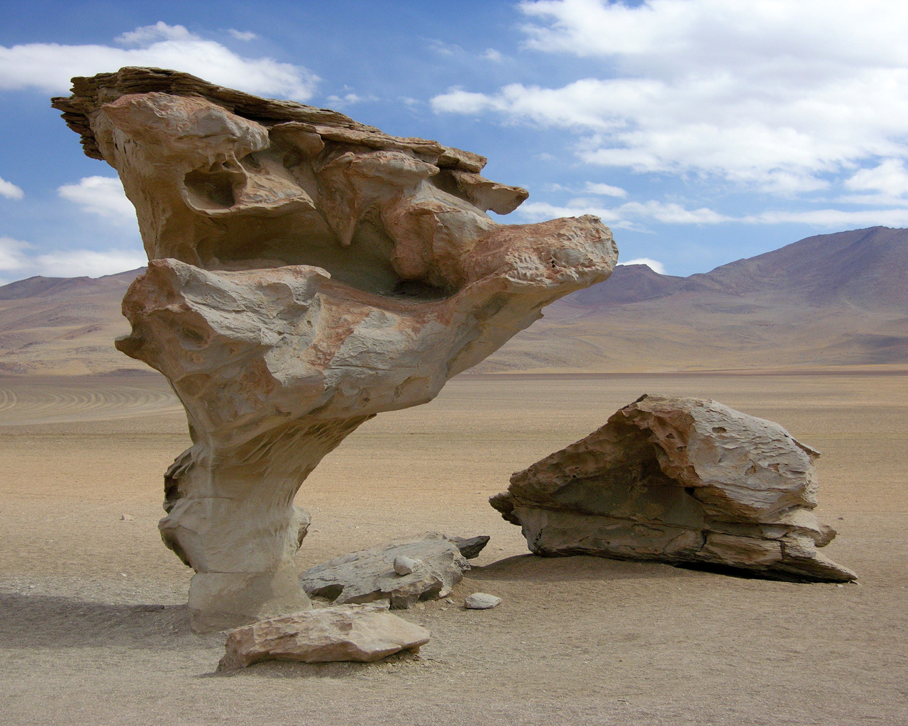

Slide 3
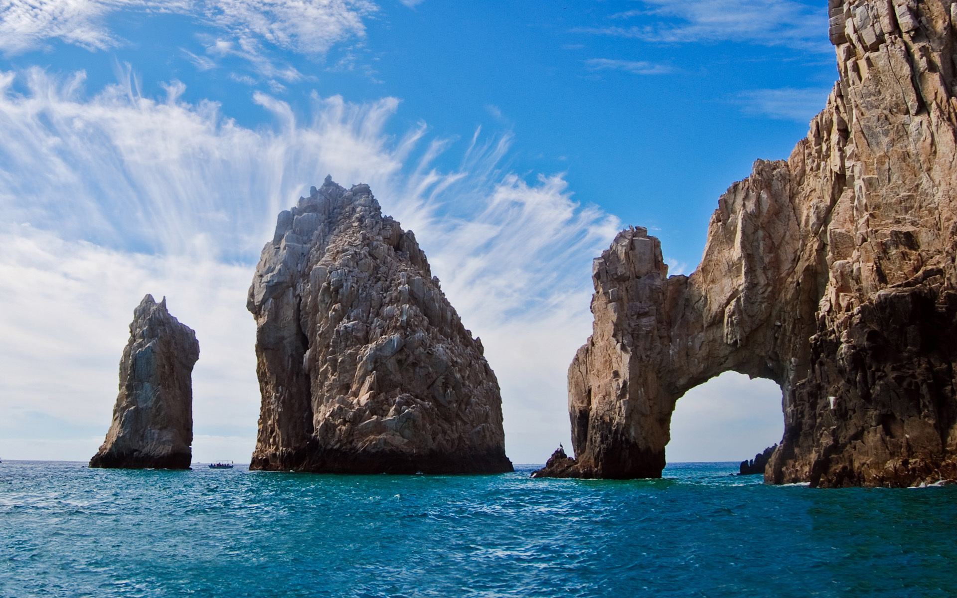

Slide 4
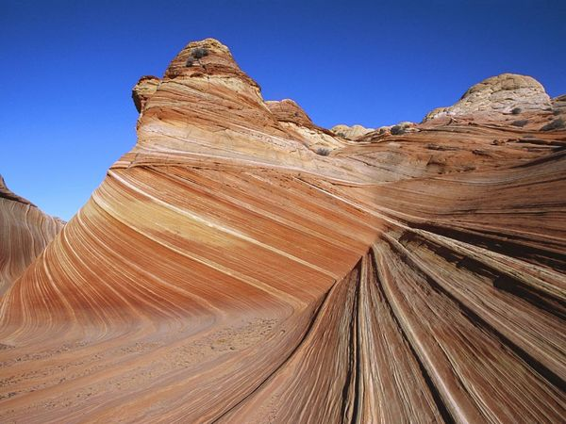

Slide 5
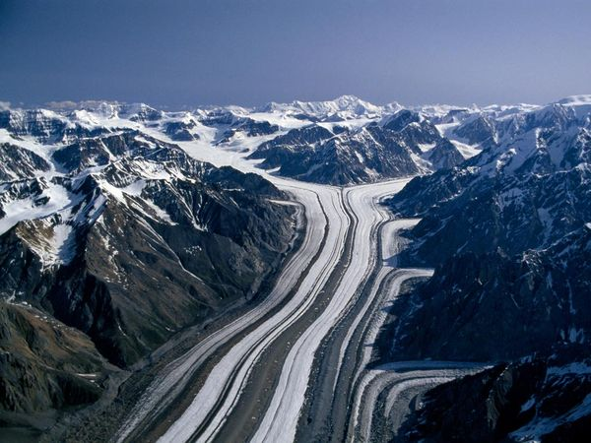

Slide 6
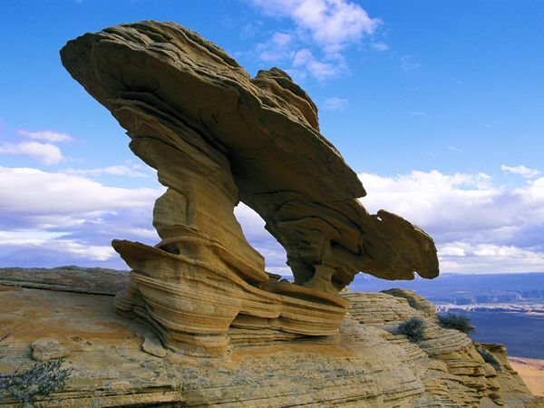

Slide 7
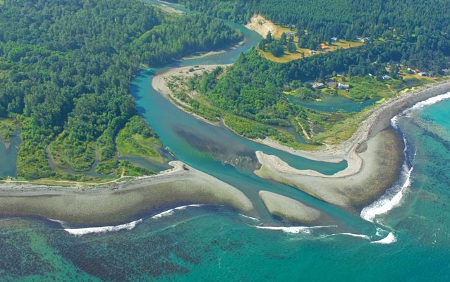

Slide 8
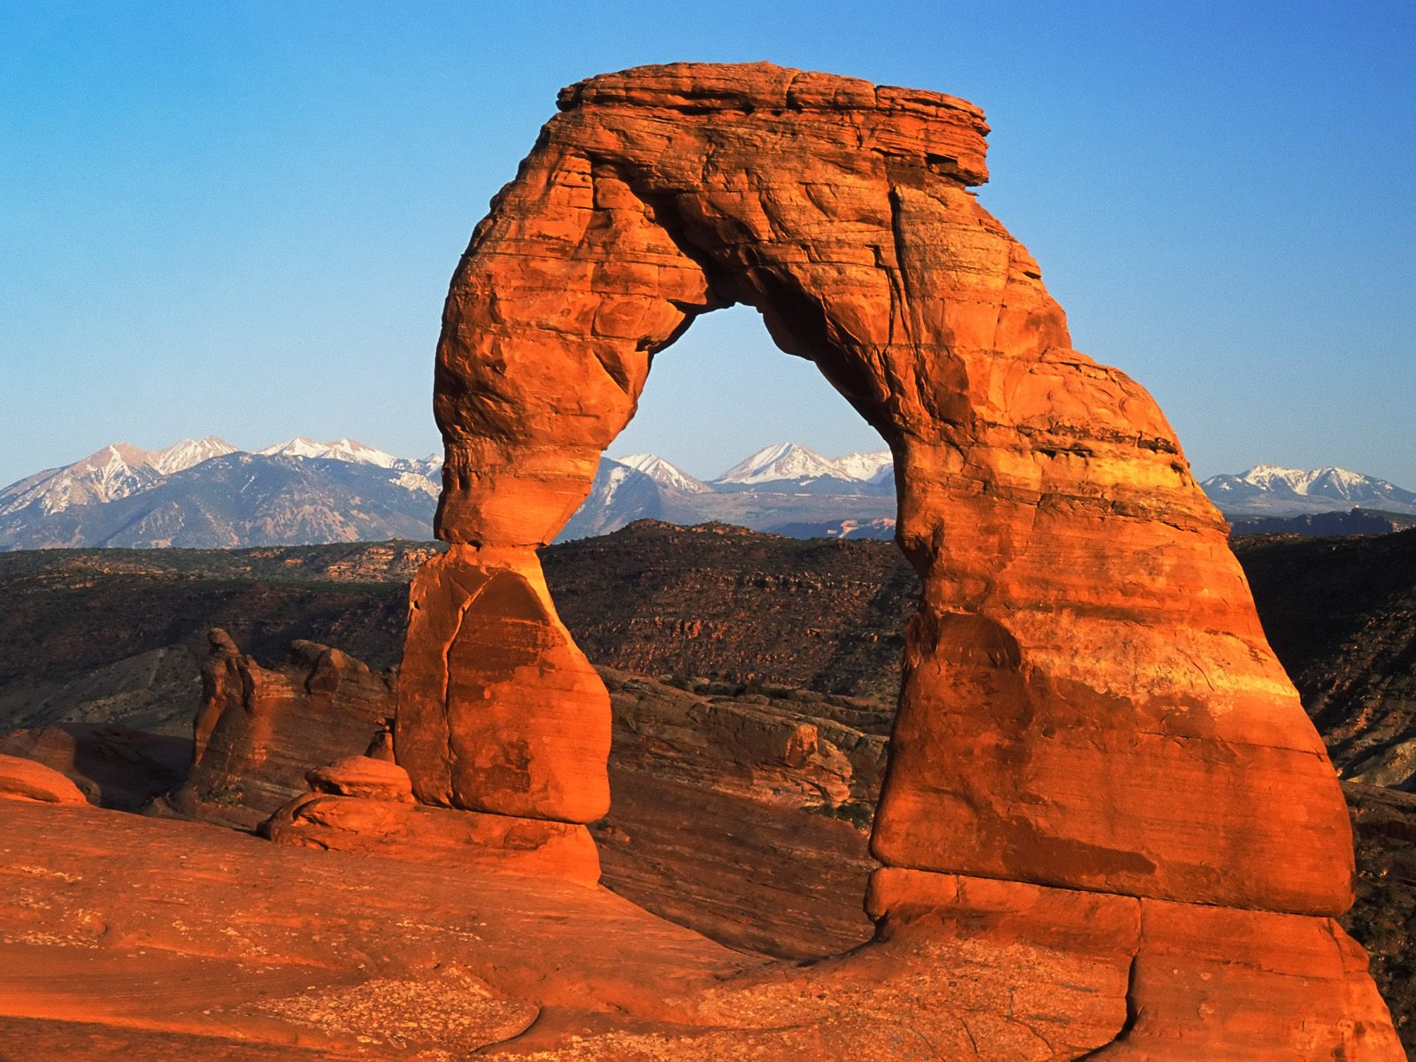
Weathering is the process that breaks down rock and other substances at Earth’s surface.

Slide 9
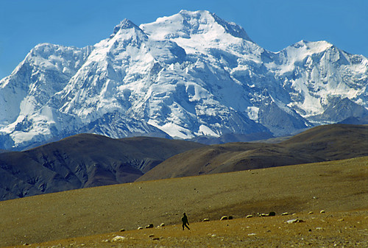
Weathering wears mountains down to hills and can produce strange rock formations like in the previous slide.

Slide 10
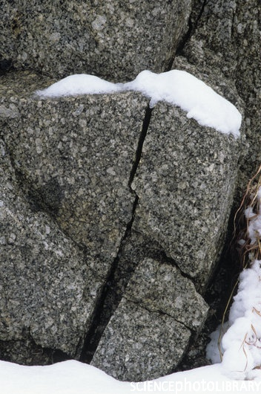
Example of Weathering:
Frost
Wedging

Slide 11
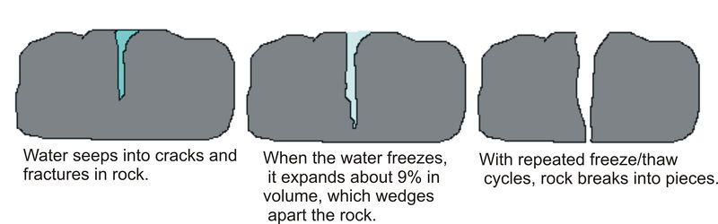
Weathering:
Frost Wedging
]

Slide 12
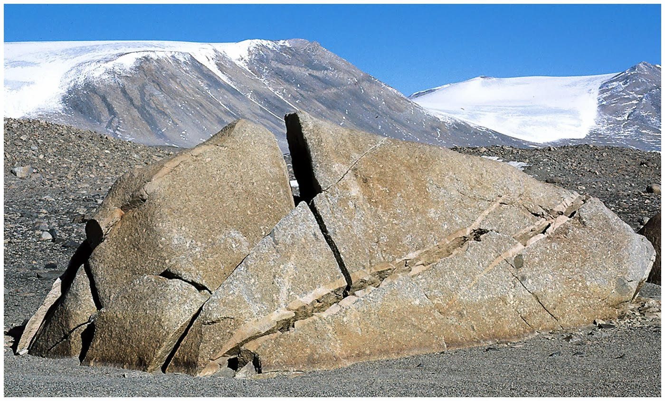
Mechanical Weathering:
Frost Wedging

Slide 13
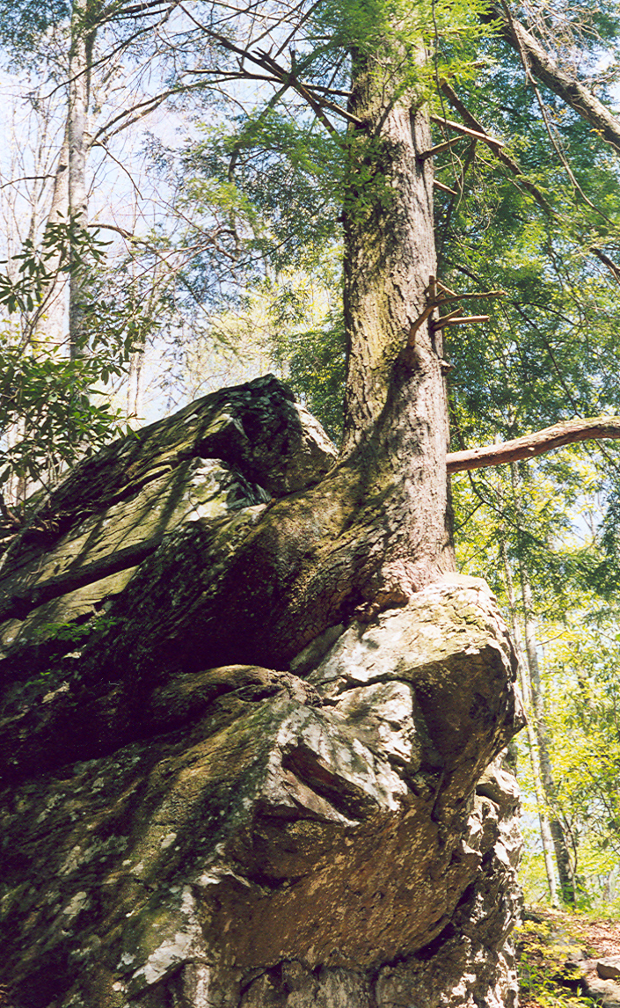
Weathering:
Biological
Weathering

Slide 14
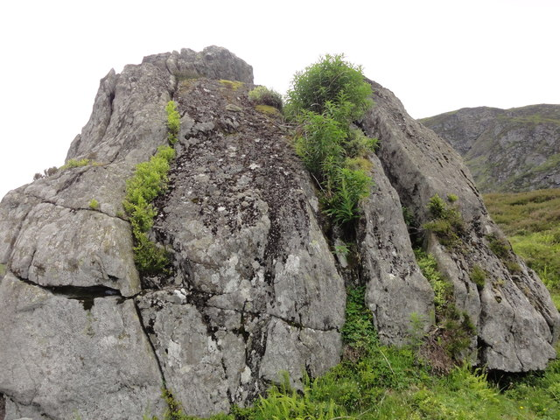
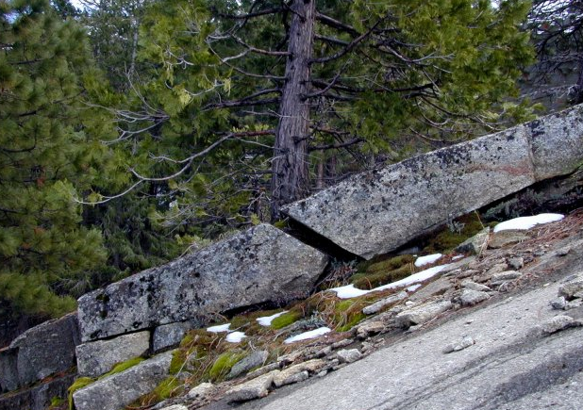
Water and nutrients collect in the cracks of rocks that can result in the growth of plants. As the roots grow, they enlarge the cracks.

Slide 15
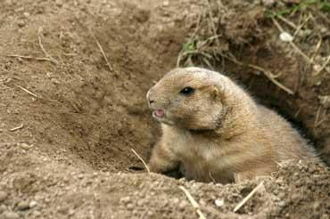
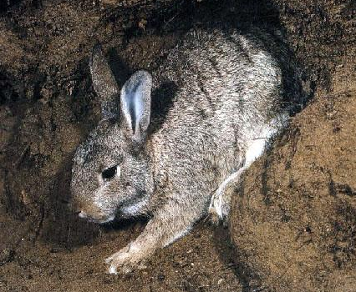
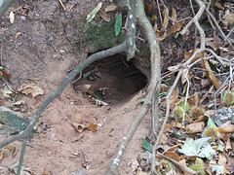
Burrowing animals also cause weathering. They loosen sediment and push it to the surface as they dig.

Slide 16
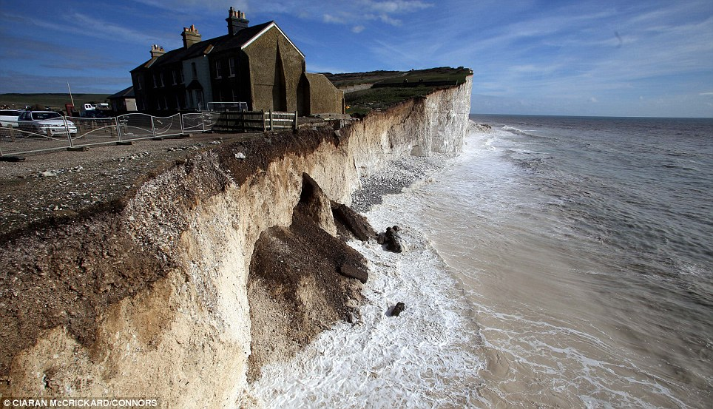
Erosion

Slide 17
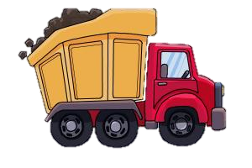
Erosion transports weathered rock material.

Slide 18
What are some ways that weathered material can be transported?

Slide 19
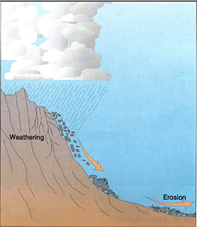
Erosion by Gravity
Rocks and other materials, especially on steep slopes, are pulled toward the center of Earth by gravity.

Slide 20
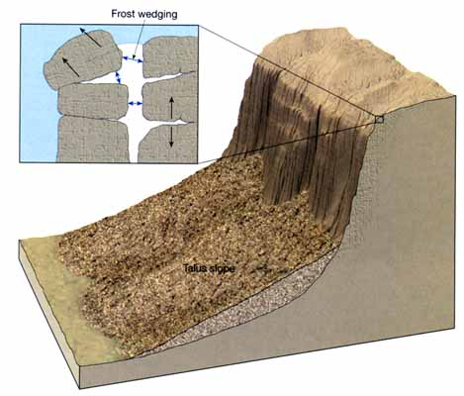
Here, the weathering occurs by frost wedging
The erosion occurs by gravity

Slide 21
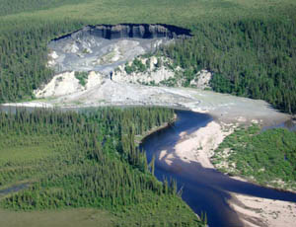
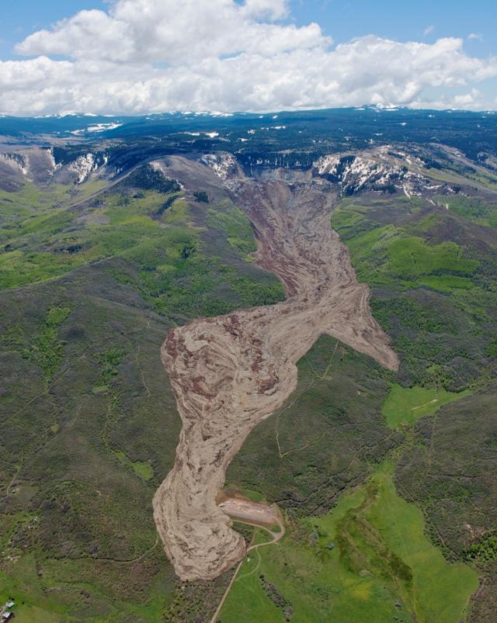
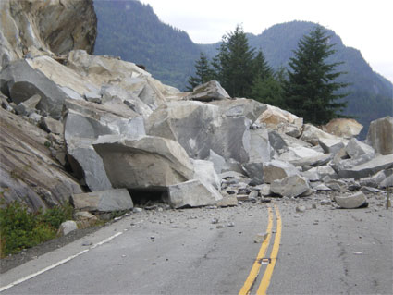
Erosion by Gravity
Slump
Rock Slide
Mud Slide

Slide 22

Erosion by Wind
When air moves, it picks
up loose material and transports it to other places.

Slide 23
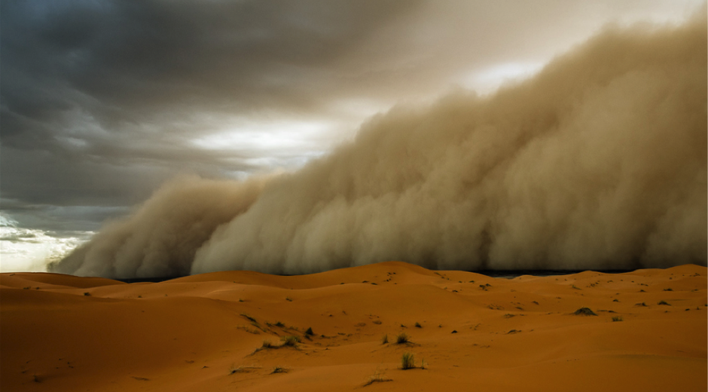
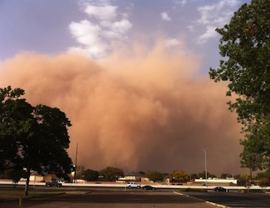
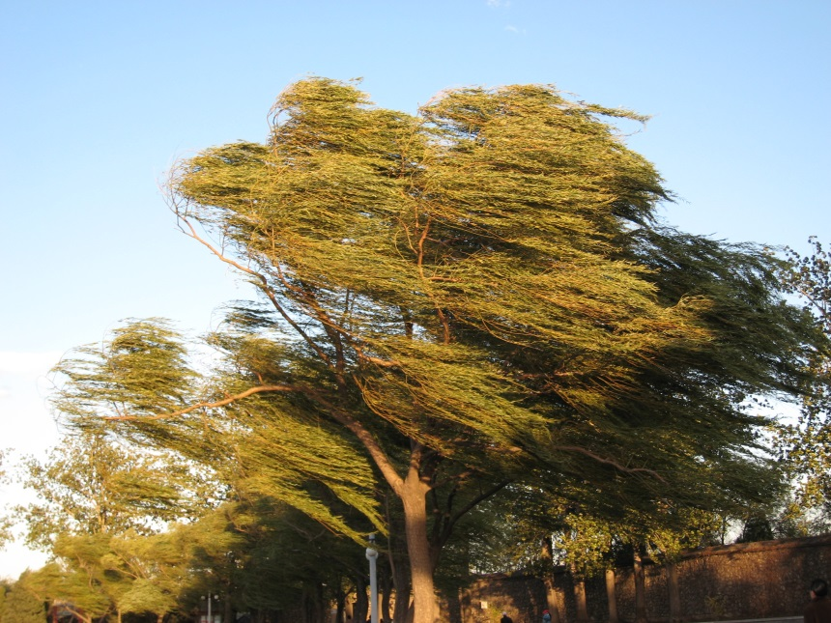
Erosion by Wind
Sandstorm
Dust Storm
Strong Winds

Slide 24
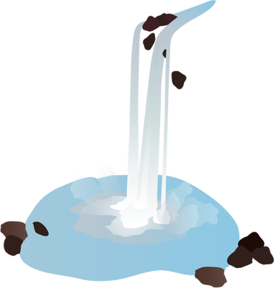
Erosion by Water
When water moves, it picks
up loose material and transports it to other places.

Slide 25
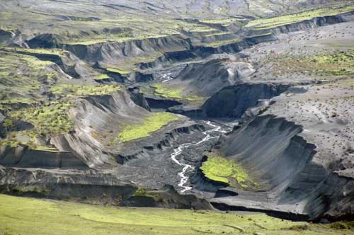
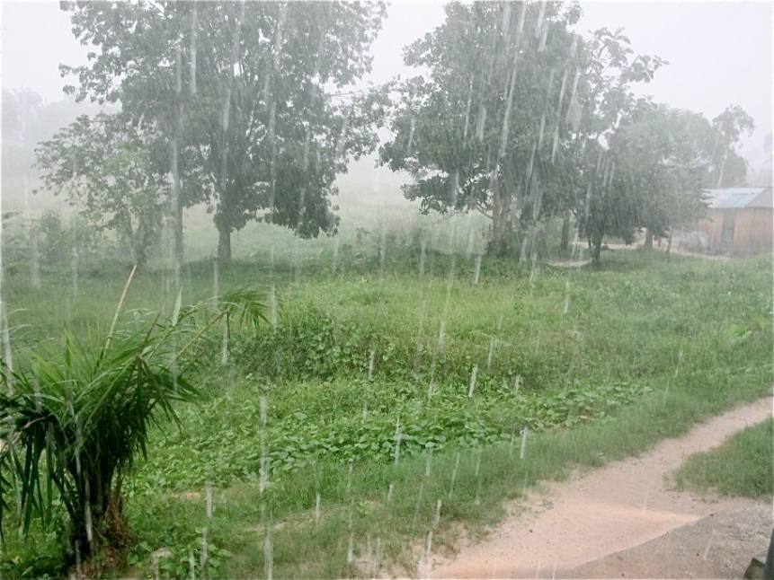
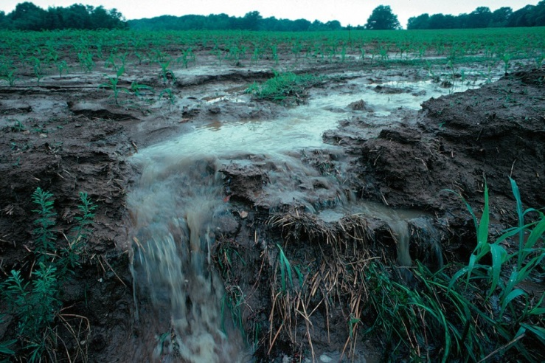
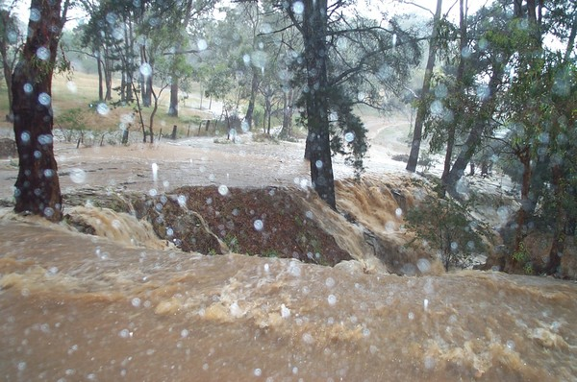
Erosion by Water
Rivers or Streams
Rain
Runoff
Flooding

Slide 26
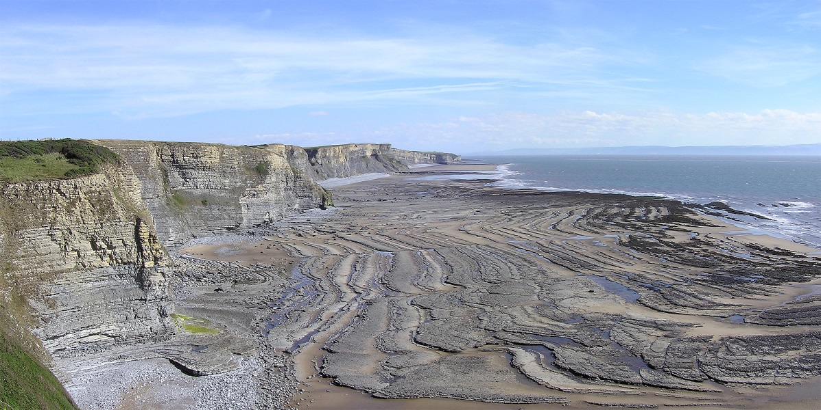
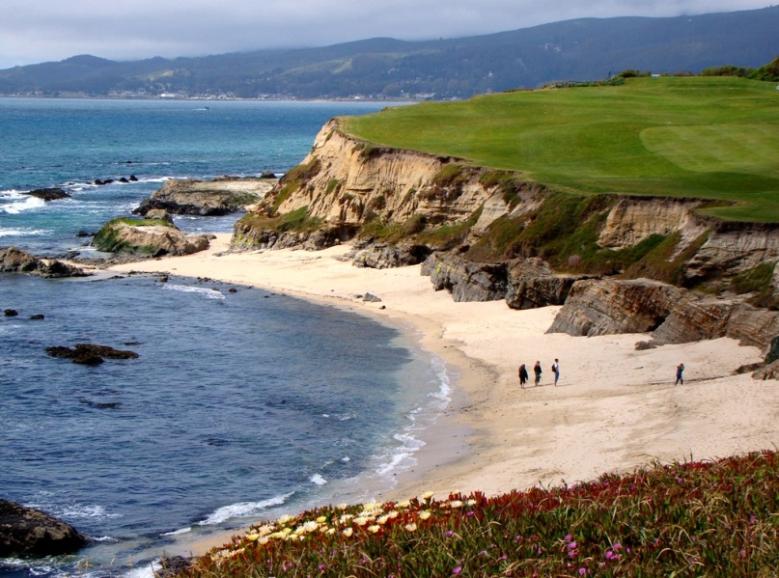
Erosion by Water
Waves eroding the shoreline
Images of Wave Erosion

Slide 27
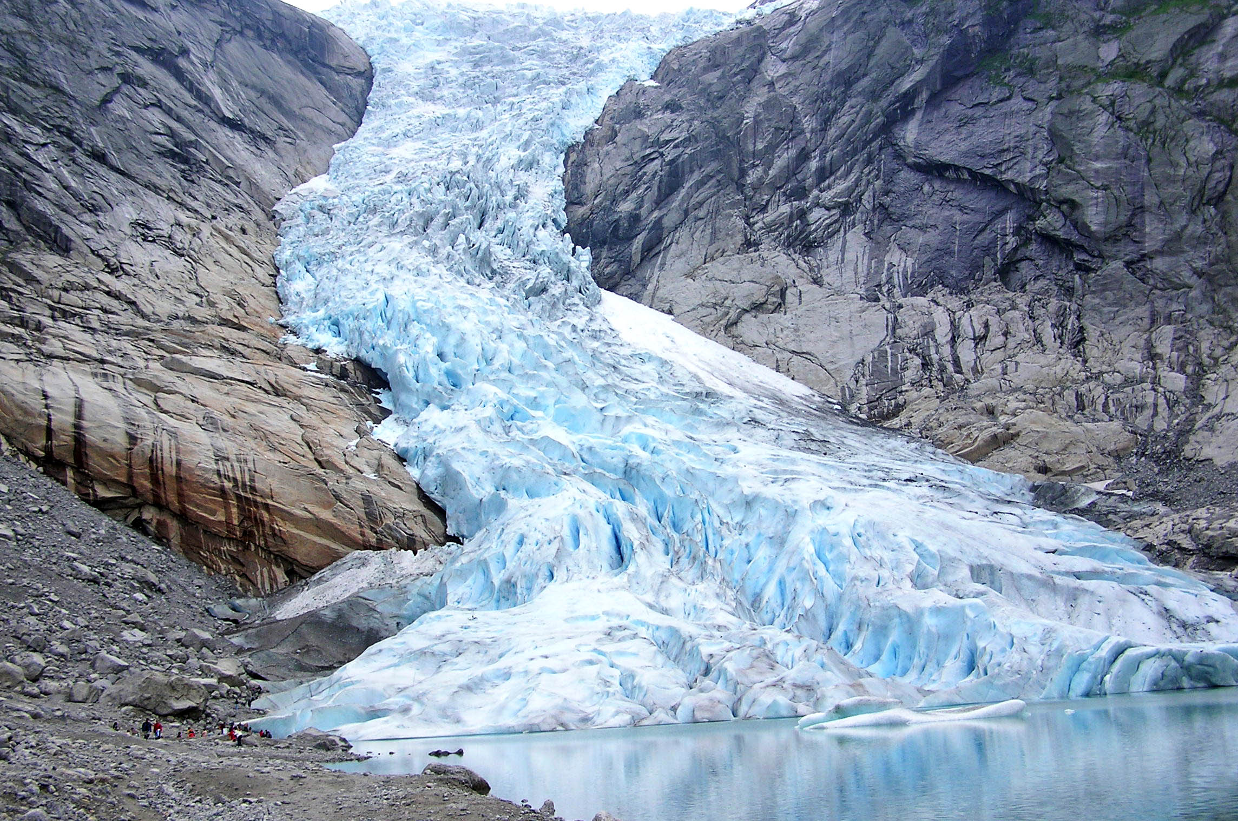
Erosion by Ice
When a glacier moves, it picks up loose material and transports it to other places.

Slide 28
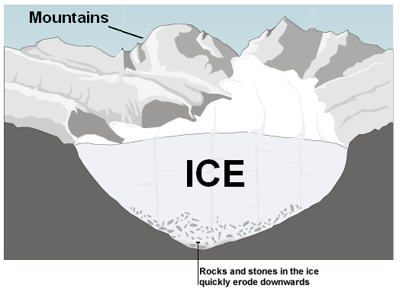
Erosion by Ice

Slide 29
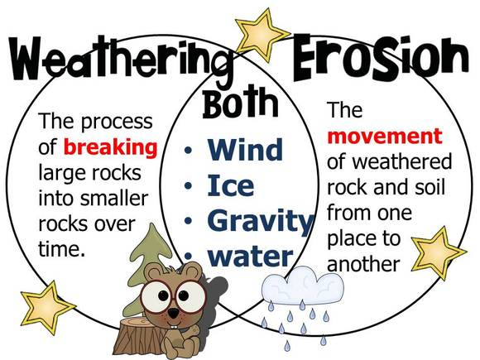
Weathering and Erosion are two very different processes that tend to act sequentially.

Slide 30
Weathering is the result of the physical and chemical changes of rock and mineral material; the resulting products might or might not be transported.

Slide 31
Study Jams:
Weathering and Erosion
Weathering and Erosion Song

Slide 32
Deposition

Slide 33

Deposition occurs where the agents (forces) of erosion lay sediment down.

Slide 34
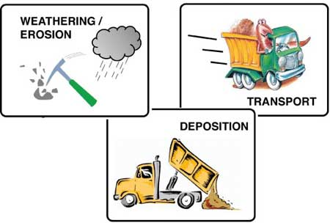
Weathering and Erosion wear down, and deposition fills in the Earth’s surface.

Slide 35
Deposition by Water
As water moves through a river, it loses some of its energy and it can no longer carry some of its sediment. As a result, it drops, or is deposited, to the bottom
of the stream.
Sediments being deposited by Classzone

Slide 36
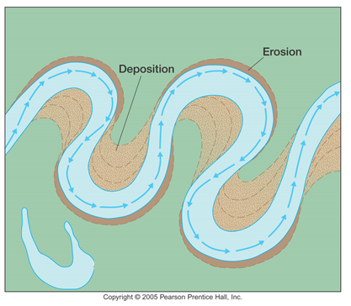
Deposition by Water
Rivers and streams erode and deposit water along their path.

Slide 37
Deposition by Water
Water also loses energy and deposits sediment when it empties into an ocean or lake.
Sediment that is deposited as water empties into an ocean or lake forms a triangular shaped deposit (delta).

Slide 38
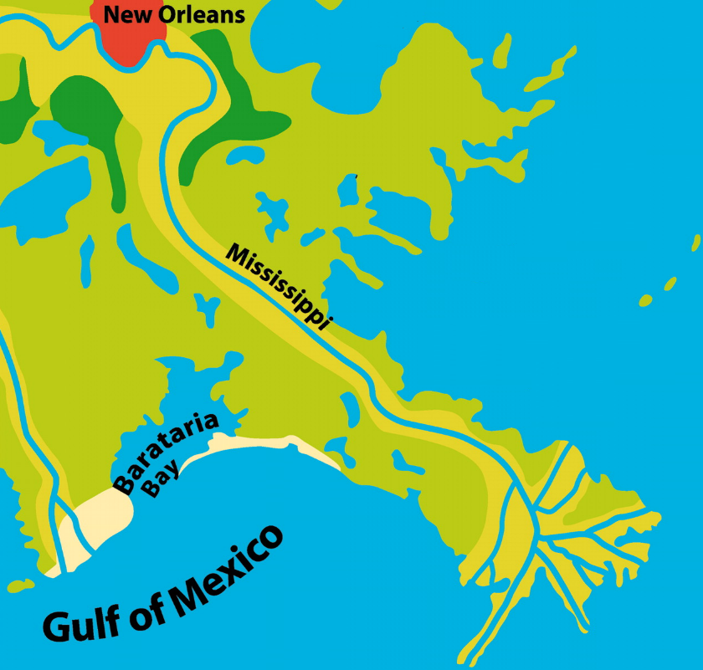
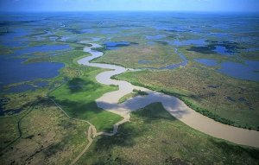
The Mississippi River flowing into the Gulf of Mexico forms the Mississippi River delta.

Slide 39
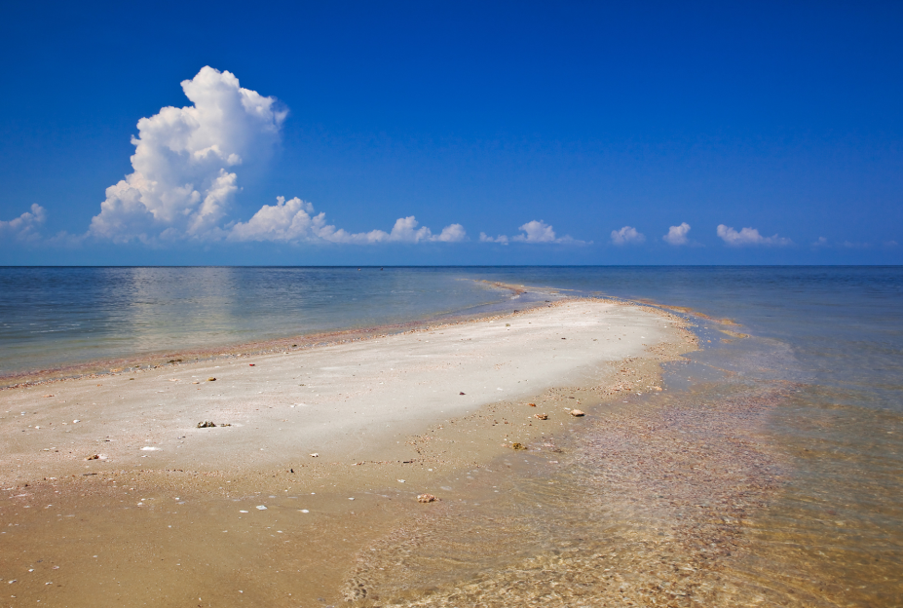
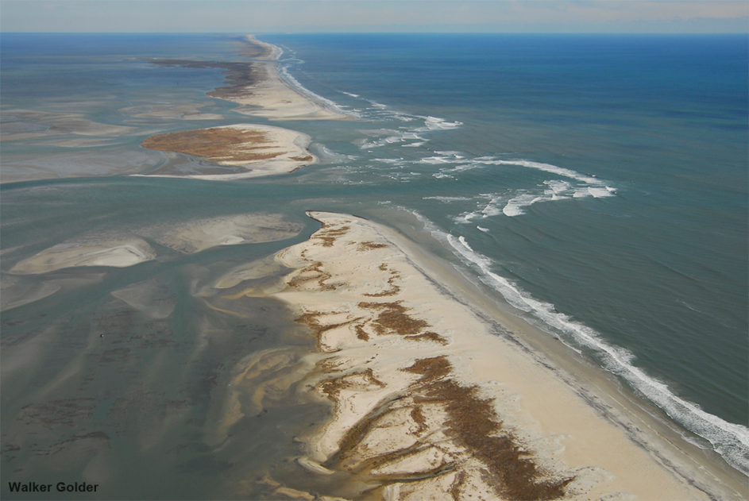
Deposition by Water
Currents, wind, and storms carry and deposit sand along beaches.
Sandbar
Barrier Island

Slide 40
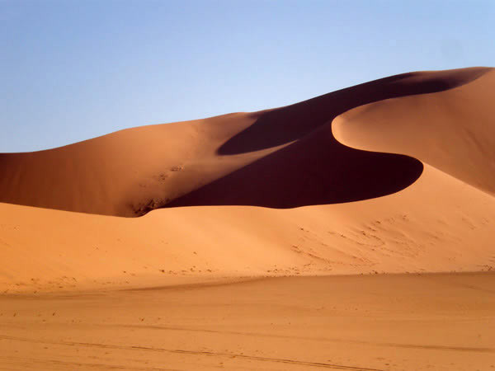
Deposition by Wind
Sediments blown away by wind eventually are deposited. Over time, these deposits develop into landforms.
Sand Dune

Slide 41
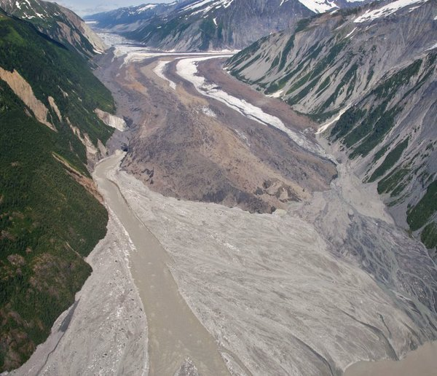

Deposition by Ice
When glaciers begin to melt, they deposit sediment on the land.

