Slide 1
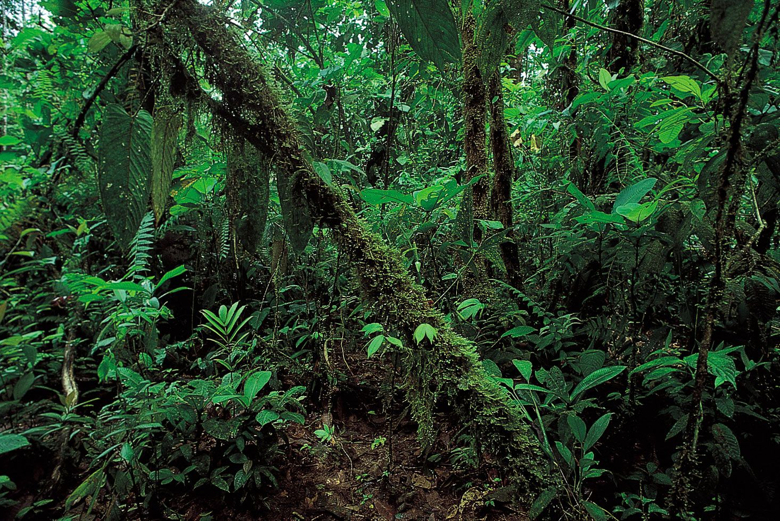
EQUATORIAL CLIMATE
MARÍA SANZ

Slide 2
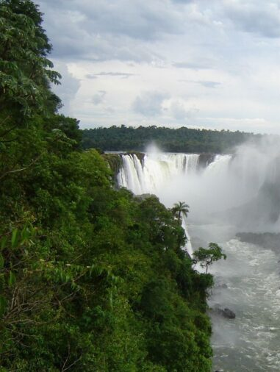
EQUATORIAL CLIMATE FEATURES
Hot and Wet throughout the Year
Rainfall is heavy and falls during most afternoons
There are no winters or summers (No Seasons)
One day is very similar to the next

Slide 3
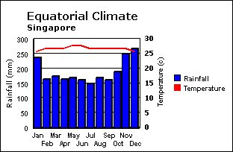
Climate Graph

Slide 4
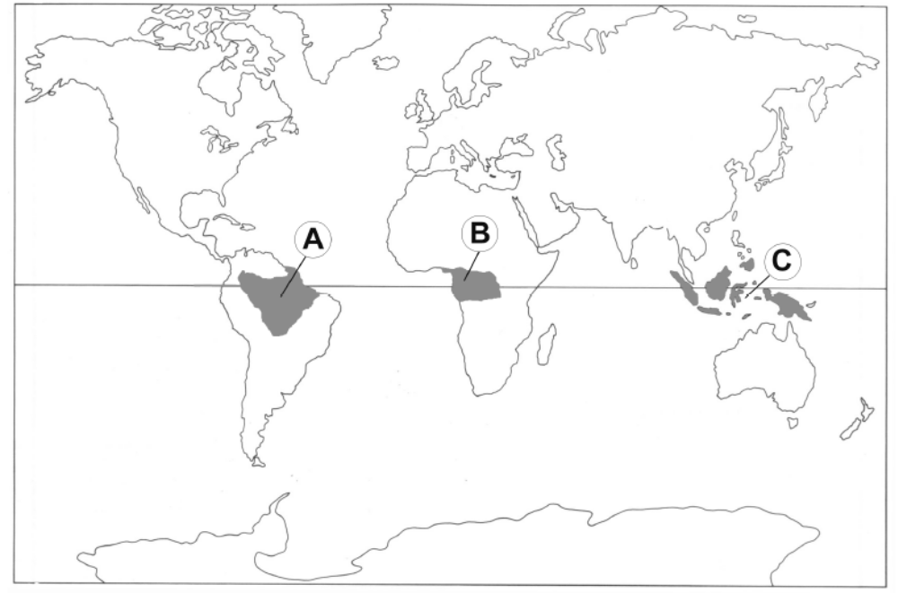
Location of Equatorial Climate
5 N
5 S

Slide 5
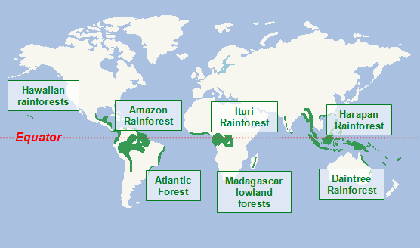

Slide 6
Location of Equatorial Climate
The Amazon Rainforest extends over Brazil, Peru, Columbia, Venezuela, Equador, Bolivia, Guyana, Suriname and French Guiana.
The Atlantic Forest covers an area in Brazil, Paraguay and Argentina.
The Madagascar lowland forests is located on the island of Madagascar.
The Ituri Rainforest is located in the Democratic Republic of Congo.
The Hawaiian tropical rainforests is located in the Hawaiian Islands.
The Daintree Rainforest covers an area of 2,600km² in Australia.
The Harpan Rainforest covers an area of 985km² in Sumatra.

Slide 7
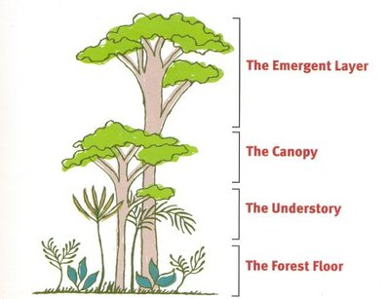
2. The structure of the rainforest
Emergent: A small number of trees break through the general level of the forest, reaching heights of over 30 metres. | Canopy: Continuous, dense tree cover protects the ground from heavy rainfall and reduces the amount of light to areas below.
Under canopy / understorey Woody plants and shrubs grow in the humid, calm conditions with limited sunlight. | Ground layer: Largely made up of decomposed material broken down by the hot, humid conditions. This level consists of scattered plants and fungi, used by insects as a source of food.

Slide 8
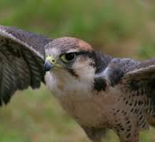
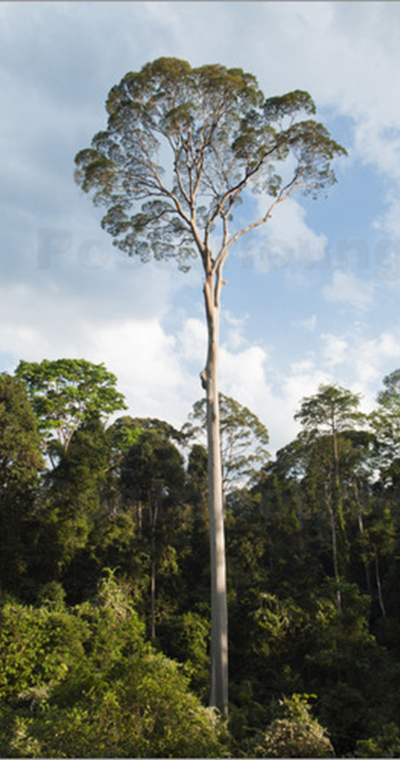
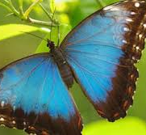
EMERGENT LAYER
The trees are so high they almost touch the sky.
Lots of birds, butterflies and monkeys live here

Slide 9
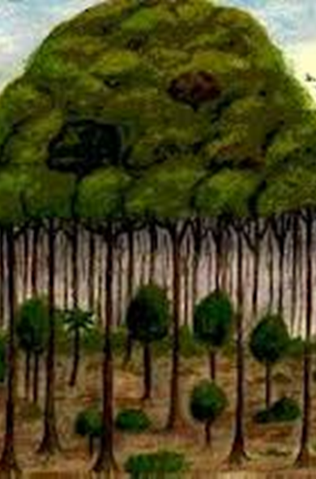

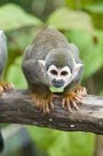
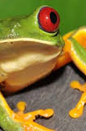
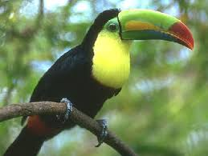
CANOPY
This layer is like a big umbrella.
Lots of animals live here as there is plenty of food.

Slide 10
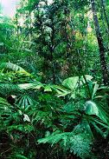
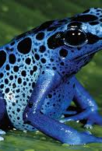
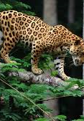
UNDERSTORY
This layer is darker and cooler.
The plants have much bigger leaves.

Slide 11
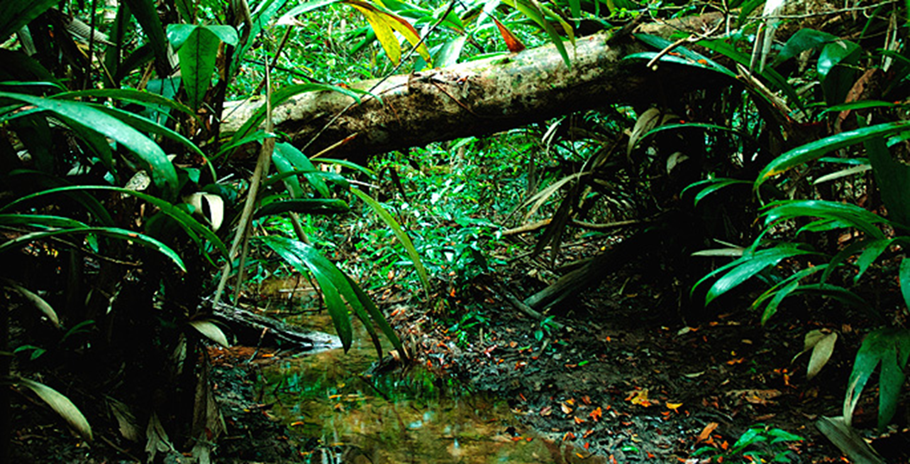
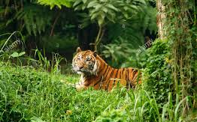
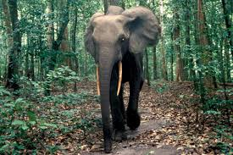
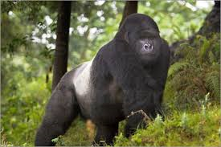
FOREST FLOOR
This layer is dim, dark and wet.
Large animals and large numbers of insects live here.

Slide 12
